Slide 1
Modernizing Mathematics Pathways: A Call to Action
Amy Getz, Strategic Implementation Lead, Higher Education
Charles A. Dana Center at the University of Texas at Austin
a Charles A. Dana Center higher education initiative

Slide 2
What is driving change?
Low student success in current math sequences
Changing mathematics needs

Slide 3
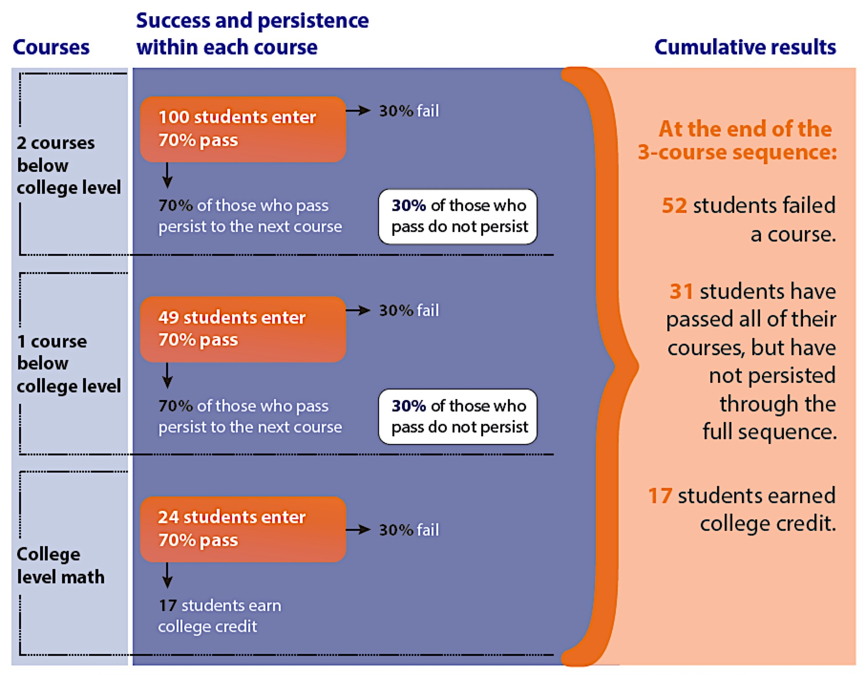
Long sequences decrease student success
A thought experiment born out by data...
Notes:
This theoretical model shows the progression of students through a three-course sequence, assuming success and persistence rates of 70% in each course. Persistence rate refers to the percentage of students who pass and enroll in the next course. As you can see, only 17% of students will successfully complete a three-course sequence even with relatively high success and persistence rates of 70%. Thirty-one percent pass every course but do not complete the sequence, and 52% fail a course. While this model is theoretical, national data closely mirrors this progression.
One might dismiss the 52% as those students who were unable to master the content, but most faculty members will point out that a significant proportion of students fail a course due to financial difficulties or family obligations such as loss of child care, family illness, or moving for a new job. Long course sequences compound these problems. It is likely that fewer students would fail if the course sequences were shorter.
One study found that only 33 percent of students complete the sequence in math, indicating that math is one of the biggest barriers to college completion in the U.S. (Thomas Bailey, Dong Wook Jeong, and Sung-Woo Cho, “Referral, Enrollment, and Completion in Developmental Education Sequences in Community Colleges,” Economics of Education Review 29 (March 2012); 255–27)

Slide 4
The impact of placement...
System-wide data for Tennessee: Students earning college level math credit in 1 year by ACT score
Students with ACT of 18 and below placed into developmental math; ACT of 19 placed into college level math

Slide 5
The purpose of college algebra
“Unfortunately, there is often a serious mismatch between the original rationale for a college algebra requirement and the actual needs of students who take the course. A critically important task for mathematics sciences departments at institutions with college algebra requirements is to clarify the rationale for requirements, determine the needs of students, and ensure that department’s courses are aligned with these findings.”
Source: Mathematical Association of America, 2004
Notes:
In other words, professional associations of mathematicians have released statements and curriculum guides that imply and/or directly state that failure can be attributed—in part—to misalignment of developmental and college-level course content with students’ intended academic and career goals. Institutions should offer multiple pathways with relevant and challenging math content aligned to specific fields of study.

Slide 6
What math is needed?
Source: Burdman, 2015; Chen & Soldner, 2013
Notes:
For students entering postsecondary education in 2003–2004, just 20% of associate’s degree and about 28% of bachelor’s degree students entered a STEM field. Students in social science, liberal arts, and fine arts would be better served by more relevant preparation in statistics or quantitative reasoning.

Slide 7
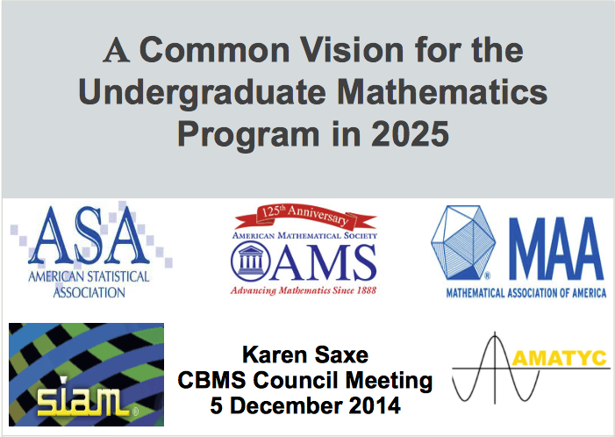
Common Vision 2025
The primary goal of this initiative is to develop a shared vision in the mathematical sciences community of the need to modernize the undergraduate mathematics program, especially the first two years.
“The mathematical sciences community must begin to think in terms of a broader range of entry-level courses and pathways into and through curricula for all students, including mathematics and other STEM majors as well as non-STEM majors.”
Common Vision report, p. 13

Slide 8
Two goals:
Increase and accelerate student success in mathematics
AND
    Teach mathematics content and skills that will be of value to students in their lives and careers

Slide 9
A new vision for the student experience in math...
1
Multiple pathways aligned
to specific fields of study
Acceleration that allows most students to complete a college-level math course in one year or less
2
3
Intentional use of strategies to help students develop skills as learners
4
Curriculum design and pedagogy based on proven practice

Slide 10
Definition of math pathway
...a mathematics course or sequence of courses that students take to meet the requirements of their program of study.
The concept of math pathways applies to pathways for college-ready and underprepared students.
Notes:
This is a shift in perspective away from thinking about discrete courses. Even if a student only takes one math course, a pathways design accounts for how the student enters the pathway and where the student goes after the pathway.

Slide 11
Why a “pathways perspective”?
What we want students to experience is too often different from the structures that we create.
Notes:
We want students to make connections, transfer learning and focus on big ideas
Too often we design courses to meet the needs of faculty and institutions and not students

Slide 12
A “pathways perspective”
A coherent and consistent learning experience with:
Aligned content;
Consistent expectations;
Well-planned scaffolding;
Similar structures.

Slide 13
The the student experience today
Students move through programs AND across institutions.

Slide 14
Implications for how we work
We must...
Work across sectors to create a smooth path for students to transfer and apply credits;

Slide 15
Implications for how we work
We must...
Work across sectors to create a smooth path for students to transfer and apply credits;
Break down the artificial divide between developmental and college-level content;

Slide 16
Implications for how we work
We must...
Work across sectors to create a smooth path for students to transfer and apply credits;
Break down the artificial divide between developmental and college-level content;
Collaborate across institutional roles.

Slide 17
There is really only one question
What is best for students?
Notes:
I don’t minimize the challenge: budget implications, staffing implications, we have to change how we work individually and institutionally

Slide 18
Dana Center approach to state level work
Each state has a customized plan and timeline.
Phase 1: Build urgency and intrinsic motivation for change
Phase 2: Enable scale by creating the policy and practice conditions for statewide implementation
Phase 3: Enact the NMP at institutions by building faculty and institutional
Consulting, tools, and services support each phase.
4
Notes:
Briefly re-evaluate MPC project process for the span of the three years.
Briefly comment on each state:
Phase 1: In each state, the Dana Center will convene a statewide math task force comprised of mathematics faculty leaders from two- and four-year institutions, policy experts, and other key stakeholders to develop a state-level agenda to improve student success in undergraduate mathematics.
Phase 2: Statewide math task forces will establish working groups to develop structures and an action plan that guide statewide implementation. This phase will be short (3 to 6 months) yet intensive.
Phase 3: The statewide math task force will oversee the enactment of the state-level agenda and action plan developed in Phases 1 and 2. This will include a plan for supporting faculty and institutions so the implementation responsibility shifts gradually to the institutional level, guided by institutional leadership teams.

Slide 19
The Call to Action
The status quo is unacceptable.

Slide 20
The Call to Action
The status quo is unacceptable.
  We face a daunting challenge...

Slide 21
The Call to Action
The status quo is unacceptable.
  We face a daunting challenge...
    That is matched by a unique opportunity.

Slide 22
Contact Information
  Amy Getz: getz_a@austin.utexas.edu
General information about the Dana Center: www.utdanacenter.org
Higher Education work:
www.utdanacenter.org/higher-education/
To receive monthly updates about the NMP, contact us at: mathways@austin.utexas.edu

