Slide 1
BOARD OF HIGHER EDUCATION
The Equity Agenda: Through a Campus Lens
A joint presentation by:
Bristol Community College
Massasoit Community College
Bridgewater State University
March 12, 2019

Slide 2
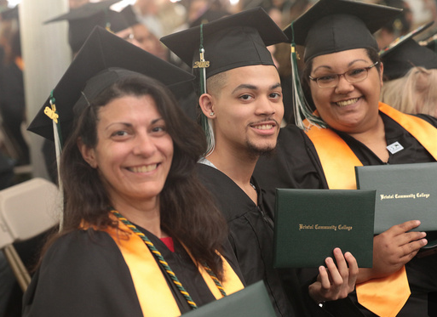
Step Up to College
Provides adult learners with a seamless transition from adult education into certificate and degree programs.
Transition program for adult learners
A combination of instruction that builds a strong academic foundation
Support for students in their transition into post-secondary education and first year of college
ABE/Dual Enrollment opportunities
Since 2016, 87 adult education students matriculated into a degree or certificate program: 20% completed; 84% remain enrolled

Slide 3
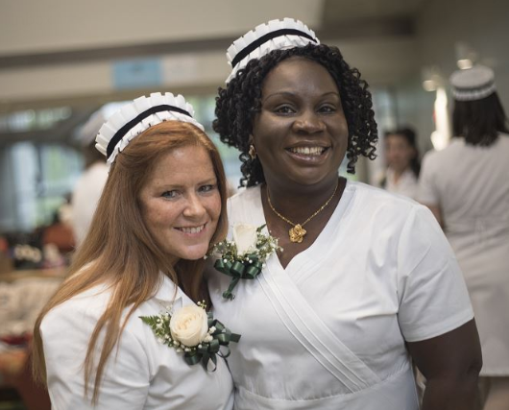
Diversity Nursing Scholars
Ensuring scholar nurses reflect the diversity of the populations we serve
Collaboration with Bristol & UMassD
Underrepresented ethnic and cultural groups
First generation
From low socio-economic backgrounds
New Bedford High School graduates
Spring 2018: 16 students
Summer 2018: 22 students
67% persistence

Slide 4
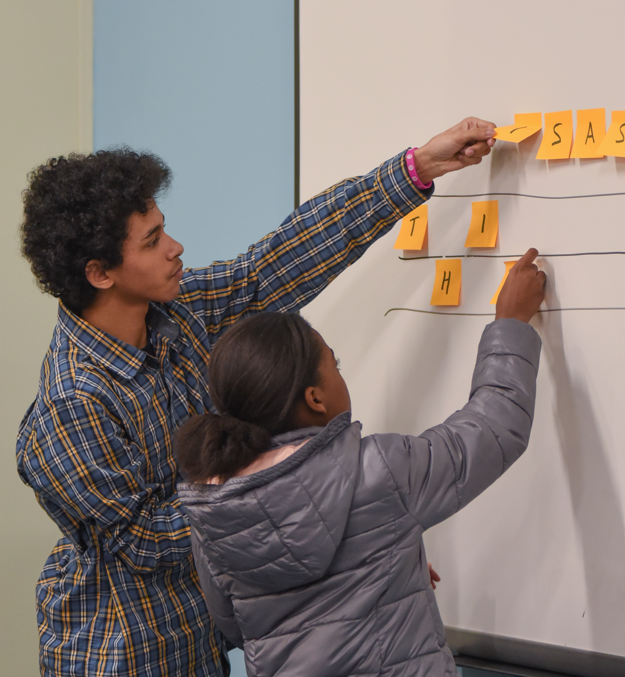
Easing Entry Pathways
Dual Enrollment & Gateway to College
467 students enrolled for spring 2019
Boys & Girls Club of Brockton
Series of visits by Brockton B&GC members
Coding for Mobile Apps, Encryption Games, 3D printing
Philanthropy
Brockton High School $100k scholarship

Slide 5
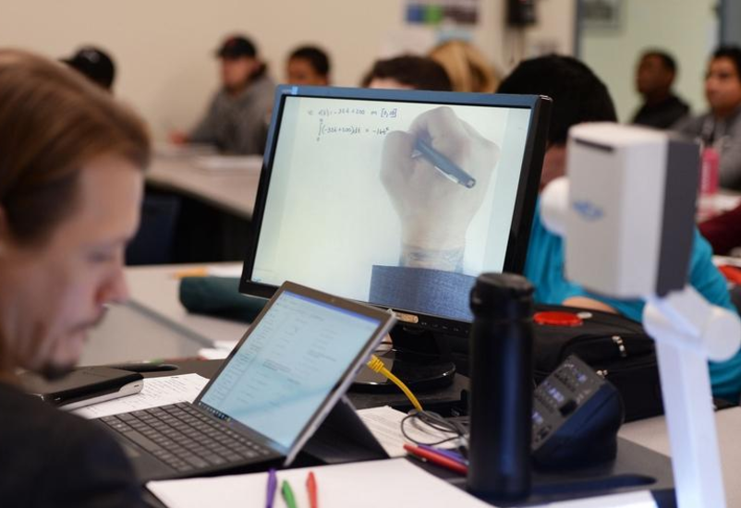
Open Educational Resources
$1,117,008 saved
December 2017 PIF grant of $58,765
For fall 2018 semester:
105 sections using OER
Increased number of students enrolled in OER sections from 1,027 to 2,159 (110% increase over fall 2017)
Increased savings for students from $136,464 to $309,792

Slide 6
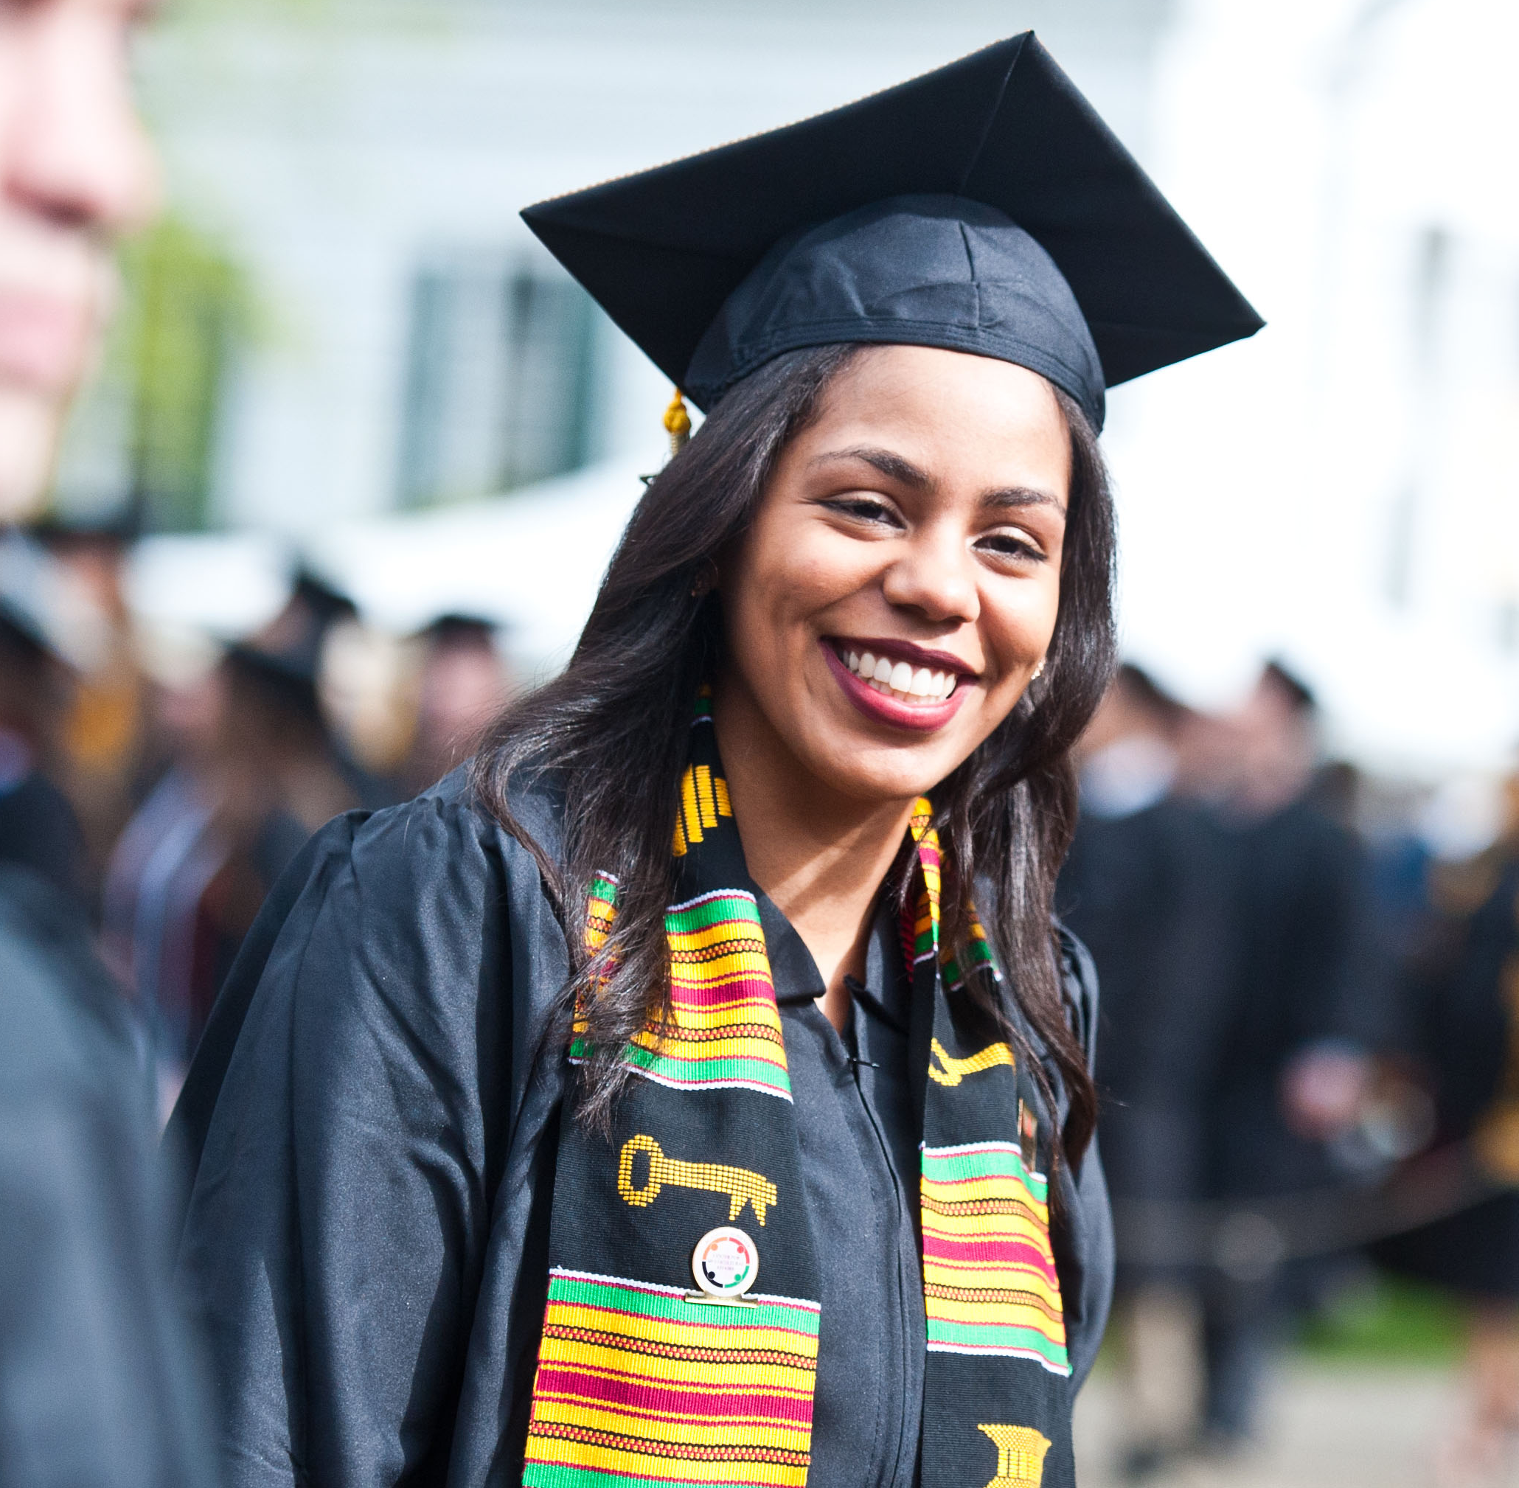
BSU Retention Grants
Modelled on Georgia State University program; supports retention, persistence and graduation of low-income students at BSU.
Students identified with genuine financial need with nonpayment holds preventing them from registering for next semester of classes.
Students offered grant of up to $3,000 to pay outstanding tuition and fees. Average grant is $1,932.54.
Students meet with staff for individualized conversations focused on student success strategies and financial literacy.
264 grants awarded since spring 2016; retention/persistence/graduation rates of 85%.

Slide 7
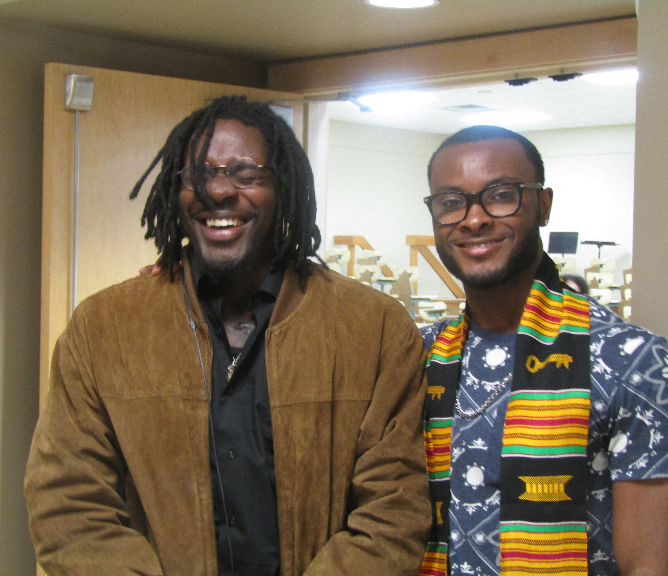
BSU Bears Summer Scholars Program
Students with high school GPAs of 2.0-3.0 recruited into summer bridge program; high percentage of students of color and low-income students in the recruitment and participant pools.
Students given free 3-credit course, text, parking and student success lunches.
Lunches focus on key student success competencies and resources including time management, effective study skills, BSU’s high-impact practices, navigating the campus, and student involvement.
Summer 2017 BSU Bears Summer Scholars: First to second year retention rate: 84.6%. (FTFT retention rate overall: 78%).
Summer 2018 BSU Bears Summer Scholars: Fall to spring retention rate: 94.7%. (Fall to spring retention rates overall: 90.3%).

Slide 8
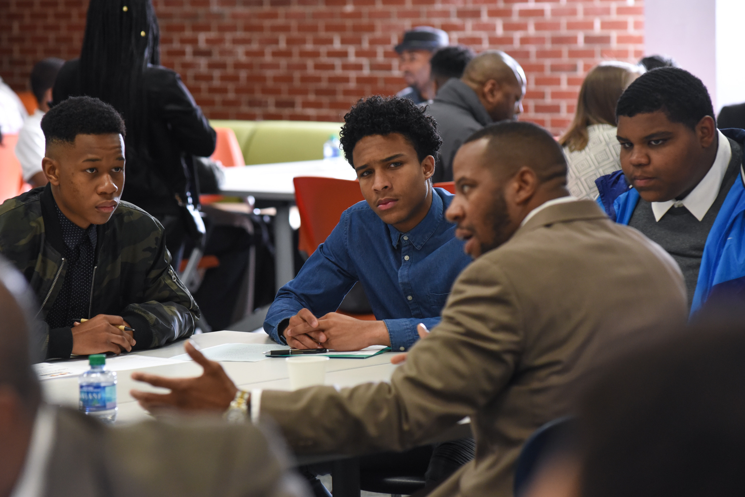
100 Males to College
Increase access, enrollment, retention & success
for low-income males and males of color
Brockton Program: Massasoit Community College Bridgewater State University Brockton Public Schools Southeastern Regional Vocational Technical High School
Mentoring
Dual Enrollment Courses
Structured college visits and cultural and community activities

Slide 9
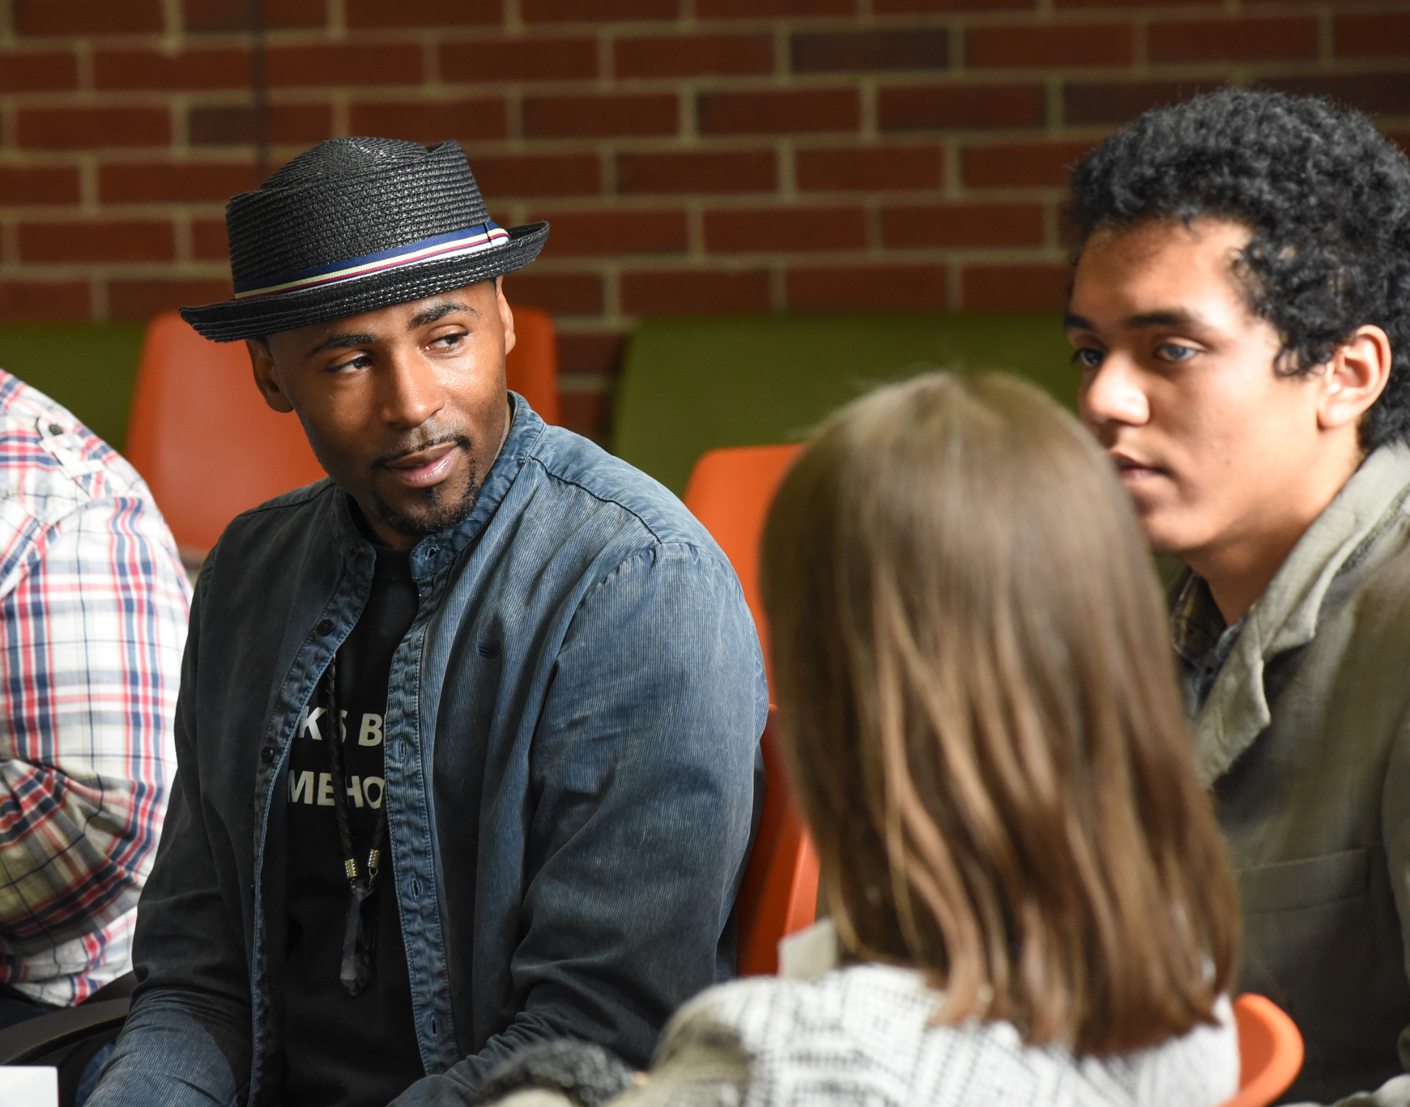
100 Males to College
Increase access, enrollment, retention & success
for low-income males and males of color
As of January 2019:
100%
of eligible program participants have graduated from high school
87.5%
of graduating seniors were accepted to college

Slide 10
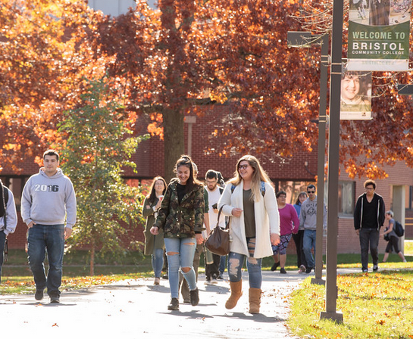
CC2BSU Partnership
An innovative program providing a seamless transition from Bristol or Massasoit Community College to Bridgewater State University.
Began fall 2018; Bristol & Massasoit
187 students enrolled
2019 graduation: 31 Bristol & 12 Massasoit
Dedicated BSU advisor
Automatic acceptance to BSU
Savings of up to $10,324
Access to facilities and events at BSU
Opportunities to participate in wider range of programs including summer residential program at BSU

Slide 11
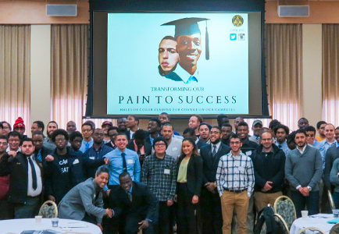
Leading for Change: Higher Education Diversity Consortium
Consortium of 26 campuses (public and private, 2-year and 4-year) committed to “hopeful, data-driven strategies to eliminate achievement and opportunity gaps in higher education.”
Membership is free, but to join presidents have to agree to:
transparently share their campus data
convene and charge a campus team to meet monthly on identifying, implementing and assessing data-driven strategies to close gaps
freely share their emerging equity practices
attend 2-3 summits a year to deepen the consortium’s learning community
In AY 2018-2019, consortium is focused on Racial Equity and Justice. All campuses completing monthly scaffolded assignments to increase campus competencies focused on data-driven racial equity campus practices.

Slide 12
Equity & Economic Insecurity: Food Insecurity
Bristol Community College
Grab and Go Food Pantry non-perishable items on a daily basis. (2017-2018 academic year: 3,180 meal bags)
Monthly Mobile Market averages 208 community members and 55 students and their families
Massasoit Community College
During fall 2018 semester, food pantry provided 144 visitors with 399 bags of food or healthy snacks; over the 2018 calendar year, the pantry served 254 visitors with 586 bags of food and snacks.
Bridgewater State University
Partnership with Greater Boston Food Bank
900 student visits to food pantry since September 2018

Slide 13
Equity & Economic Insecurity: Homelessness
Governor’s MA Student Housing Security pilot program
Housing homeless students in participating university’s residence halls
Pairs State University or UMass campus with community college
Bridgewater State University – Massasoit
Currently 2 MCC and 3 BSU homeless students residing in BSU residence halls

Slide 14
Welcome Bridgewater State University
Student Mariah Porter

