Slide 1
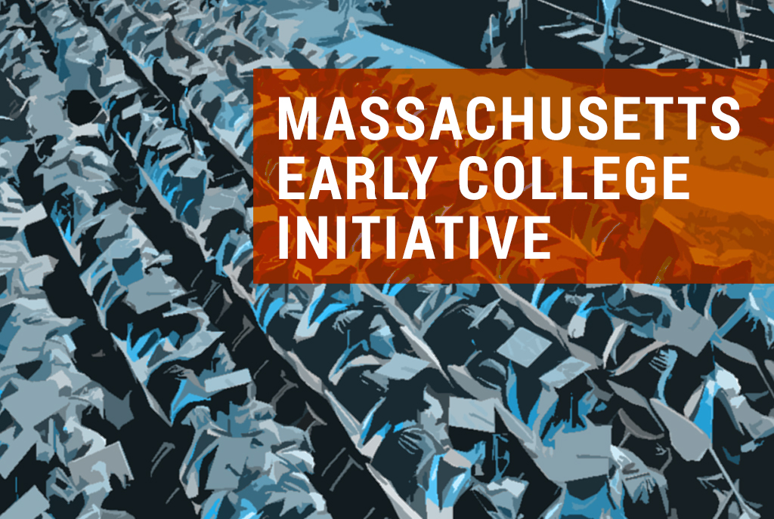
UPDATE
Joint Meeting of BHE & BESE – January 23, 2018

Slide 2
Early College One Year Later
Massachusetts Early College Initiative
Energy and engagement across campuses and districts
Applicants represent most community colleges, several state universities, K-12 districts across the state
33 applicants in preliminary phase
Rigorous criteria & application development process
Robust application review & analysis

Slide 3
Early College Joint Committee
Massachusetts Early College Initiative
Designs, develops and coordinates the administration of a Massachusetts Early College initiative and designation process
Includes five voting & two non-voting members
Chair of BESE, Paul Sagan
Chair of BHE, Chris Gabrieli
Member of BESE appointed by Chair, Margaret McKenna
Member of BHE appointed by Chair, Paul Toner
Secretary of Education, Jim Peyser
Interim Commissioner of DESE, Jeff Wulfson (non-voting)
Commissioner of DHE, Carlos Santiago (non-voting)
Staffed by agencies
Working group comprised of staff across EOE, DHE and DESE
Early College work is integrated with broader initiative to support High Quality College and Career Pathways

Slide 4
Criteria and Application Process
Massachusetts Early College Initiative
Criteria Framework—Guiding Principles
Equitable Access
Guided Academic Pathways
Enhanced Student Support
Connection to Career
Effective Partnerships
ECJC approval in May, BHE/BESE approval in June
Application process in two phases
Preliminary phase—applications due September 27, 2017, applicants notified in November 2017
Final phase—applications due February 9, 2018

Slide 5
Preliminary Phase Applications
Massachusetts Early College Initiative
33 applications
Team-based application review
Five 3-member teams (DHE, DESE, EOE)
Review of 6-7 applications by each team
Consensus scoring for each team based on uniform rubric
Full group review and calibration
Interagency leadership team review
21 successful applicants invited to submit an application for final phase of designation process
9 grantees receiving $10,000 planning grants

Slide 6
Applicants Moving Forward
Massachusetts Early College Initiative
Higher Education Partner(s) | K-12 Partner(s)
Bristol Community College | Fall River Public Schools
Bunker Hill Community College | Charlestown High School (Boston Public Schools)
Bunker Hill Community College | Chelsea High School
Fitchburg State University Mount Wachusett Community College | Fitchburg High School, Gardner High School, Leominster High School, Sizer School (North Central Charter Essential School)
Framingham State University Massachusetts Bay Community College | Framingham Public Schools Milford Public Schools
Holyoke Community College | Holyoke Public Schools
Massasoit Community College | Oliver Ames High School, Hanover High School, Middleborough High School, Norton High School, Randolph High School, Whitman-Hanson Regional High School
Massasoit Community College | New Heights Charter School of Brockton
Merrimack College | Lawrence Public Schools
Middlesex Community College | Lowell High School (Lowell PS)
Middlesex Community College | Nashoba Valley Technical School

Slide 7
Applicants Moving Forward
Massachusetts Early College Initiative
Higher Education Partner(s) | K-12 Partner(s)
Mount Wachusett Community College | Murdock High School
North Shore Community College | Lynn Public Schools
Northern Essex Community College | Amesbury High School, Haverhill High School, Lawrence High School, Methuen High School, Pentucket Regional High School, Greater Lawrence Technical School, Whittier Regional Vocational Technical High School
Quincy College | West Roxbury Academy (Boston PS)
Quincy College, Bunker Hill Community College, Urban College, Holyoke Community College | Collaborative for Educational Services
Quinsigamond Community College | Marlborough Public Schools
Quinsigamond Community College Worcester State University | Worcester Public Schools
Roxbury Community College Bunker Hill Community College | Madison Park Technical Vocational High School (Boston Public Schools)
Salem State University | Salem Public Schools
Westfield State University | Holyoke PS, Springfield PS, Westfield PS

Slide 8
Applicant Technical Support
Massachusetts Early College Initiative
2 webinars offered prior to preliminary application deadline
Direct email and phone support to applicants through process
January calls with each applicant reviewing feedback from preliminary phase
2 webinar calls for open Q&A
Continued communication with applicants
Follow-up with applicants declined in preliminary phase

Slide 9
Next Steps
Massachusetts Early College Initiative
Successful applicants convened December 13, final application distributed
Final phase applications due February 9
Competitive grant application appended to designation application, implementation funds from New Skills for Youth grant, at least 5 grants of up to $140,000 each
Similar interagency review team across expertise
Review by agency leadership
Interviews with applicants for follow-up as needed
Final review and approvals by ECJC, notifications of first designations by mid-April

Slide 10
Continued Work
Massachusetts Early College Initiative
Building community of practice among Designated Early College programs
Technical support to programs in development
Evaluation and refinement of process and feedback
Analysis of funding needs and opportunities
Development and refinement of performance measures and data collection
Sharpening expertise and incorporation of learning and success in Massachusetts and nationally

Slide 11
Discussion

