Slide 1
Educator Preparation
Joint Board Meeting - January 2018
ESE: Heather Peske, Sr. Associate Commissioner for the Center of Instructional Support; Sandra Hinderliter, Lead of Educator Preparation Reviews
DHE: Pat Marshall , Deputy Commissioner for Academic Affairs and Student Success, and Allison Little, Executive Director of STEM

Slide 2
Background
68 Sponsoring Organizations, 1,800+ programs
12 Publics – 8 State Universities, 4 UMass
Public Universities produce roughly 40% of newly licensed initial teachers in MA public schools each year

Slide 3
Opportunity
Our first year teachers are disproportionally hired into high-needs schools and assigned students who are farther behind academically.
First year teachers, on average, are also less effective than their more experienced peers
Preparation CAN and SHOULD prepare educators to be ready on day one.

Slide 4
Program Approval Standards & Review Process
Review criteria are descriptive of expectations, not prescriptive of approach
Process is based on triangulating evidence from providers, from state outcome measures and from a site visit
Providers must demonstrate need for low-enrollment or new programs at the beginning of the process
Teams of reviewers, comprised of PK12 educators and preparation faculty/staff, make recommendations which are then vetted internally for consistency

Slide 5
Review Process – Early Results
Through the Needs Assessment phase of the review, approximately one-third of all programs expire as a result
In each of the last three cohorts, 1 or 2 providers have chosen to cease operation entirely
More than 90% of reviewers over the last few years have indicated high-levels of confidence in the process and consistency of judgements made
ESE issued first “Approved with Distinction” determination to Clark University this past year
The Formal Review consistently receives the highest exemplary ratings for implementation and engagement on the Ed Prep Annual Field Feedback Survey

Slide 6
“Massachusetts state education officials also evaluate independent teacher preparation programs on outcomes the teachers trained by these programs actually deliver. This is different from most other states in the country, and it’s more rigorous than how teacher education programs have historically been held to account….
By setting high standards and holding programs accountable, the Massachusetts system identifies programs that are preparing teachers well for the rigors of the classroom, while weeding out the ones that don’t. We’ve welcomed the added scrutiny, in exchange for greater autonomy to test new ideas.”
Scott McCue & Orin Gutlerner, Sposato Graduate School of Education
Editorial published April 2016, The 74 Million

Slide 7
Supporting Initiatives
2014 Professional Standards for Teachers & the development of the Candidate Assessment of Performance
Educator Preparation Annual Snapshot & other Edwin Analytic Reports
Supporting innovative pilots and providing seed funding to support partnership and diversify the pipeline

Slide 8
Higher Education Collaborations
Elementary Education A2B pathway
Elementary Education mathematics course taking recommendations
Diversifying the Teacher Pipeline
EPIC
NSF Noyce proposal

Slide 9
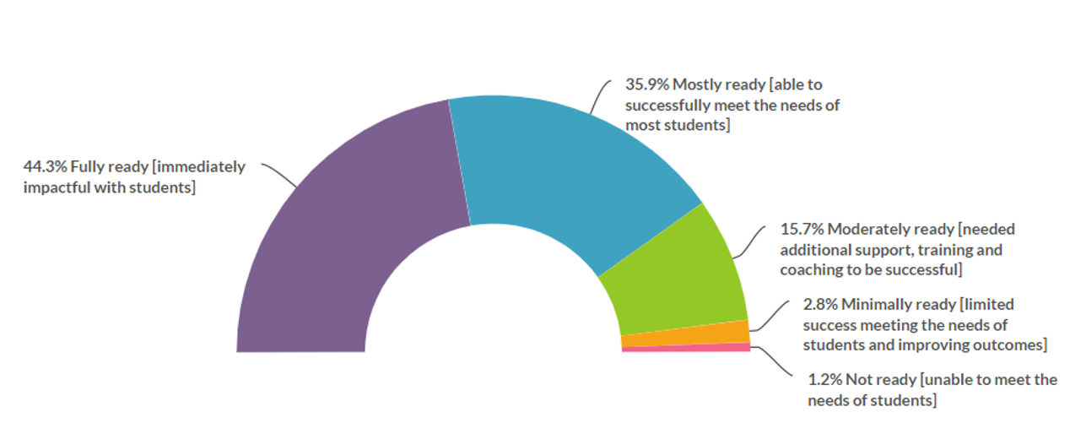
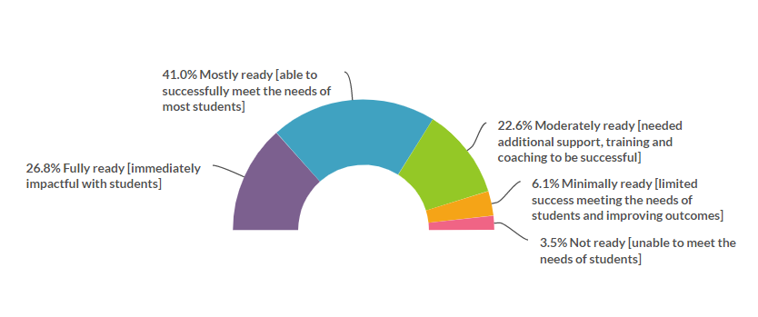
Signs of Progress
HP perceptions of 2015-16 teacher completers
Hiring Principal perceptions of 2014-2015 teacher completers

