Slide 1
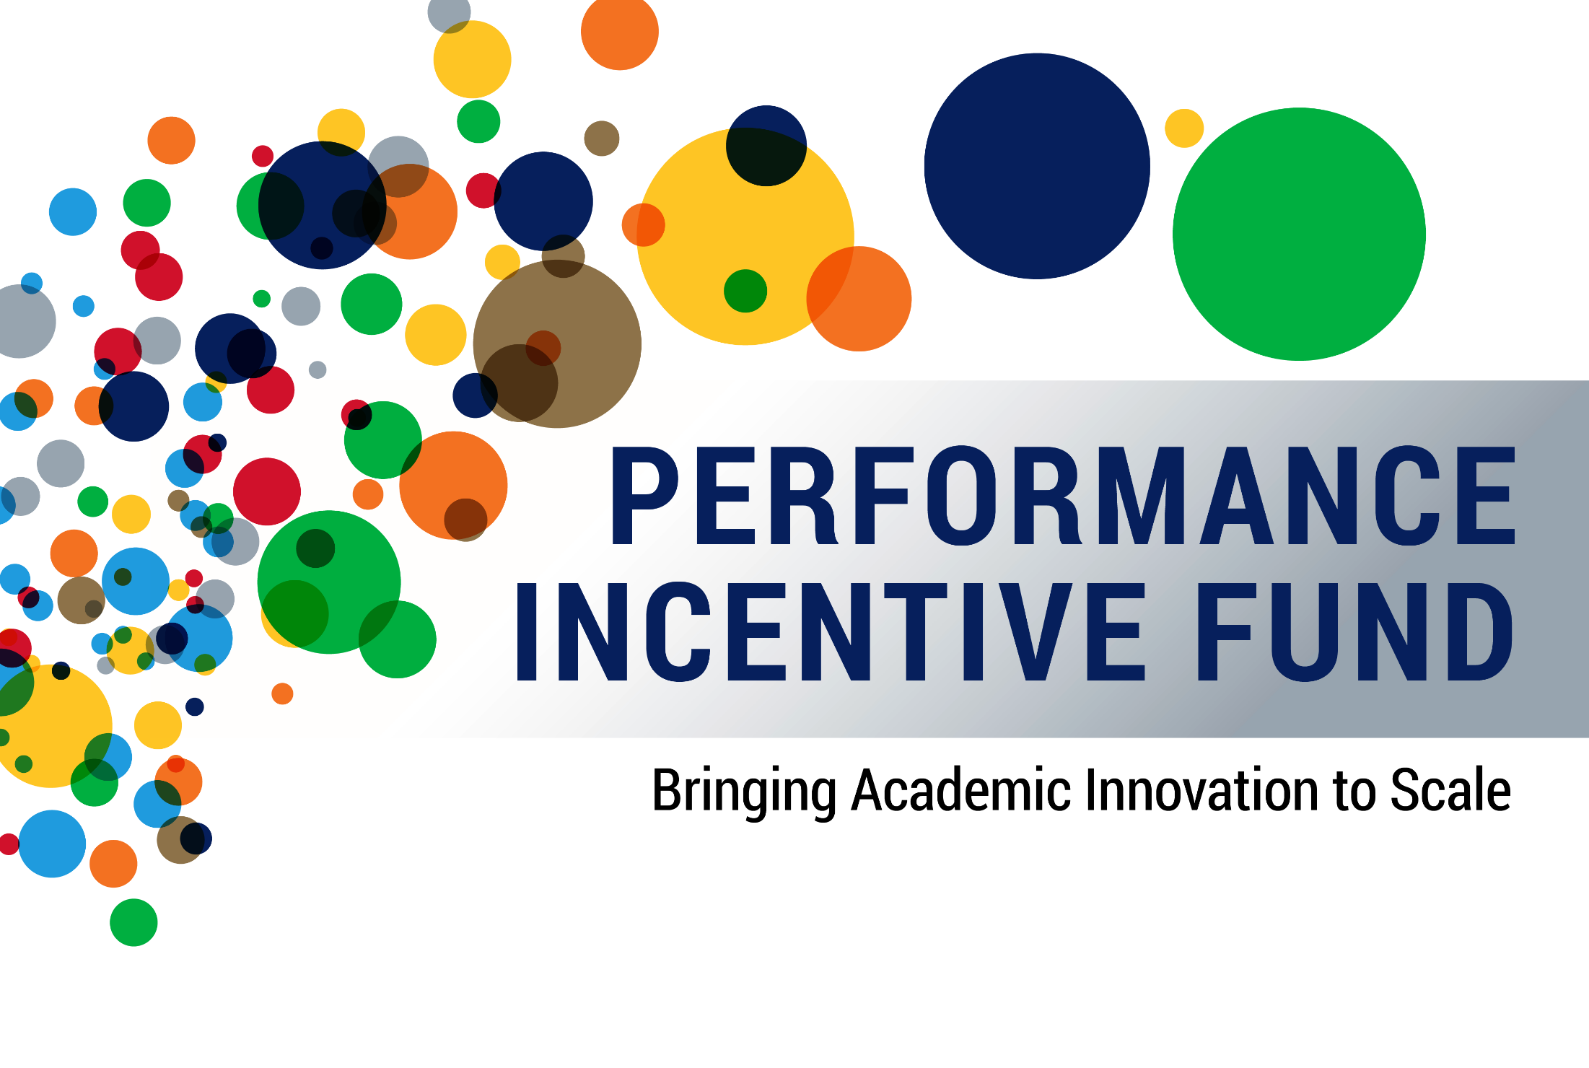
BHE Meeting | January 23, 2018

Slide 2
Presentation Overview
Performance Incentive Fund: Bringing Academic Innovation to Scale
  Redesign of the FY17 PIF Request for Proposals
  The three projects that form the backbone of the FY17 and FY18 RFPs:
    Co-requisite at scale
    100 Males to College
    Competency Based Education for
    Early Childhood Educators
  System-level metrics for success
  Campus Projects

Slide 3
Timeline
Performance Incentive Fund: Bringing Academic Innovation to Scale
FY 2012
PIF created by MA Legislature to provide competitive grants to campuses to make progress on BHE goals
FY 2012–2016
$22.5M available
to campuses through PIF
FY 2016
UMDI PIF Evaluation
FY 2017
Redesign of PIF focused on:
1. bringing best practices to scale
2. rigorous evaluation

Slide 4
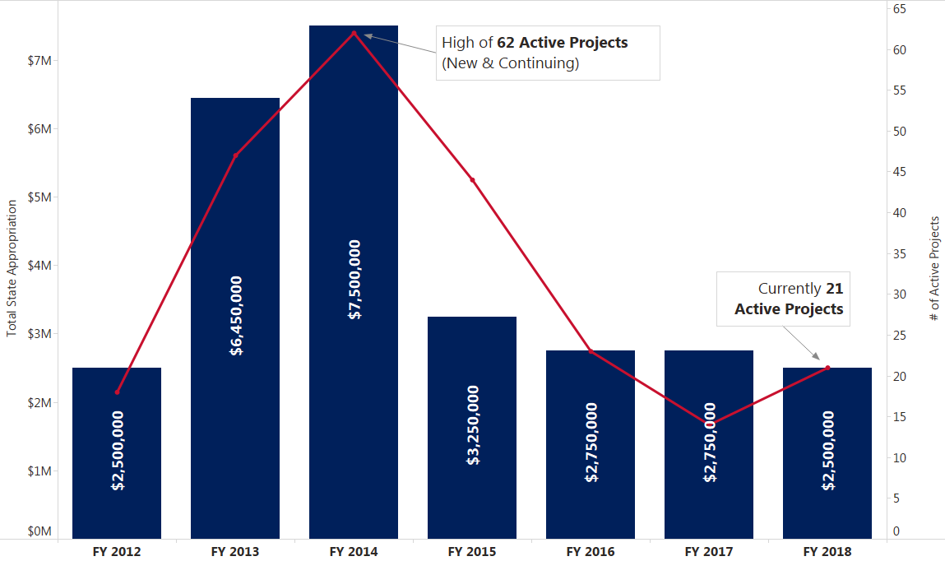
Trend in Appropriation & Grant Activity
Performance Incentive Fund: Bringing Academic Innovation to Scale

Slide 5
UMDI Retrospective Analysis of 2012–2015 Grants
Performance Incentive Fund: Bringing Academic Innovation to Scale
Quantifiable results in college participation & completion
reported by several grantees:
CCCC
First Year Experience
Bristol
Guided Pathways to Success
Persistence
88% for GPS
70% for all students
Massasoit
Degree Auditing
Retention
59% for FYE
47% for all students
Retention
57% in AY13
61% in AY14
Middlesex
First Year Experience
Retention
57% vs 41% taking non-linked courses
UMass Boston
Academic Success
Persistence
83% vs 53% of all first-time full-time students
4 yr Grad Rate
25% vs 13% for other liberal arts students
Massasoit
Experiential Learning
Major finding: Need to define common metrics to support rigorous evaluation
Fitchburg
Math Progress Requirement
MCLA
30 in 3
Students with 30 credits by sophomore year
34% for fall 2010
64% for fall 2013
MWCC
Get Started
1-year course completion rate
43% in 2011
62% in 2014
Placement in college-level courses
14% increase from 2009–2014

Slide 6
UMDI Retrospective Analysis of 2012–2015 Grants
Performance Incentive Fund: Bringing Academic Innovation to Scale
Grantees reported substantial impacts on campus services,
particularly in the following areas:
New College Prep Programs
Academic Advising Models and Tools
Improved Coordination and Collaboration Among Depts
Increased Community Engagement
Faculty and Staff Professional Development
Approaches to Developmental Instruction
Assessment of Learning Outcomes
Curriculum Mapping and Degree Pathways
Supplemental Instruction
Major finding: Need to narrow range of programs and objectives

Slide 7

“There are literally dozens of exciting and intriguing model programs across our
29 campuses, each worth celebrating for
the effort and the anecdotes of success.
But there is a worrisome lack of scale to
the work, taken as a whole.”
—Chris Gabrieli, “Scale Matters”
The Degree Gap (June 2016)

Slide 8
FY2017 Redesign
Performance Incentive Fund: Bringing Academic Innovation to Scale
Limited categories in order to:
  Provide better alignment with specific BHE Goals and ongoing projects
  Scale existing programs grounded in research and
  best practice
  Provide support for projects that could be rigorously evaluated at both campus and system levels by defining a common set of metrics for success
  Focus on sustainability through curricular reform, capacity building, and systemic change
  Promote collaboration and reduce duplication of efforts

Slide 9
Why Co-requisite at Scale?
Co-requisite at Scale builds upon successful models that feature concurrent developmental and credit-bearing coursework, supporting greater student retention and persistence

Slide 10
Why Co-requisite at Scale?
Performance Incentive Fund: Bringing Academic Innovation to Scale
Aligned with BHE Goals of Elevating Performance of Public Higher Education, Incubating Innovation
Core component of our 3-pronged approach to Remediation Reduction
Campus
GPA Pilots
CCA
Co-requisite
at Scale
Dana Center
Math Pathways
Remediation Reduction

Slide 11
Trends in Developmental Enrollment: 2010-2017
Performance Incentive Fund: Bringing Academic Innovation to Scale
Downward trend in developmental enrollment
in all three segments:

Slide 12

Why Co-requisite at Scale?
Performance Incentive Fund: Bringing Academic Innovation to Scale
2013
● Task Force Report on Transforming Dev’l Math
2014
● Begin GPA pilots
2015
● Continue GPA pilots; prelim. analysis indicates positive results
● Transforming Developmental Mathematics Conference
2016
● Refine GPA pilots
● MA selected to be part CCA’s Co-requisite at Scale initiative
● Expand remediation reduction to
include English
● Hold Co-requisite at Scale Statewide Institute
● Include Co-requisite at Scale in FY17 PIF RFP
2017–2018
● Continue
GPA pilots
● Develop statewide approach to co-requisite education in both English and mathematics
● Include Co-requisite at Scale in FY18 PIF RFP
● Release Designing
Math Pathways report
● Release Co-requisite at Scale report

Slide 13

Why Co-requisite at Scale?
Performance Incentive Fund: Bringing Academic Innovation to Scale
A nationally recognized best practice:
Identified by CCA as a
“Game Changer” to boost
college completion and close
attainment gaps
Significant positive results in
several states after adoption
Tennessee: “success in college-level math improved from 12 percent to 61 percent…[and] the state’s data suggest that this approach works for virtually all students (CCA)

Slide 14
How will we measure success?
Performance Incentive Fund: Bringing Academic Innovation to Scale
Metrics:
  50% of institutions at scale by 2018; 75% by 2019; 100% by 2020
  At least 75% of developmental students will receive it through co-requisite model
  Increase the number of students who complete their gateway level math/English course within one year

Slide 15
English Co-requisite
Christopher Laney, Interim Dean of Humanities,
Berkshire Community College

Slide 16
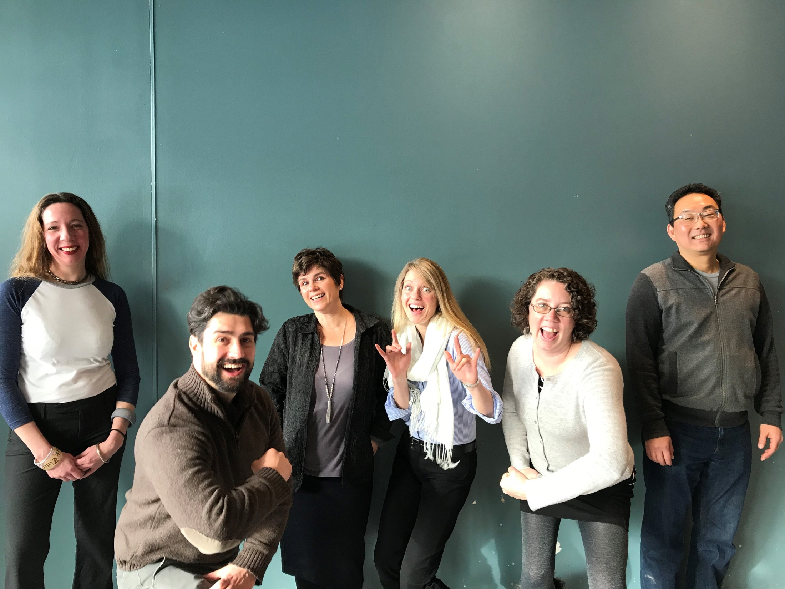
Why go “all in”?
English Corequisite at Berkshire Community College
BCC English Department

Slide 17
How it Works: An Example
English Corequisite at Berkshire Community College
ENG 101
9-9:50
Dr. Amazing
22
(11 + 11)
ENG 090
10-10:50
Dr. Amazing
11

Slide 18


PIF Grant
English Corequisite at Berkshire Community College
Tuition / Fees
Laptops / Books
Instructor Training
Peter Adams
Materials for Library, Tutoring, and Writing Center

Slide 19
Faculty Reactions
English Corequisite at Berkshire Community College
“Students are acting more like college students.”
“Students are upbeat about attending class and seem invested in their work, making teaching them a joyful endeavor.”
“Teaching in this way (supporting students as they actually work towards their degree) seems very natural… this is the way developmental writing should have always been done.”

Slide 20
Week 1 Withdrawals
English Corequisite at Berkshire Community College

Slide 21
Comparison – Before and After the Coreq
English Corequisite at Berkshire Community College
Pathway | #Students | Pass % | Took Comp I | Did not take Comp I | Passed Comp I | Pass % Comp I (full cohort)
ENG 060 (FA13 - SP17 | 748 | 63.0% | 355 (47.5%) | 393 (52.5%) | 297 | 39.7%
ENG 090 (FA17) | 65 | 60.0% | 65 (100.0%) | 0 (0.0%) | 40 | 61.5%

Slide 22
Why go “all in”? … THIS:
English Corequisite at Berkshire Community College
Over four years, from Fall 2013 through Spring 2017, only 39.7% of students who took developmental writing have passed Comp I
Whereas 61.5% of students who took corequisite developmental writing in Fall 2017 have already passed Comp I after one semester
If we had adopted the coreq model in Fall 2013, approximately 150 more students would have passed Comp I by now.

Slide 23
Why 100 Males to College?
100 Males to College (MtC) supports the college-going aspirations of low-income males, and males of color (LIMMOC) in Gateway cities

Slide 24
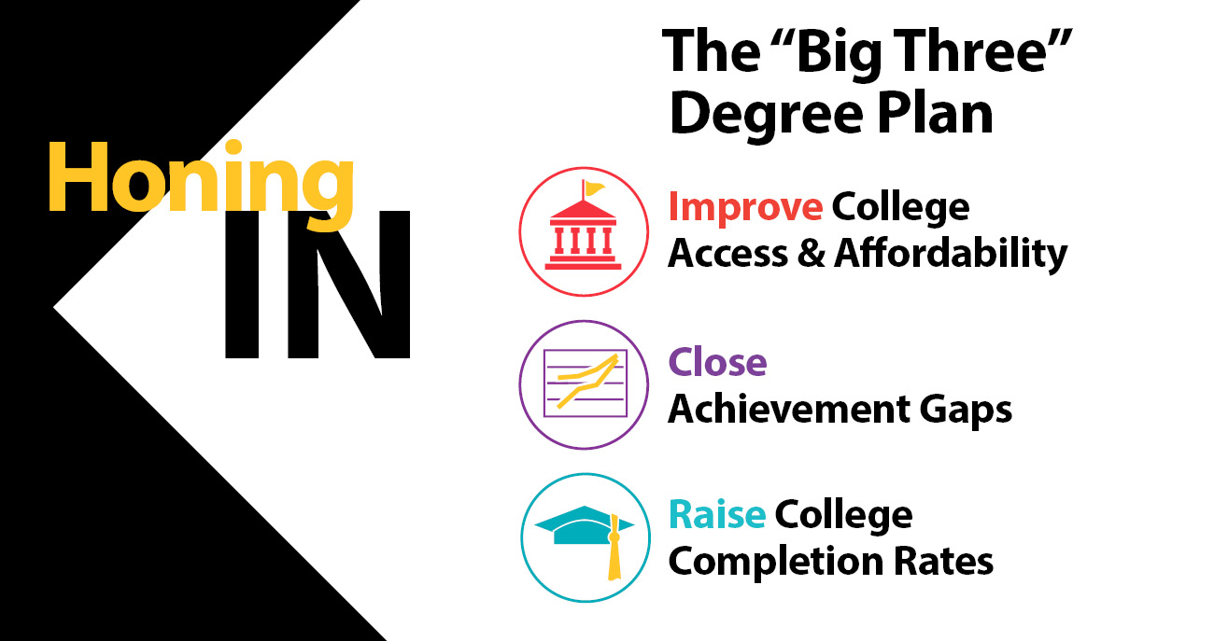
Why 100 Males to College?
Performance Incentive Fund: Bringing Academic Innovation to Scale
Aligned with BHE Goals of Fostering a More Integrated Public Higher Education System, Developing Better Integration with P–12, Incubating Innovation
Supports Big Three Priorities:

Slide 25
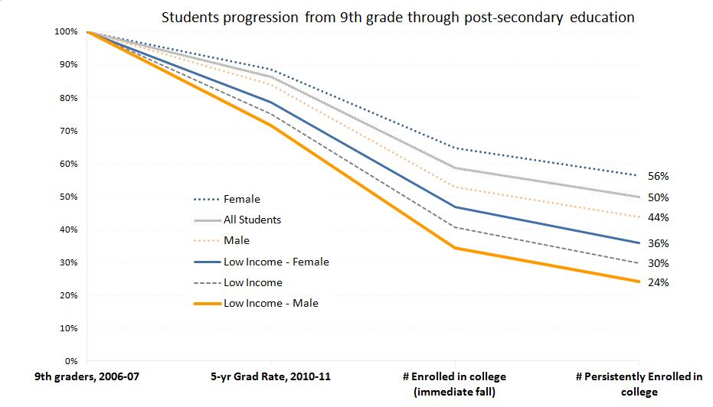
Why 100 Males to College?
Performance Incentive Fund: Bringing Academic Innovation to Scale
College Participation Advisory Group (CPAG) Report findings (2010):
Low-income
males and
males of color
(LIMMOC) rank
lowest among
all students,
including low-
income females,
in academic
outcomes
Several national
examples of
programs that
address unique
needs of young
men at risk

Slide 26

Why 100 Males to College?
Performance Incentive Fund: Bringing Academic Innovation to Scale
2010
● College Participation Advisory Group (CPAG)
2014
● CPAG findings and recommendations
2015
2016
2017–2018
● 100 MtC launched in Brockton and Worcester
● 100 MtC expanded to Salem State University through FY18 PIF
● First statewide convening of 100 Males to College Sites
● 100 Males to College leadership team formed to address program sustainability and performance metrics
● 100 Males to College showcased in 2018 Rennie Center’s COE Report
● 100 MtC launched
in Framingham
● 100 MtC included in FY17 PIF to scale the two successful pilot sites
● Core project principles/ program elements developed for 100 MtC
● Pilot program
launched in Springfield

Slide 27
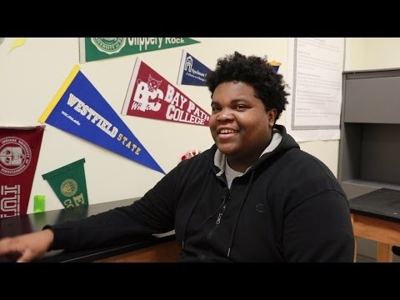
Why 100 Males to College?
Performance Incentive Fund: Bringing Academic Innovation to Scale
Video available at: https://www.youtube.com/watch?v=mdxmkZH1j3o

Slide 28
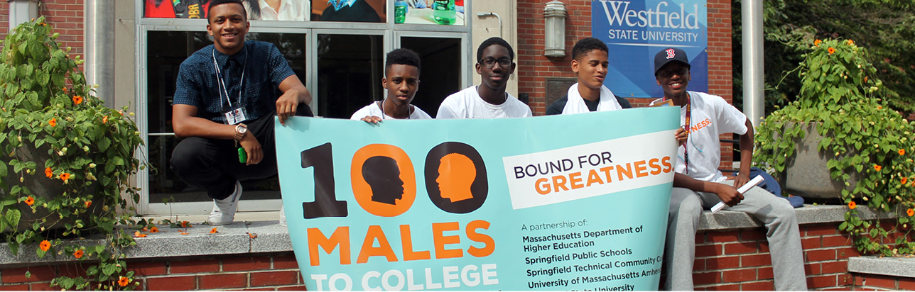
Why 100 Males to College?
Performance Incentive Fund: Bringing Academic Innovation to Scale
Early Results:
  100% of Springfield participants graduated HS; 96% enrolled in college
  100% of Framingham participants enrolled in college
  97% of Worcester participants passed dual enrollment courses and were preparing for college

Slide 29
How will we measure success?
Performance Incentive Fund: Bringing Academic Innovation to Scale
Metrics:
  Overall increase in percentage of LIMMOC who enroll, persist, and graduate college
  Reduction of gaps between LIMMOC and other groups
  Number of students who successfully complete dual enrollment courses

Slide 30
Brockton 100 Males to College
Sabrina Gentlewarrior, Vice President of Student Success and
Diversity, Bridgewater State University
on behalf of the Brockton 100 Males to College Team

Slide 31
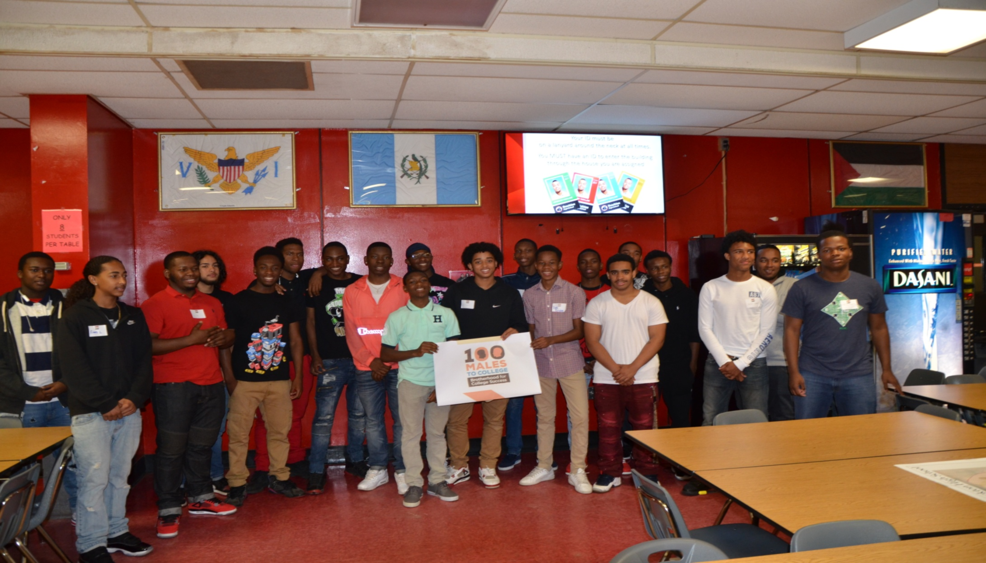
100 Males to College:
A Realistic Response to A Pressing Need
Brockton is a densely developed, diverse urban community, located 25 miles south of Boston, with a population of 95,314 (Census Data).
18% of Brockton residents over 25 years old, have a bachelor’s or advanced college degree; this is less than half of the statewide average of 39%.
The 2016 high school graduating class had 409 males of color that were economically disadvantaged; of these, 244 of them enrolled in post-secondary education within 16 months of graduation from high school.
Bridgewater State University, Massasoit Community College, Brockton Public Schools and Southeastern Regional Vocational Technical High School partnered to create the Brockton 100 Males to College Program in order to support college participation and completion, and the closing of achievement gaps -- DHE’s BIG THREE.
Performance Incentive Funding has been integral to the program’s launch and continuation.

Slide 32
Program Objectives
Project Objectives | Project Outcome Measures
Support mentees’ persistence and high school graduation | Enhanced High School GPA High school graduation rates for mentees that are higher than matched peers (BHS and SERVT LIM and/or MOC who are not participating in the program). Increased scores on Commitment to School Scale (Thornberry, Bjerregaard & Miles, 1993). (Note: this 10-item scale with strong reliability (.81) has been utilized with racially diverse youth to measure commitment to school).
Facilitate mentees’ acceptance to higher education institution | College enrollment rate higher than matched peers
Enhance likelihood that mentees will succeed in college | First to second year retention rates, persistence rates and graduation rates higher than matched peers attending BSU or MCC (LIM or MOC from Brockton enrolled at MCC or BSU that were not mentees in B100MTC). (Note: this cannot be measured until mentees enroll in college.)
Support mentees’ development of healthy masculinities | Decreased scores on the Adolescent Masculinity Ideology in Relationships Scale (Pleck, Sonestein & Ku, 1993). (Note: this 12-item scale with strong reliability (.70), has been utilized with racially diverse samples of adolescent males to measure the level to which they conform with or “resist hegemonic masculinity.”

Slide 33
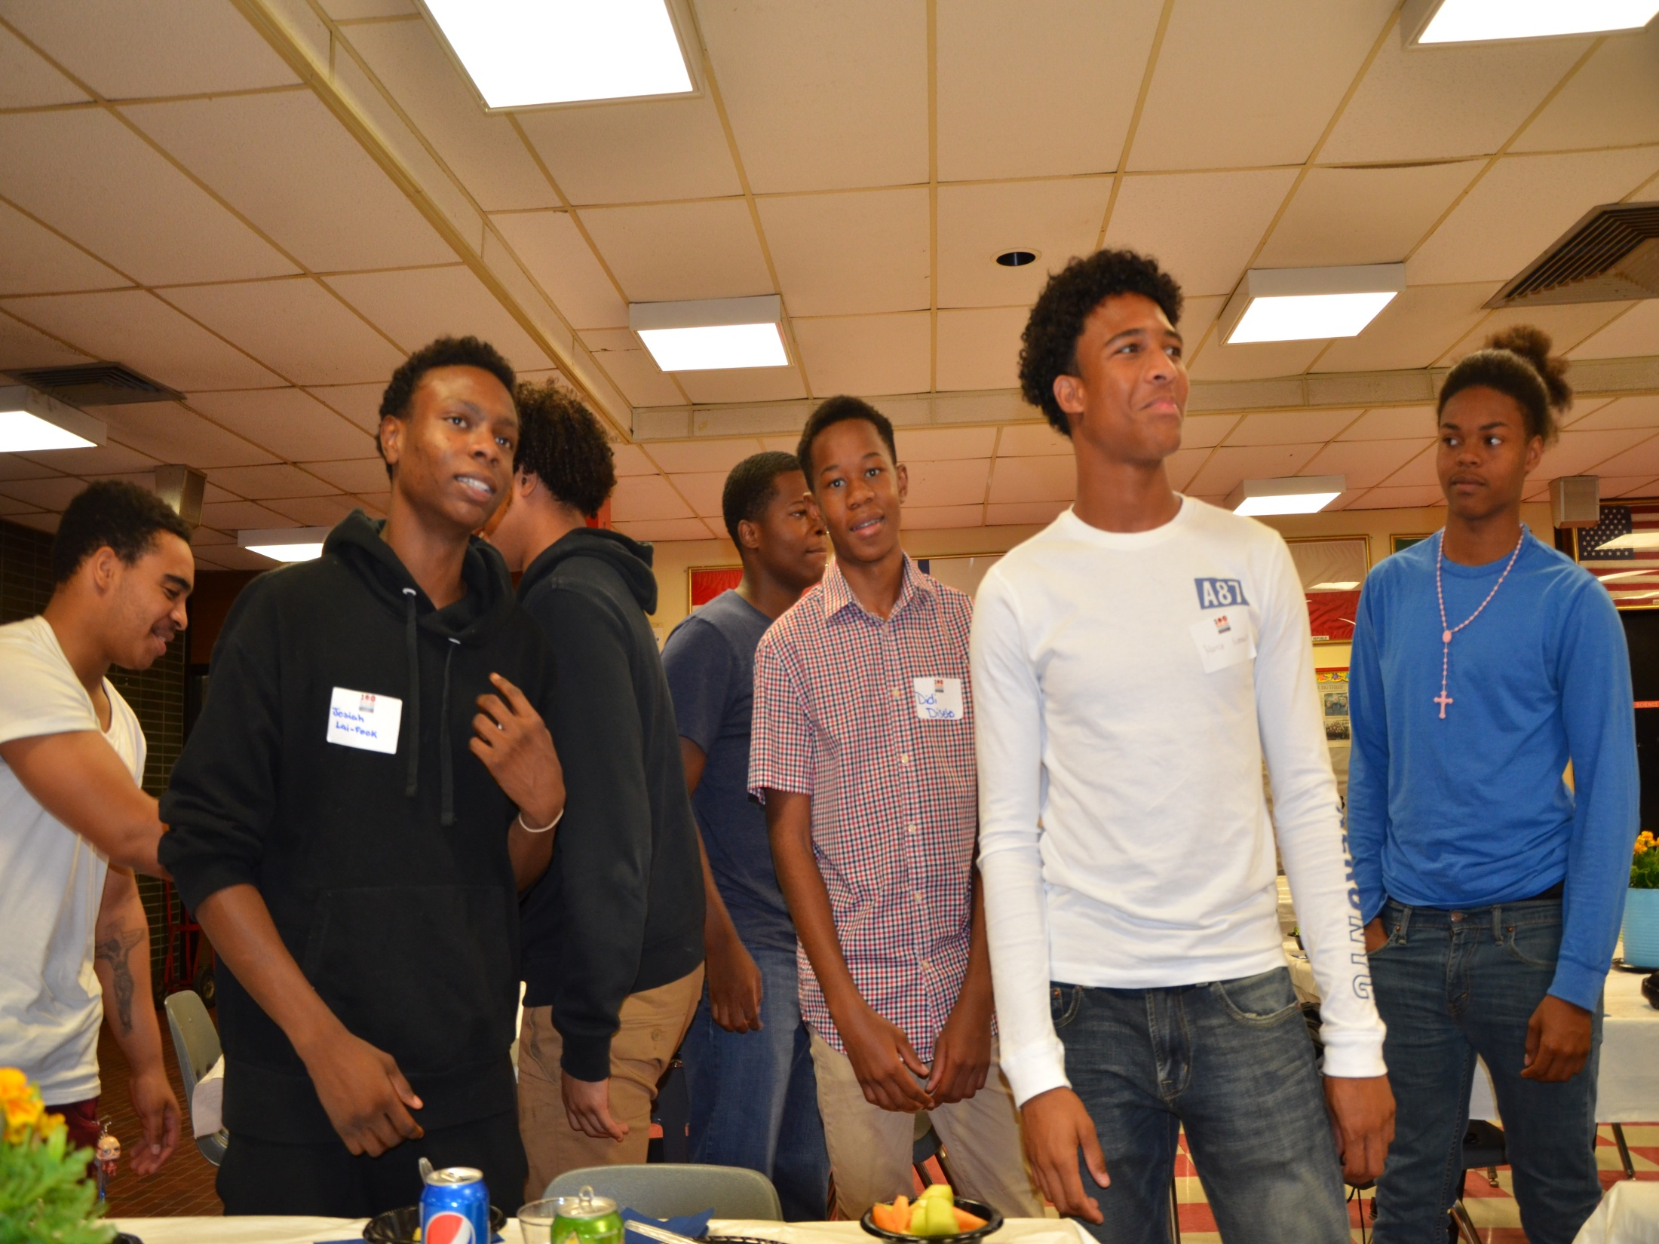
Program’s Evidence-Based Activities
Dual enrollment courses (Karp, Calcagno, Hughes, Jeong, & Bailey, 2007; Swanson, 2008).
Mentoring by college-enrolled students (Jackson, Sealey-Ruiz, & Watson, 2014; Jucovy & Garrington, 2008; Mtika, Payne, 2014).
Emphasis on building student success ethos and competencies (Randolph, & Johnson, 2008; Woods, & Preciado, 2016).
Support of healthy masculinities (Kimmel 2010; Harris 2010; Sanchez, Hurd, Neblett & Vaclavik, 2017).
Partnering with families and communities on behalf of mentees (Borden 2010; Dappen, & Isernhagen, 2006; Garrington, et al., 2015; Jackson, Sealey-Ruiz, & Watson, 2014; Nguye; 2005).

Slide 34
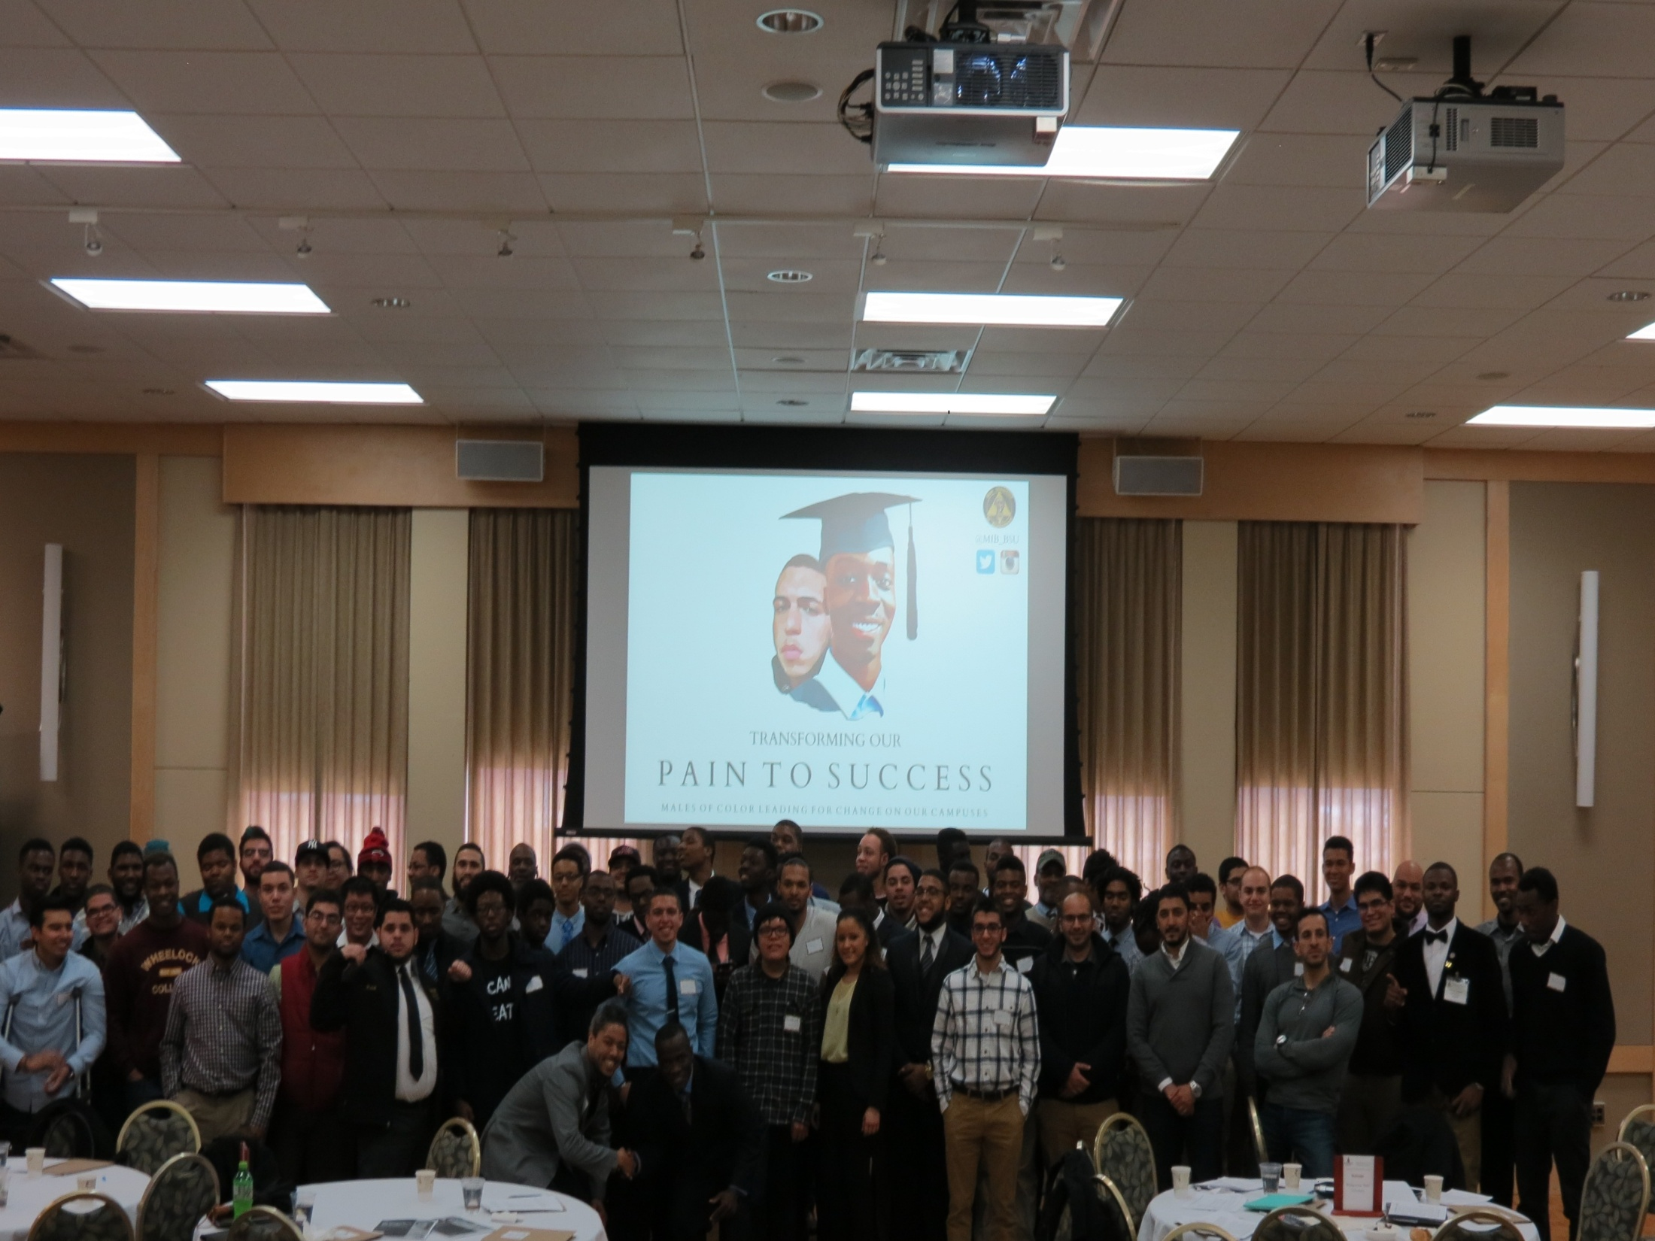
Student Success
As An Ongoing Commitment
College student mentors are offered a free three-credit college course focused on mentoring in order to support their success and ensure rigorous training.
Mentees are educated about the ongoing student success resources at their high schools as well as on the campuses.
Once mentees are enrolled in college, the campus resources that build on the 100 Males to College principles include:
  Massasoit Community College has Ubuntu Scholars and Brunch IV Brothers Program, and a Male Student Success Coordinator
  Bridgewater State University offers Male Mentoring Dinners and Men Integrated in Brotherhood, and a Male Student Success Coordinator

Slide 35
Results to Date
During the planning and launch year,
31 mentees participated in the program.
In our second year, we are recruiting
50 additional mentees.
We will build on the first year’s work and offer mentees additional student success-oriented information and skill-building opportunities. This material will be infused in high school experiences, mentoring relationships and the dual enrollment course.

Slide 36
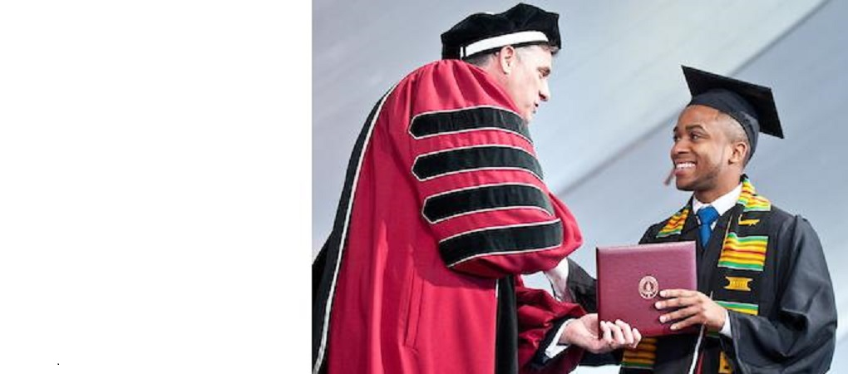
On Behalf of Brockton 100 Males to College – Thank You!

Slide 37
Why CBE for
Early Childhood Educators?
Competency-Based Education for Early Childhood Educators supports campus efforts to adapt academic programming to students’ mastery of key learning objectives for early childhood (birth–age 8) educators

Slide 38
Why CBE for Early Childhood Educators?
Performance Incentive Fund: Bringing Academic Innovation to Scale
Aligned with BHE Goals of Fostering a More Integrated Public Higher Education System, Developing Better Integration with P–12, Incubating Innovation
Continues collaborative work between DHE/EEC
designed to address educational opportunity gaps where they are constructed—in early childhood
  Creates a foundational CBE ECE certificate program and provides a pathway to Director 2 EEC Certification
  Maximizes resources and reduces duplication of efforts

Slide 39


Why CBE for Early Childhood Educators?
Performance Incentive Fund: Bringing Academic Innovation to Scale
2010–2011
● ECE Degree Program Mapping Project
2012–2013
● Early Education to Higher Education Advisory Committee
2014–2015
● Birth to Grade 3 Advisory
● Building the Foundations of Future Success for Children from Birth through Grade 3 endorsed by DHE, EEC, ESE Commissioners
2015–2016
● ECE Mass Transfer Pathways
● Early EdU
● MA state team and MA IHE’s pilot bachelor completion program in ECE
● PIF RFP includes an
ECE CBE
2016–2017
● PIF funded competency based pathway in Early Childhood Education: developed faculty capacity to deliver competency-based education
● FY18 PIF RFP: Seven community colleges will use a collaborative approach to scale the NECC/MCC model and to develop statewide digital CHE pathways for early educators

Slide 40
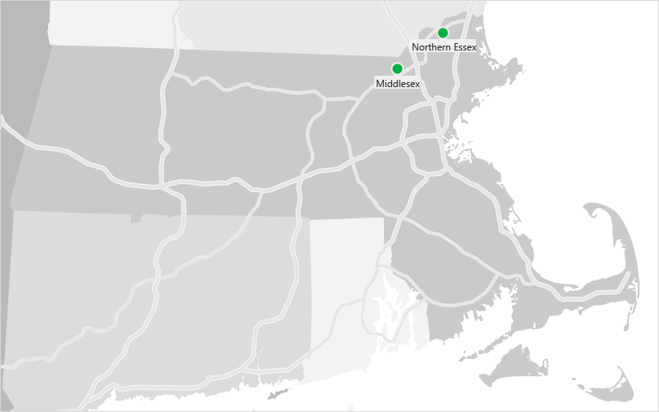
How will we measure success?
Performance Incentive Fund: Bringing Academic Innovation to Scale
Scaling Up: FY 2017 Participating Campuses

Slide 41
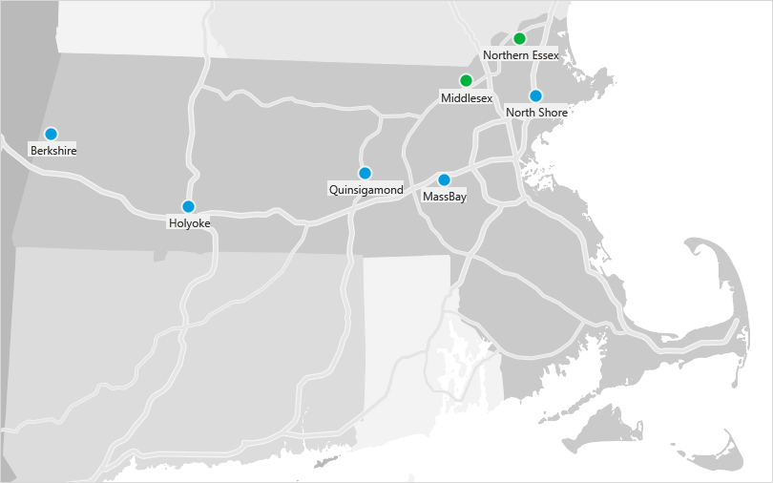
How will we measure success?
Performance Incentive Fund: Bringing Academic Innovation to Scale
Scaling Up: FY 2018 Participating Campuses

Slide 42
How will we measure success?
Performance Incentive Fund: Bringing Academic Innovation to Scale
Metrics:
  Increase degree completion for adult learners through alt. delivery systems
  Broaden early educator access to certificates and degree programs
  Increase number of faculty who are able to describe national and local CBE models
  Expand model to engage all 15 community colleges

Slide 43
Competency-Based Education for Early Childhood Educators
Kimberly Burns, Dean of Academic Innovations and Dean of Professional Development, Northern Essex Community College

Slide 44
Overview
Address time to degree for early childhood educators by exploring:
  Increasing early childhood faculty knowledge and skills around competency-based education
  Alignment of early childhood education accreditation standards, professional competencies and college courses
  The academic support needs of early childhood students needing developmental education and students who are dual language learners
  The need for students to master instructional technology professional competencies

Slide 45
Program Components
CBE 101 Workshop
Competency alignment
Competency validation
CBE course adaptation
NAEYC Conference
New Directions in Developmental Ed & ESL
Mobile devices in the ECE classroom
Preparation for NECC NEASC accreditation visit
Statewide ECE meeting
External evaluation

Slide 46
Why Competency-Based Education?
Students, policy makers, employers and the general public want more students to earn degrees faster
Providing students with the opportunity to separate learning from seat time is appealing to students, employers and policy makers
Strategy aimed to attract and retain adult students

Slide 47


Student Segments
CAREER CHANGERS &
CAREER ACCELERATORS
COMING OF AGE

Slide 48


A disruptive innovation with minimal disruption
WHAT WE ARE NOT DOING
Abandoning the credit hour – complete separation of time
& learning
Offering a subscription
payment option
WHAT WE ARE DOING
Offering a course-base model based on success of community colleges from around the country
Providing flexibility within
credit courses

Slide 49
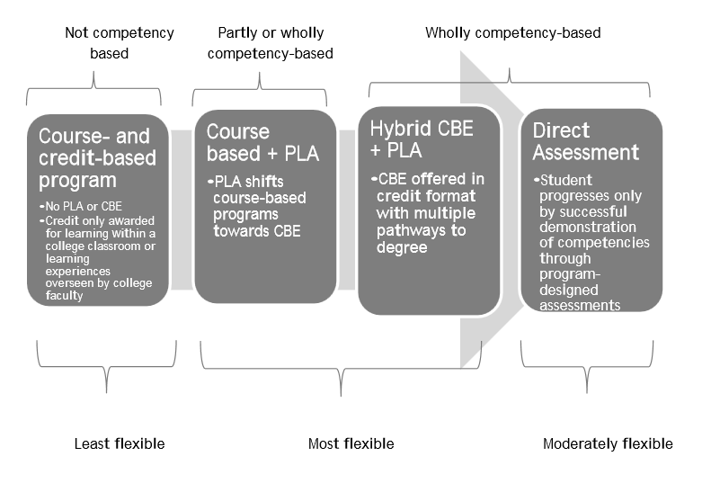


Tate, P. & Klein-Collins, R. (2015). PLA and CBE on the Competency Continuum: The Relationship between Prior Learning Assessment and Competency-Based Education. Chicago, IL: Council for Adult and Experiential Learning.

Slide 50
Early Data:
Computer Applications CBE Courses
Spring 2017 Course Completion Rate
  78.4% CBE courses
  73.1% All courses
  68.5% 100% online courses
Fall 2016 - Fall 2017 Retention Rate
  72.7% CBE students
  60.9% All NECC students

Slide 51
Questions & Discussion

