Slide 1
Redesigning Massachusetts State Financial Aid Simplifying Process & Maximizing Impact
Board of Higher Education Meeting | March 6, 2018

Slide 2
Presenters
Redesigning Massachusetts State Financial Aid
Consultants: Harvard Graduate School of Education
Prof. Bridget Terry Long, Ph.D.
Monnica Chan, Ph.D. Candidate
Staff: Massachusetts Department of Higher Education
Clantha McCurdy, Senior Deputy Commissioner, Access & Student Financial Assistance

Slide 3
Project Overview
Redesigning Massachusetts State Financial Aid
Study grew out of the Redesigning State Aid in New England initiative, sponsored by the New England Board of Higher Education and funded by The Lumina Foundation
Goal was to produce a set of recommendations for reforming and consolidating state-funded financial aid programs that would move the Commonwealth forward on three BHE priorities:
Enhance student success, decreasing students’ time to earning a postsecondary degree
Improving college access and affordability
Closing achievement gaps between groups of students

Slide 4
Today’s Presentation
Redesigning Massachusetts State Financial Aid
Overview of the study findings
High-level preview of questions that must be addressed in formulating new financial aid policy
BHE is asked to accept the report, further directing the Commissioner to develop new financial aid policy recommendations and a plan for implementation

Slide 5
Study Outcomes
Redesigning Massachusetts State Financial Aid
Analyzes the extent to which current financial aid programs are meeting residents’ needs
Identifies opportunities to create efficiencies
Identifies opportunities to simplify the aid process for families
Forecasts future state financial aid needs based on projected demographics and socioeconomic changes

Slide 6
The Current Aid Portfolio
Redesigning Massachusetts State Financial Aid
We have 31 different state financial aid programs
There is a great deal of variation in eligibility requirements, funding sources, and administrative oversight
Most are funded from the General Fund or Tuition Revenue, but some also receive private matches
Many focus on particular groups (e.g., teachers, Dept. of Children and Families; workforce-related)
Vary in whether they are available at private colleges
In addition to grants, we offer a large number of tuition waivers, which vary by institutional sector → they add a layer of complexity to the aid system

Slide 7
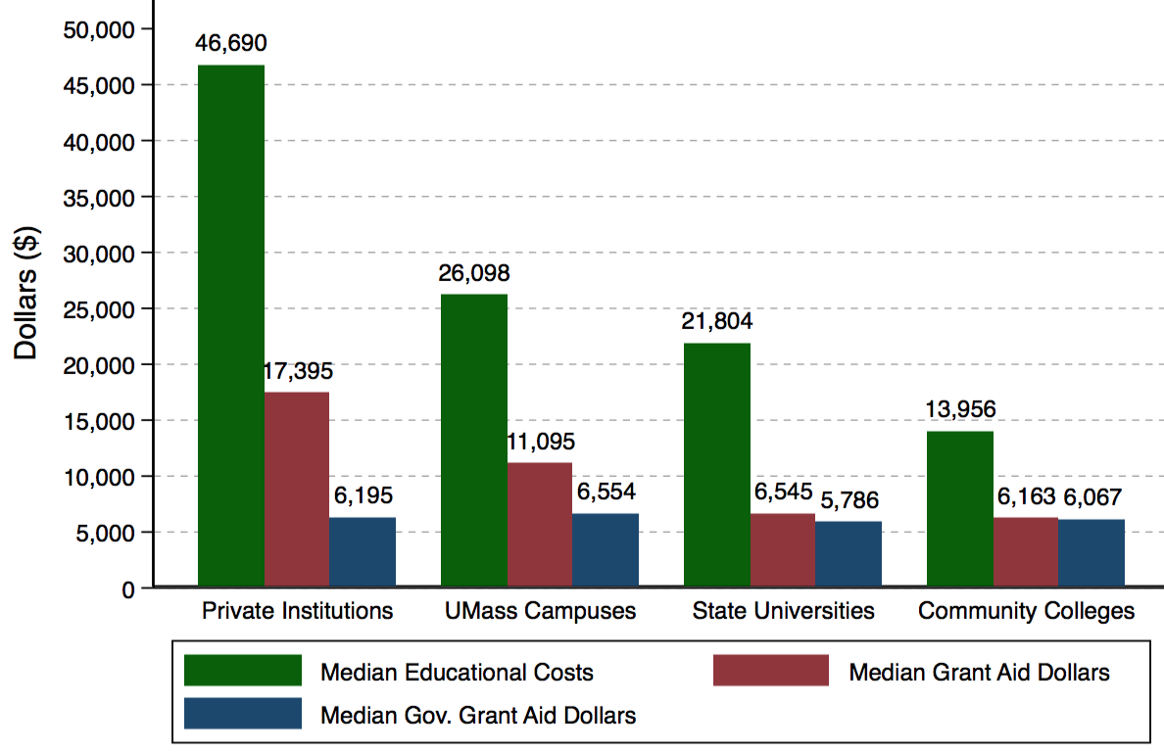
Median Educational Costs & Grant Aid, FY2014
Redesigning Massachusetts State Financial Aid
Costs
How well does our aid system support student affordability?
Grant Aid
Note: Full-time, Full-Year Students

Slide 8
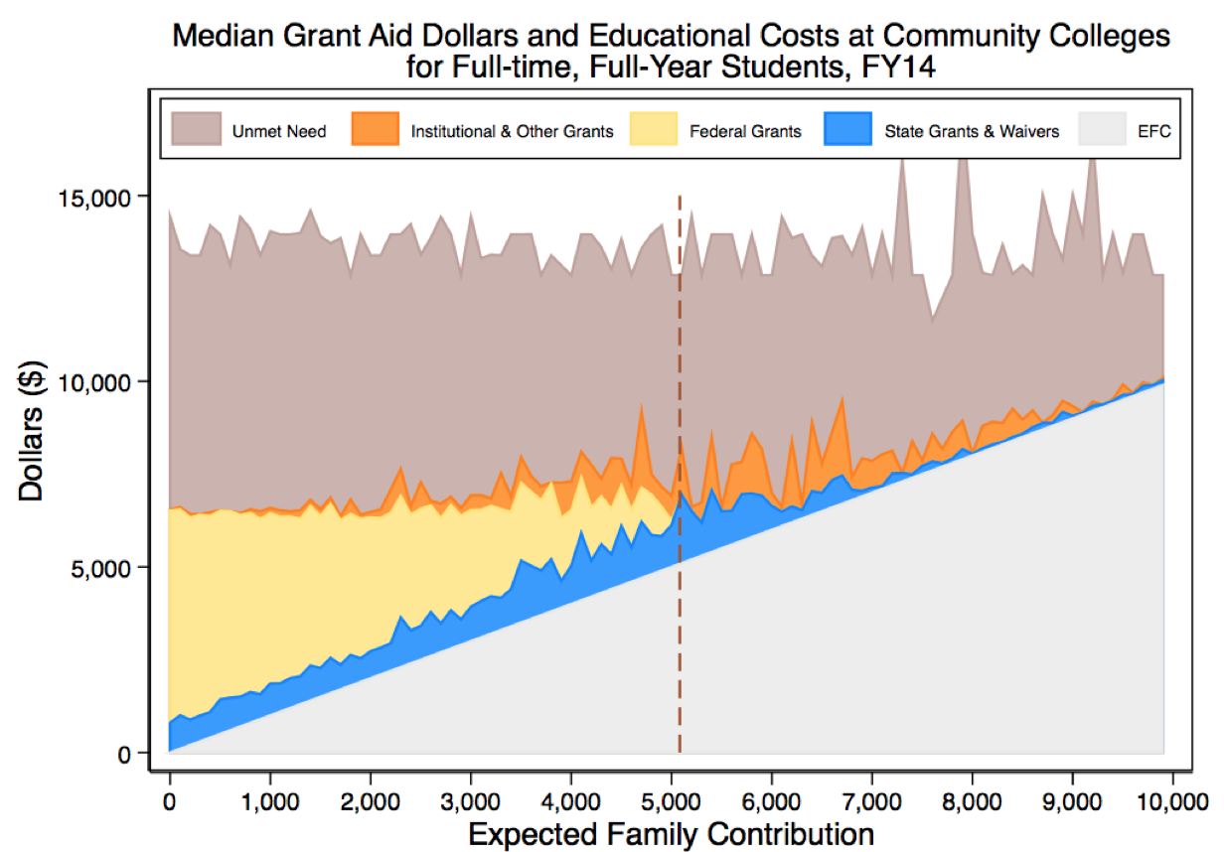
Median College Costs, Aid Awards, and Unmet Need, FY2014
Full-time, Full-Year Students
COMMUNITY COLLEGES
UNMET NEED
Institutional Aid
Federal Grants
State Grants & Waivers
LOWER INCOME
HIGHER INCOME

Slide 9
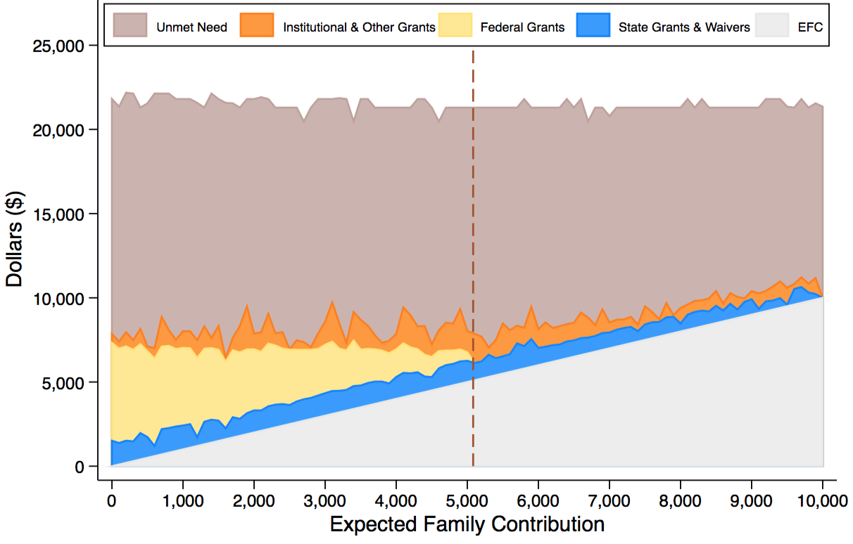
Median College Costs, Aid Awards, and Unmet Need, FY2014
Full-time, Full-Year Students
STATE UNIVERSITIES
UNMET NEED
Federal Grants
Institutional Aid
State Grants & Waivers
LOWER INCOME
HIGHER INCOME

Slide 10
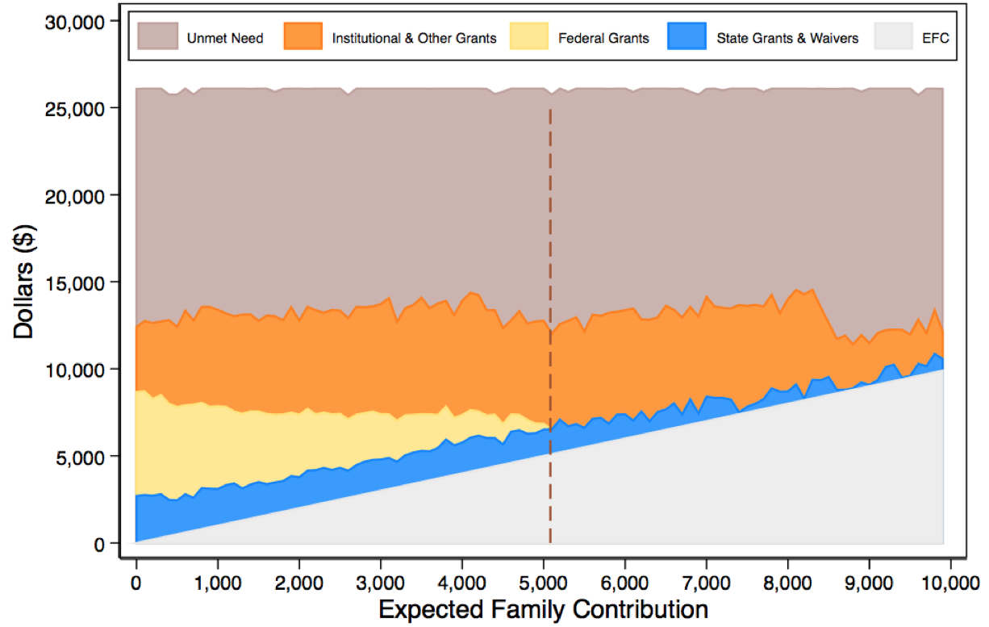
Median College Costs, Aid Awards, and Unmet Need, FY2014
Full-time, Full-Year Students
UMASS SYSTEM
UNMET NEED
Institutional Aid
Federal Grants
State Grants & Waivers
LOWER INCOME
HIGHER INCOME

Slide 11
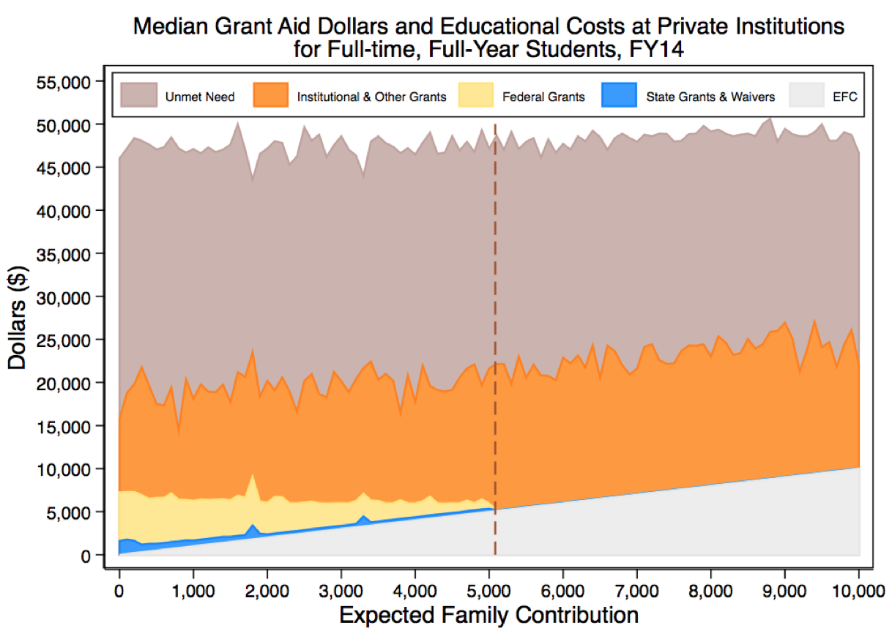
Median College Costs, Aid Awards, and Unmet Need, FY2014
Full-time, Full-Year Students
PRIVATE INSTITUTIONS
UNMET NEED
Institutional Aid
Federal Grants
LOWER INCOME
HIGHER INCOME

Slide 12

Overlap in State Need-Based Grant Awards
Redesigning Massachusetts State Financial Aid
Public Institutions, FY2014
Full-Time/Full-Year students
68% of Cash Grant recipients also received a MASS Grant
70% of Need-based Waiver recipients also received a MASS Grant
Cash Grant
MASS Grant
3,948
2,343
8,815
7,115
(all three)
2,774
4,892
2,447
Need-Based Waiver

Slide 13

Overlap in State Need-Based Grant Awards
Redesigning Massachusetts State Financial Aid
Private Institutions, FY2014
Full-Time/Full-Year students
73% of Gilbert Grant recipients also received a MASS Grant
MASS Grant
Gilbert Grant
5,552
(both)
7,568
2,093

Slide 14
State Aid Portfolios across the Nation, FY2014
Redesigning Massachusetts State Financial Aid
We rank #25
#1 spends nearly FIVE times as much per student as Mass.
A much smaller fraction of our need-based aid is dispersed through our primary program
Source: National Association of State Student Grant and Aid Programs (NASSGAP) 45th Annual Survey Data.

Slide 15
Opportunities for Improvement
Redesigning Massachusetts State Financial Aid
After all sources of financial aid, unmet financial need is still substantial in the Commonwealth (and particularly hard to handle for low-income students)
What is a reasonable amount of unmet need?
What should be the state role? What should we expect of institutions (both decentralized state aid and institutional resources)?
Is there a benchmark we should use across institutions?
To improve the aid system, more support is needed, but there may also be ways to be more impactful and efficient with our current funds

Slide 16
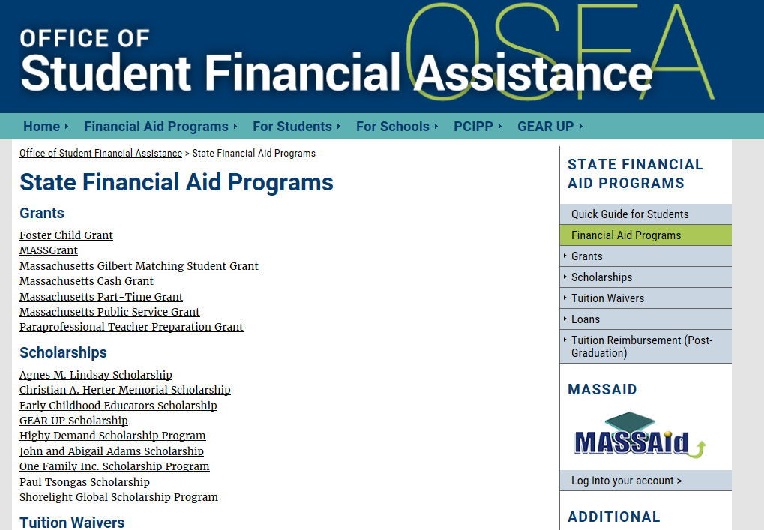
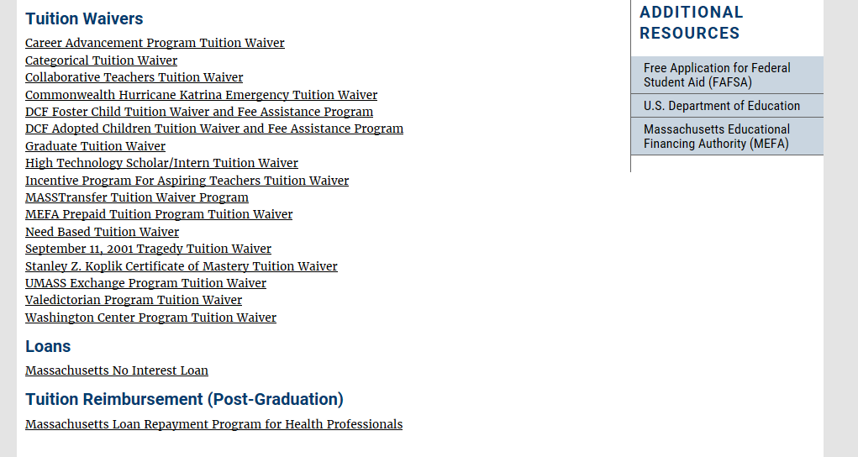
What does the Massachusetts aid system look like to families?
From the OSFA Website…
How difficult is it for a family to navigate our system?
What the tradeoffs from having so many targeted programs?
Could the same goals be accomplished with a simpler approach?

Slide 17
Opportunities for Improvement
Redesigning Massachusetts State Financial Aid
Should we consolidate some aid programs?
There is significant overlap among multiple programs—could we reach the same goals using a much simpler approach?
Consolidation could:
Make administrative oversight easier
Increase transparency and the ability to publicize what families might expect to receive
Reduce burden and uncertainty for families

Slide 18
Opportunities for Improvement
Redesigning Massachusetts State Financial Aid
Should we consolidate some aid programs?
Collapse/remove waivers that have not been used in recent years
Examine “one-off” programs—Could they be folded into larger program and accomplish the same goals?
Consolidate need-based aid programs to build a singular, more progressive aid program (similar to other states)
In communications (e.g., website), prioritize the larger programs and make sure they are highly visible (smaller programs should be listed at the bottom)

Slide 19
Study Conclusions
Redesigning Massachusetts State Financial Aid
Other Issues to Consider
Grants ≠ Tuition Waivers
Differential impact on student decisions?
Anticipate changes to tuition retention policies by reconsidering tuition waiver programs and associated state statutes
Piloting Other Ideas?
e.g., Lessons from other aid programs/states
Must balance with unmet need that already exists

Slide 20
Study Recommendations: Summary
Redesigning Massachusetts State Financial Aid
Five overarching recommendations to improve effectiveness and efficiency of current aid system:
More support is needed to address the substantial unmet financial need facing many families
Consolidate programs with similar goals into a simpler, more streamlined system to benefit multiple stakeholders
Repackage the Massachusetts system of tuition waivers into a simplified, well-publicized grant program
Apply lessons and innovations from pilot programs to existing aid policies
Improve communications regarding state financial aid programs for clarity and increased awareness

Slide 21
Study Recommendations
Redesigning Massachusetts State Financial Aid
Recommended next steps in moving to redesign the Massachusetts State Financial Aid program:
Share findings with Massachusetts colleges and universities
Collect feedback from institutional financial aid officers, the Statewide Financial Aid Advisory Committee, students and parents who navigate and use state financial aid
Conduct additional analysis, including unmet need
Develop recommendations for suggested modifications

Slide 22
Stakeholder Feedback
Redesigning Massachusetts State Financial Aid
Report has been widely circulated and discussed at various forums, workshops and committee meetings with stakeholders over past several months
Commissioner circulated report to campus presidents
Financial Aid Forum held on December 15, 2017
Key meetings with the Statewide Financial Aid Advisory Committee
DHE received feedback from a variety of stakeholders, including campus leadership, financial aid professionals, and organizations whose work include student success advocacy
Survey conducted by Ripples captured student feedback regarding the financial aid process, services and resources (part of OSFA Business Process Review)

Slide 23
Stakeholder Feedback
Redesigning Massachusetts State Financial Aid
Overall consensus to revamp state financial aid programs
Continue to advocate for increased financial aid resources to serve more students
Address unmet need, which continues to increase
Do not overlook students who do not qualify for entitlement aid (Pell Grant, MASSGrant)
Programs should be flexible and available to all students (full- and part-time)
Address balance of state aid that benefit public and private college students

Slide 24
Key Factors for Policy Recommendations
Redesigning Massachusetts State Financial Aid
Administration
Is sustainable legislative support feasible, and is there a possibility of increases in state financial aid funding over time?
How can resources be replaced if tuition waivers are no longer available due to statewide implementation of tuition retention policy?
What will be the impact of demographic changes in college-going population based on enrollment projections?
What are the expectations for increased institutional financial aid (i.e., partnership with institutions)?
What will be the impact of/on current initiatives such as Commonwealth Commitment and Governor Baker’s proposed increase in MASSGrant for community college students?

Slide 25
Key Factors for Policy Recommendations
Redesigning Massachusetts State Financial Aid
College Affordability
What is the target share of college costs to be covered by state financial aid?
What is the target for a reasonable level of unmet need, and what amount of additional resources would be required to meet it?
How can current funds be maximized to impact unmet need in an environment where college costs continue to increase?

Slide 26
Key Factors for Policy Recommendations
Redesigning Massachusetts State Financial Aid
Improving College Participation & Completion Rates, Closing Achievement Gaps
Should additional financial aid resources be provided to institutions with proven success in these areas?
How can state financial aid support early college initiatives, through partnerships with institutions and local communities?
Should programs support students who meet certain milestones towards degree completion (i.e., incentive-based programs that encourage persistence)?

Slide 27
Summary of Goals
Redesigning Massachusetts State Financial Aid
Consolidating and revamping programs that are similar and/or no longer effective to achieve greater efficiency
Having clear & defined eligibility requirements and expectations
Revamping DHE/OSFA website for clarity and to include tools to enhance a student’s ability to make informed decisions for college
Note: A Business Process Review (BPR) is currently in process at DHE, intended to evaluate how financial aid and related fiscal/administrative services may be improved for effectiveness and efficiency of state financial aid processes and services. BPR results are expected to impact new state financial aid policy.

Slide 28
Next Steps
Redesigning Massachusetts State Financial Aid
Finalize recommendations for new financial aid policy
Develop implementation plan and timeline to manage program changes
Present details of recommendations (and implementation plan) to FAAP for BHE approval
Provide BHE with periodic (annual) reports on the progress and status of state financial aid

Slide 29
Questions & Discussion
Redesigning Massachusetts State Financial Aid

