Slide 1
Fundamentals of Trusteeship

Slide 2
Welcome
Michael Mizzoni
Deputy General Counsel
Department and Board of Higher Education

Slide 3
Session Outcomes
Greater understanding of the Framework for Trustee Work
What is the role of the trustees?
What is the role of the BHE?
Trustees as Fiduciaries
10 Fundamental Responsibilities

Slide 4
Higher Education Governance

Slide 5
M.G.L. Chapter 15A
“It is hereby declared to be the policy of the commonwealth to provide, foster and support institutions of public higher education that are of the highest quality, responsive to the academic, technical and economic needs of the commonwealth and its citizens, and
accountable to its citizens through lay boards, in the form of the board of higher education and the boards of trustees of each of the system’s institutions.”

Slide 6
Role of the BHE
The BHE is responsible for defining the mission of and coordinating the Commonwealth’s system of public higher education and its institutions.
The BHE’s enabling legislation also includes several specific governance and oversight responsibilities.

Slide 7
Examples of BHE Legislative Responsibilities
Analyze present and future goals, needs and requirements of public higher education
Establish goals to achieve well-coordinated, quality system
Establish coordination among post secondary public institutions
Resolve conflicts of policies or operations
Approve 5-year master plans, & develop a 5-year system master plan
Develop performance measurement system and funding formulas
Approve mission statements
Approve admissions standards and affirmative action plans
Approve presidential appointments and removals
Approve and fix presidential compensation
Define and authorize new functions or programs;
Set tuition rates (campuses set fees)
Collect, analyze and maintain data from institutions
Coordinate activities and engage in advocacy

Slide 8
Role of Boards of Trustees
Boards are “responsible for establishing those policies necessary for the administrative management of personnel, staff services and general business of the institution”

Slide 9
Higher Education Governance

Slide 10
Examples of Duties and Powers of Local Boards: M.G.L. c. 15A, § 21 & 22
Each board shall:
Develop a mission statement
Prepare maintenance and capital budgets
Manage and keep in repair all property
Establish fees
Appoint, transfer, dismiss, promote and award tenure
Seek, accept and administer grants, gifts and trusts
Implement and evaluate affirmative action policies and programs
Establish, implement and evaluate student services
Recommend to the BHE admission standards
Have authority to transfer funds within and among subsidiary accounts
Establish/operate programs in accordance with degree conferring authority
Submit a 5-year master plan to the BHE
Submit financial data as required
Submit an annual institutional spending plan
Submit an institutional self-assessment report
Appoint & remove the CEO (with the approval of the BHE)

Slide 11
Overview and Comparison: Legislative Authority of BHE and Local Boards

Slide 12
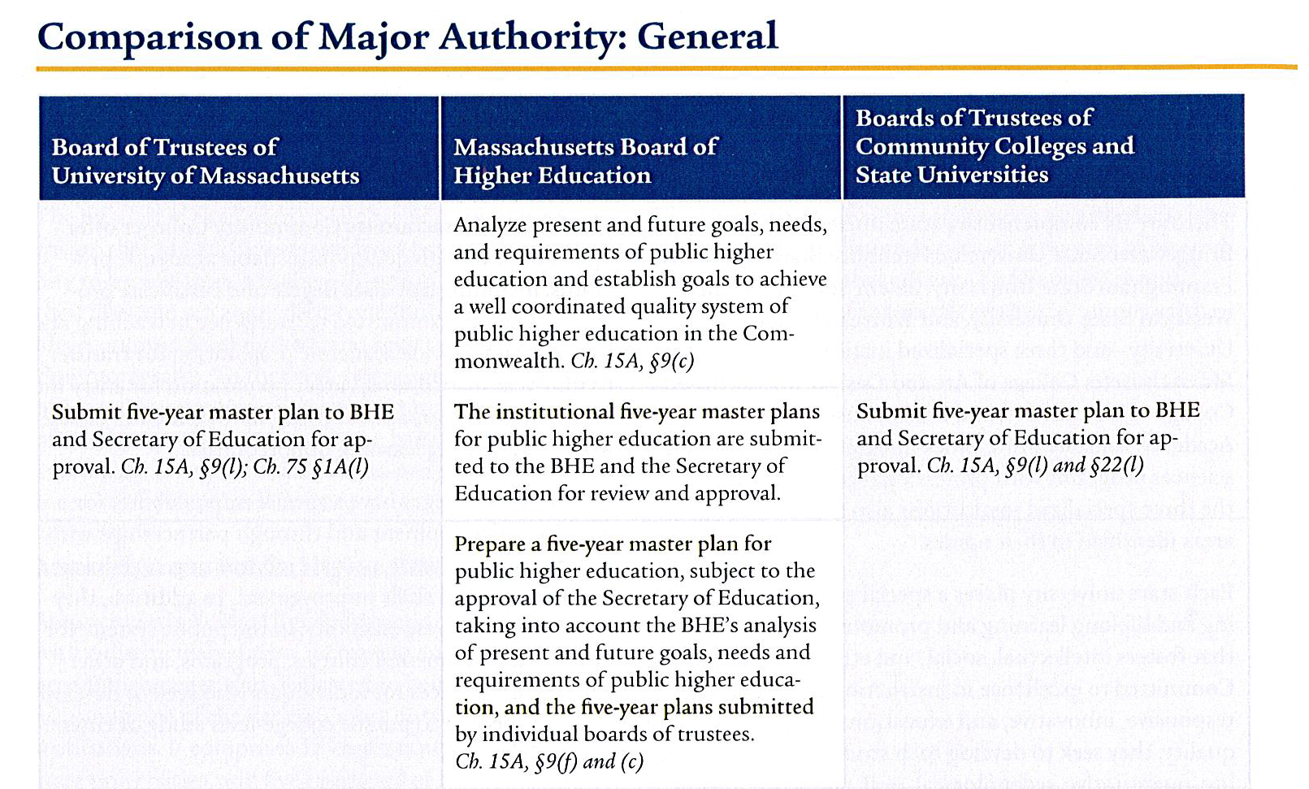
Overview and Comparison:

Slide 13
Trustees as Fiduciaries
Fiduciary – One who holds some asset(s) in trust for another and is charged to act beneficially on behalf of the other in managing that asset.
The Asset – The college/university you govern, including mission & identity, property, human resources & educational product.
For Whom – Founders and sponsors, students and families, donors, alumni, (the public)

Slide 14
Fiduciary Duties
Duty of Care
Act in good faith for best interests of institution
Act reasonably, competently and prudently
Duty of Loyalty
Put interest(s) of institution above all else
Do not act from self interest; no self-dealing
Conflict of loyalty
Duty of Obedience
Obligation to advance mission
Duty to act ethically and consistent with mission
Serve a Public Purpose

Slide 15
Ten Fundamental Responsibilities of
Effective Governing Boards
1. Ensure that the institution’s mission is kept current and is aligned with public purposes. In the case of a multi-campus system, ensure the alignment of each campus’s mission with the system’s vision and public purposes.
2. Select a chief executive to lead the institution.
3. Support and periodically assess the performance of the chief executive and establish and review the chief executive’s compensation.

Slide 16
Fundamental Responsibilities
4. Charge the chief executive with the task of leading a strategic planning process, participate in that process, approve the strategic plan, and monitor its progress.
5. Ensure the institution’s fiscal integrity, preserve and protect its assets for posterity, and engage in fundraising and philanthropy.
6. Ensure the educational quality of the institution and its academic programs.

Slide 17
Fundamental Responsibilities
7. Preserve and protect institutional autonomy, academic freedom, and the public purposes of higher education.
8. Ensure that institutional policies and processes are current and properly implemented.
9. In concert with senior administration, engage regularly with the institution’s major constituencies.

Slide 18
Fundamental Responsibilities
10. Conduct the board’s business in an exemplary fashion and with appropriate transparency, adhering to the highest ethical standards and complying with applicable open-meeting and public-records laws; ensure the currency of board governance policies and practices; and periodically assess the performance of the board, its committees, and its members.

Slide 19
Trustee Responsibilities
Advance educational mission
Oversee policies and plans
Measure results
Ensure sound financial management
Advance philanthropic goals
Actively participate in board and committee meetings
Review strategic plans
Put the institution first, before personal interests

Slide 20
When in doubt, reach out to Legal Counsel
or
Send an email to Jennifer Perkins in the Office of Trustee Relations
Resources: Trustee Web Corner - www.mass.edu/trustees
*Special “Thank You” to AGB’s Dr. Merrill Schwartz for content

