Slide 1
Massachusetts Centralized Clinical Placement System©
Processes and Practices
Massachusetts Department of Higher Education
West Region
November 10, 2020
Notes:
1

Slide 2
Guidelines for the Zoom Webinar/Call
Click the link below to join the webinar:
Please click the link below to join the webinar:
https://us02web.zoom.us/j/85704960594?pwd=bGJsT242OWRBaTZ0c3dvRWd2a2MzQT09
Meeting Webinar ID: 857 0496 0594 / Meeting Password: 902391
Call in phone numbers were included in the meeting document email.
Will use PowerPoint slides to guide discussion.
  Slides are numbered (lower right corner)
  Will refer to slide number often for reference
Will use circle methodology to gather your feedback.
  You may be muted upon entry to the webinar.
  Will occasionally unmute the call but you may also have to mute/unmute your line.
  We will pause for questions during the presentation.
  Please identify yourself each time before speaking.
Marie/Dave available for individual questions at later date.

Slide 3
Plans for Today’s Meeting
  Check-ins, Updates and Reminders
  CCP Placement Database
  Nursing Faculty Database
  Demographic Survey
  Clinical Faculty Database
Sustainability Update
CCP Online Orientation Program
  Academic year 2020-2021
  Sustainability Updates
  Website Updates
Next Steps
  Upcoming Meetings
  Group Check-out
Notes:
3

Slide 4
CCP Database Check-in, Updates and Reminders
  How’s it going?
  Consecutive Temp Release Limits
  HCOs: Use of Temporarily Unavailable

Slide 5
CCP Database Check-in, Updates and Reminders
Consecutive Temp Releasing of Placements
In February 2020, we noted that with the Summer 2020 renewals, the site would implement an automatic default limit of 1 time / 1 term on the consecutive temp releasing of a placement.
In March 2020, in response to COVID, many clinical partners marked placements as temporarily released.
To facilitate updating of the database for AY 2020-2021, the CCP will turn off that automatic default limit and allow temp releasing of winter, spring, summer or fall 2021 placements even if they had been temp released the previous year.
HCOs retain complete control on whether or not to temp release a placement, so
  HCO may decide that they do no allow temp releasing at all, or
  HCO may set a different limit
HCOs, we recommend that if you know that a unit will not be available, you should preemptively mark the placement as Temporarily Unavailable, then the nursing program can match that renewal plan.
The placement will be renewed as Temporarily Unavailable.

Slide 6
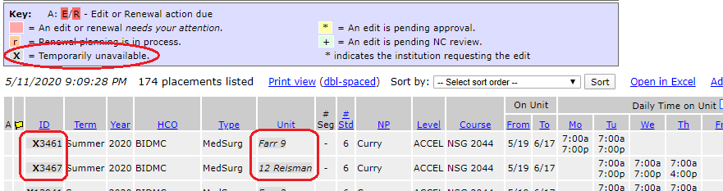
Temporarily Unavailable Placements
Recommending that HCOs mark placements as Temp Unavailable if the unit cannot accommodate students for spring (or summer if known).
  HCOs can edit existing placements to mark them as Temp Unavailable or, for renewals, submit a renewal plan of Temp Unavailable (do not need to wait for nursing program to submit a plan first)
This will preserve the placement and the connection with the nursing program so it can be renewed normally in the future (if available).
The Temp Unavailable designation of a placement will be made more prominent on the Placement List:
  The Placement ID will be in dark gray and preceded with a bold ‘X’;
  The Unit will be in dark gray and in italics.
Notes:
6

Slide 7
CCP Database Check-in, Updates and Reminders
Most important date for each set of timeframes is the nursing programs “send by” date.
We ask HCOs not to respond until their regional nursing program "send by” date passes. Allows:
  nursing programs time to plan and submit renewals and new opportunity requests in a coordinated and fair way.
  HCOs to see all of the nursing program requests before making any determinations.
Once the "send by” date passes, HCOs are encouraged to respond as promptly as possible.
HCOs do not need to wait until their “respond by” date if they can respond sooner.
We ask nursing programs not to call/email HCO for approvals. Overwhelming for the HCOs.
West Timeframes
Fall 2020
Nsg Prg send by Friday, May 8, 2020.
HCOs respond by Friday, June 5, 2020.
Winter/Spring 2021
Nsg Prg send by Friday, Oct 16, 2020.
HCOs respond by Friday, Nov 20, 2020.
  Thanksgiving is November 26, 2020.
Summer 2021
Nsg Prg send by Friday, March 5, 2021.
HCOs respond by Friday, April 2, 2021.

Slide 8
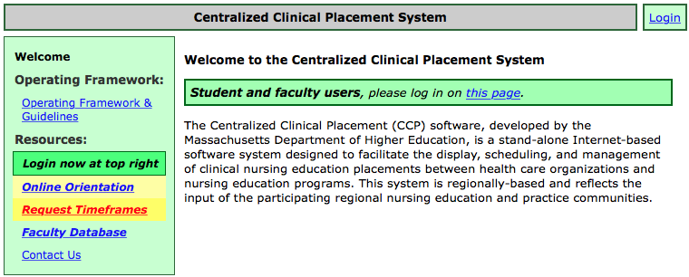
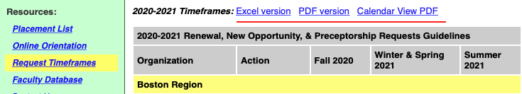
Timeframe Guidelines
Each region sets its own Timeframe Guidelines.
2020-2021 Timeframe Guidelines are posted on the site.
Nursing Programs: if you send renewals or new opportunity requests to regions other than your home region, you need to follow their timeframe guidelines.
Several “views” of Timeframe Guidelines are available to print.
Don’t need to login to open
Timeframe Guideline page.

Slide 10
CCP Nursing Faculty Database Check-in & Reminders
Nursing Faculty Database holds (as of 10/27/2020):
  11 posted positions for 2021 or fall 2020;
  31 new faculty candidate registrations since 7/1/2020;
  64 faculty candidates with current or near-term availability.
Through 10/27/2020, 215 positions have been posted:
  11 are active;
  98 have been reported as filled;
  51 have been reported as not filled or no longer needed;
  26 closed/removed for unknown reasons;
  Remaining 29 have not yet been reported.
  We encourage nursing programs who have posted a position to report on its status so that we have more complete outcome data.

Slide 12
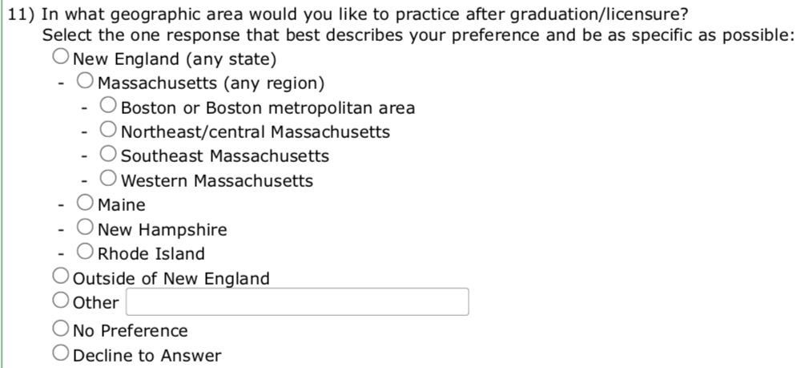
Academic Year 2020-2021 Demographic Survey Check-ins
  1,195 students/faculty completed the survey in West.
  Annual survey is mandatory but each question has a ‘Decline to answer’ option.
  For AY 2020-2021 added a new question to the survey:

Slide 13
Placement Rosters in CCP
  Placement rosters provide the ability for nursing programs to add a list of students to a group placement that can then be viewed by the health care organization.
In brief, placement rosters are:
  controlled (activated/turned on) by the nursing programs;
  customizable, nursing programs can choose which placement rosters to make visible to their HCO partners.
  a standard CCP component. There is no additional fee to activate or use placement rosters.
  private, you can only view rosters for your own placements. They are not visible to other CCP participants.
  hidden if the tool is not enabled, neither the education program nor the HCO, will see any changes to the site.
  printable and can be saved via the Export to Excel link.

Slide 14
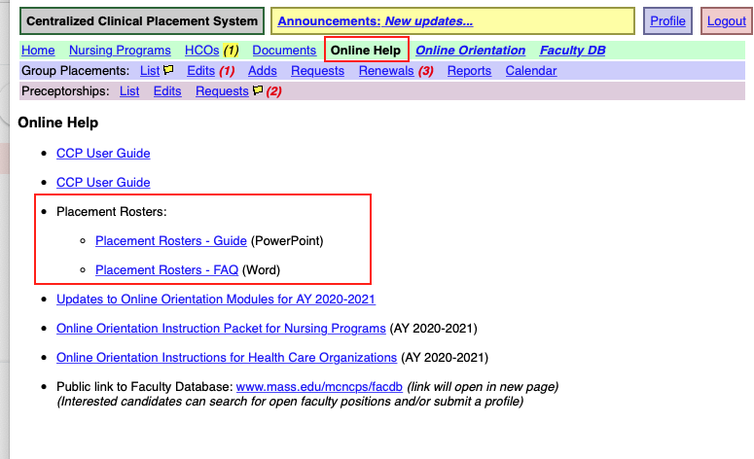
Placement Rosters
A PowerPoint presentation and a set of Frequently Asked Questions (FAQs) about placement rosters are in the Online Help section.
    Contact Marie with questions: 781-891-8860 / marietobin1@gmail.com

Slide 15
AY 2020-2021 Online Orientation Check-in (1)
How is it going?
Reminders:
    New academic year began on July 1, 2020. Students/faculty can re-certify on/after July 1, 2020.
    All students/faculty need to certify for AY 2020-2021.
    Modules are completed annually.
    Clinical Assignment Tickets are created for each clinical assignment.
    Students/faculty register (create) and certify (complete modules) under their own user account (not the school’s admin account).
    Students/faculty can do modules whenever it is convenient and appropriate for their clinical assignment schedule.
    Questions how to track students’ progress in online orientation program Marie: 781-891-8860 / marietobin1@gmail.com
  AY 2020-2021 West Online Orientation (10/25/20)
    1,220 students/faculty have registered. (Created/updated user account)
    1,195 have certified. (Completed the modules)

Slide 16
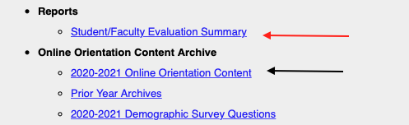
AY 2020-2021 Online Orientation Check-in (2)
Content Archive
Users can review detailed feedback from your students via your Online Orientation Admin page (red arrow).
  Process detailed in Spring 2020 PPTs.
Online Orientation material posted to the Content Archive section of your Online Orientation Admin page (black arrow)
  Older archives consolidated onto a “Prior-Year Archives” page.

Slide 17
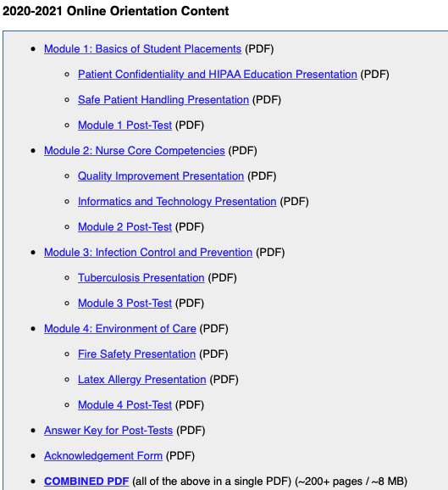
AY 2020-2021 Online Orientation Check-in (3) Content Links
Orientation Content available as individual PDFs and as a combined PDF.
Post-tests and answer key included.

Slide 18
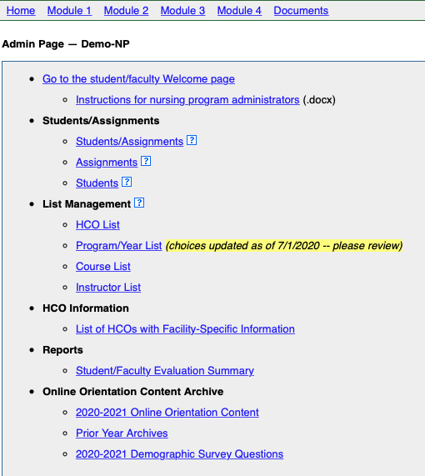
Nursing Program Online Orientation Admin Page Update
Nursing Programs create/manage the lists that their students use to enter a clinical assignment.
At start of each term, review the Links under List Management.
  HCO list.
  HCOs in CCP & self-managed
  Program/Year List
  Course List.
  Instructor List
Program/Year list updated for AY 2020-2021. Some new programs/levels have been added and accelerated programs now specify a degree (e.g. "MSN/Accel").
Please review your list.

Slide 19
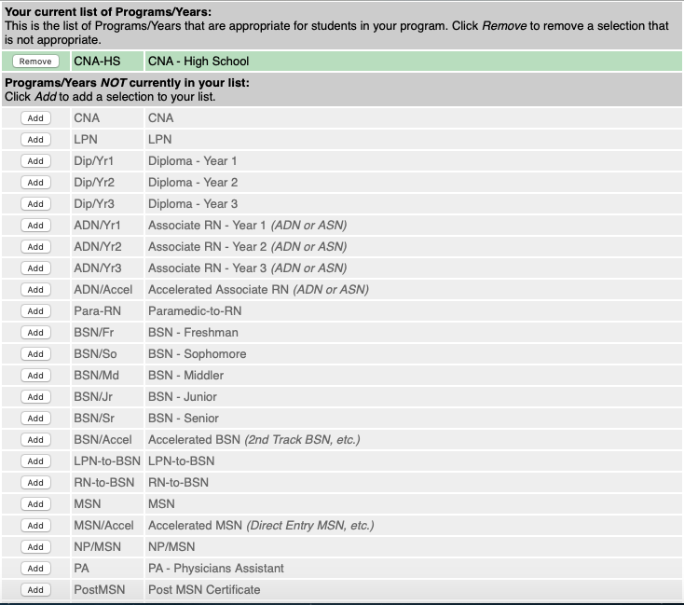
Nursing Program Online Orientation Admin Page
Admin Page
Program/Year List
Program/Year List updated for July 1, 2020.
Please review your list.
Add / Remove choices as appropriate.

Slide 21
FY 2021 Sustainability Update
FY 2021 invoices emailed to nursing programs & HCOs.
We review the fee model annually.
For FY 2022:
  In light of COVID, anticipate no changes to the fee model for FY 2022.
  Had previously planned a change in way nursing programs’ capacity fee was calculated.
    The number of student/faculty online orientation certifications will be used as the basis for a program’s capacity fee.
  The multiplier will stay at $6.50.
  Will calculate two fees: capacity and usage.
  Pay the lesser of the two or $400 minimum fee.
  Will share FY 2022 fees in February conference call.
  Reminder: By early December will be collecting (through the website) the one number that equals the total number of individual (non-duplicated) students enrolled at your nursing program between September 1, 2019 – August 31, 2020.
  Questions: Marie, 781-891-8860 / marietobin1@gmail.com

Slide 23
CCP Website Updates
COVID-related updates:
  Temp Release / Temp Release Limit
  Max Number of Students on Unit
  Viewing Partner Notices
  Sequencing of Placement Segments
Online Orientation updates:
  HCO Admin page
  Nursing Program HCO List / Self-Managed HCOs
  AY 2020-2021 Online Orientation Content
Additional updates:
  Demographic Survey Reporting
  Faculty Database updates
  Sustainability Enrollment Reporting
Ongoing/proposed development:
  Instructor/Faculty Naming Conventions
  Program-Specific Orientation Information
    Placements and preceptorships
    Online orientation Instructor List (for placement assignments)
  Names can be entered inconsistently making it difficult to filter, search, and generate reports by instructor.
Proposal:
  Entering all instructor/faculty names in a [last name], [first name] format.
  Last name only is also acceptable.
  Titles and credentials (Professor, RN, PhD, etc.) should not be entered.
  Can use nickname instead of formal first name if it is generally used.
  Placeholder names (e.g. “TBD for NUR123”) okay if necessary.
  Additional information could be added but should be added only if necessary:
    “Lopez, Maria & Smith, John” (if two instructors for a placement)
    “Doe (Jones), Pat (if recent last name change)
  We would automatically convert names already in the database to this format where possible.

Slide 24
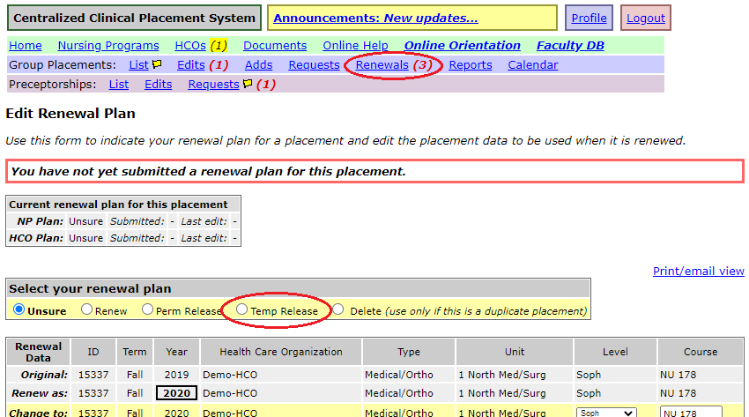
Temp Release Review
Review of Temp Releasing:
  During each term’s renewal timeframe, nursing programs need to indicate if they would like to renew each placement they used that term in the previous year.
  If a program does not need a placement for the upcoming term but hopes to use it the following year, they may be able to renew a placement as a temporarily released placement (a “Temp Release”):
  This allows the HCO to temporarily assign the placement to another program for the upcoming term but the original program will retain the right to request renewal of the placement for the next year.

Slide 25
Temp Release Limit – COVID Change
HCOs can limit the number of times a program can consecutively temporarily release a placement.
  Once a placement as reached this limit, a nursing program will no longer see an option to renew the placement as a Temp Release.
  The default limit is one, but HCOs can also set this limit to zero to prevent any Temp Release requests.
To accommodate special needs during the COVID pandemic, Temp Releases during 2020 are not being counted against the Temp Release Limit.

Slide 26
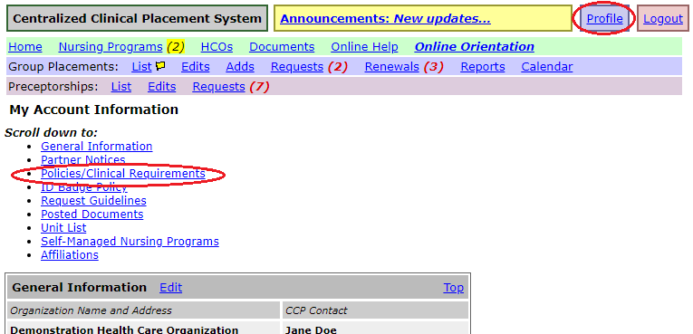
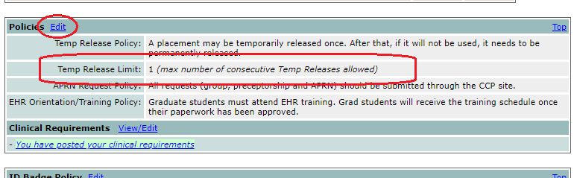
Viewing Temp Release Limit
Health care organizations can view and set their Temp Release Limit in the Policies section of their Profile:

Slide 27
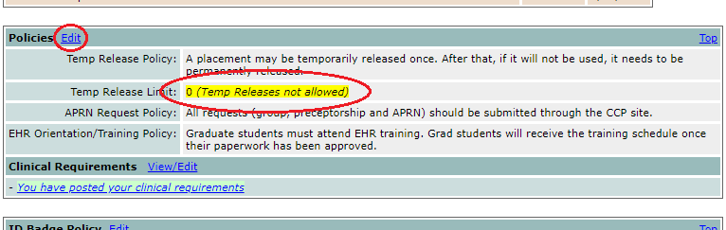
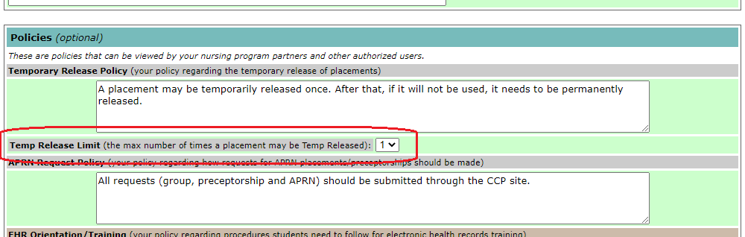
Changing Temp Release Limit
HCOs: If your Temp Release Limit is set at zero (no Temp Releases allowed), it will be highlighted:
To change your Temp Release Limit, select a number from the dropdown menu on the edit page:

Slide 28
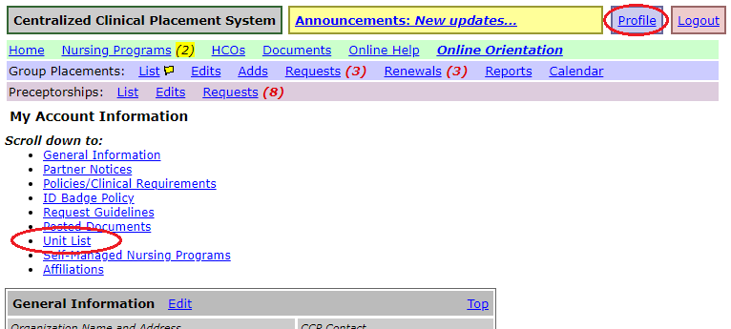
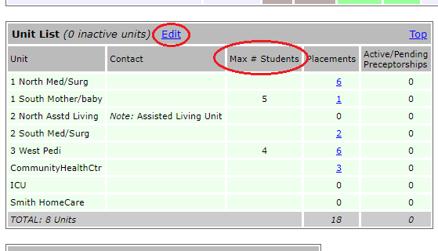
Unit Max Number of Students – Review
HCOs can optionally indicate the maximum number of students allowed on a unit.
This is set in the Unit List section of the HCO’s Profile page.
Click the Edit link to open the list for editing.

Slide 29
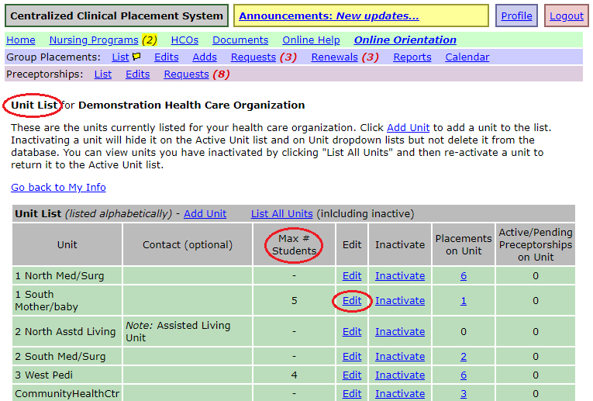
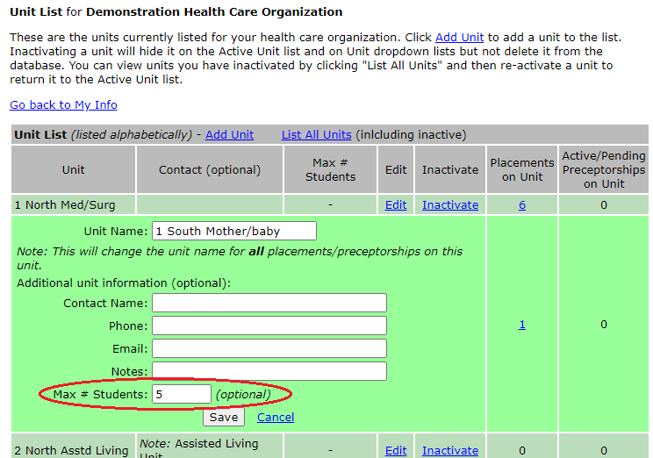
Unit Max Number of Students – Editing
Clicking the Edit link for a unit will allow you to set the Max Number of Students.

Slide 30
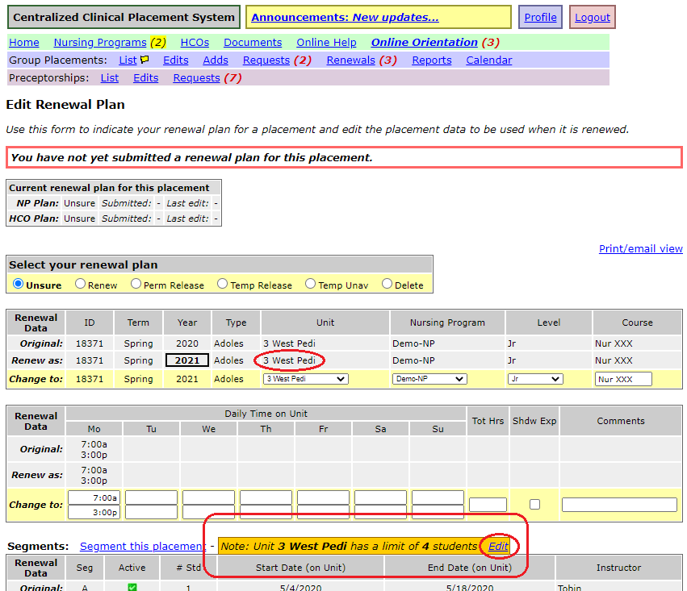
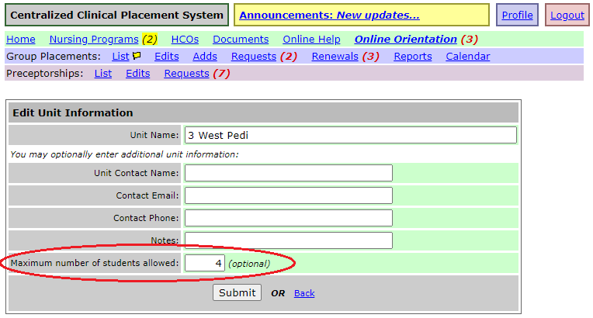
Unit Max Number of Students – Renewal Display
If a Max Number of Students is set for a unit, it is now displayed on the renewal page for placements on that unit (but it is not otherwise enforced by the CCP).
For convenience, for HCOs, there is an “Edit” link to allow the HCO to change the Max Number directly from this page via the “Edit” link.

Slide 31
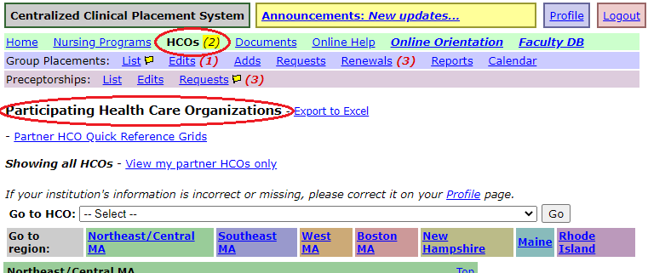
Viewing Partner Notices (1)
Both HCOs and programs can post Partner Notices for their placement partners to read (notices are posted via the Partner Notices section of your Profile page).
If you have unread notices from a partner, you will see a highlighted number next to the Nursing Programs or HCOs link on the menu bar.
Click the link to open the list of organizations:

Slide 32
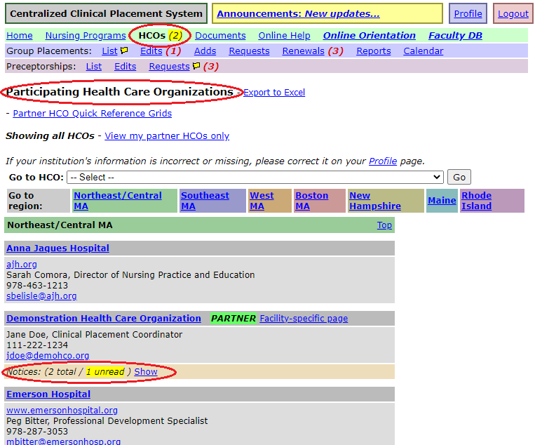
Viewing Partner Notices (2)
Unread notices are highlighted on the organization list.
Notices on the organization list are now “collapsed” by default to make the page easier to scroll through.
Click the “Show” link to expand an organization’s list of notices.

Slide 33
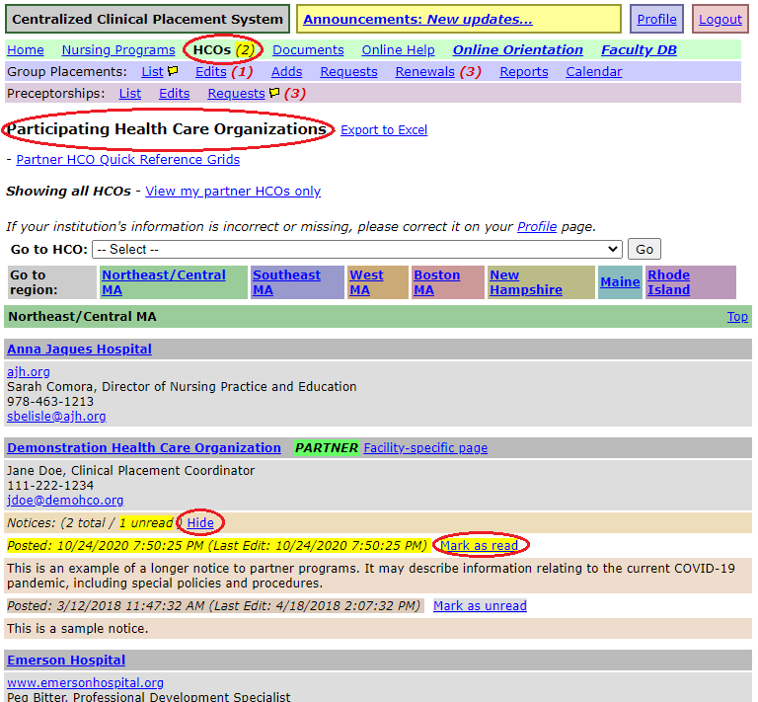
Viewing Partner Notices (3)
When notices are expanded, you can click the “Mark as read” link to mark the notice as read an remove the highlight.
You can click the “Hide” link to collapse an organization’s notice list

Slide 34
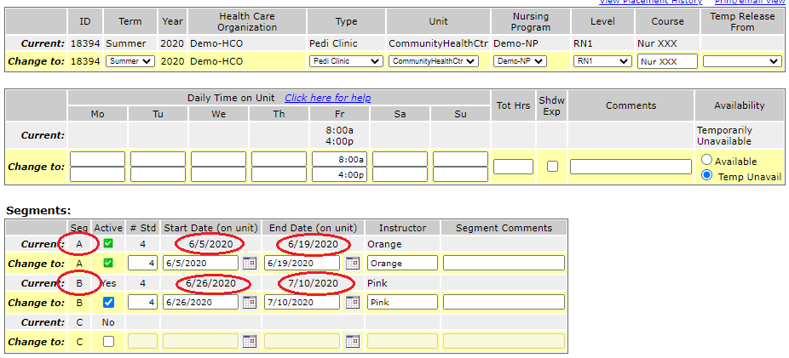
Sequence of Placement Segments (1)
Review of segments:
  If more than one group of students rotates through the same placement slot during a term you can “segment” the placement instead of creating a separate placement for each group.
  Managing a single segmented placement is generally easier than managing multiple placements.
Typically, segments are consecutive: the first group (“A” segment) has the placement for the first few weeks, then the next group (“B” segment):

Slide 35
Sequence of Placement Segments (2)
But there are multiple ways that student groups may rotate through a placement:
  Consecutive (shown on prior slide):
    For a placement that runs 12 weeks, Group A is on the first 6 weeks, Group B is on the second 6 weeks.
  Alternate Weeks:
    Group A is on weeks 1, 3, 5, 7…; Group B is on weeks 2, 4, 6, 8….
  Alternate Days:
    For a Tuesday/Thursday placement, Group A is on Tuesdays and Group B is on Thursdays.
  Split Days:
    For 7am-3pm placement, Group A is on from 7am-11am and Group B is on from 11am-3pm.
(The above examples assume two segments but the same concepts apply to three-segments as well.)
Currently there is no way to indicate the “sequence” of segments that are not consecutive (except by putting in a comment).

Slide 36
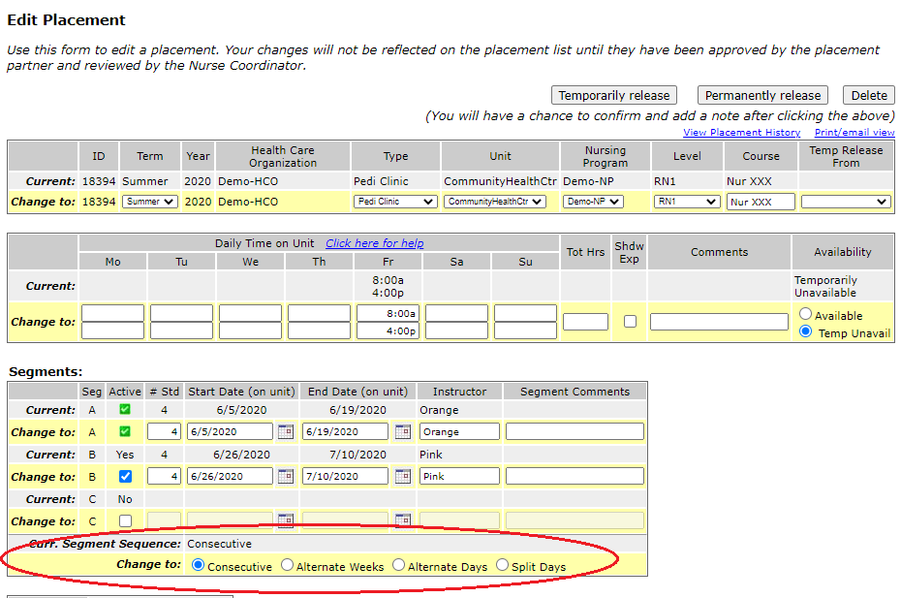
Sequence of Placement Segments (3)
Proposal: add a field that will allow you to indicate the “Segment Sequence” of a segmented placement.
Either: Consecutive, Alternate Weeks, Alternate Days, or Split Days.
Makes it easier for the HCO to understand and allows for more accurate reporting of student time.

Slide 37
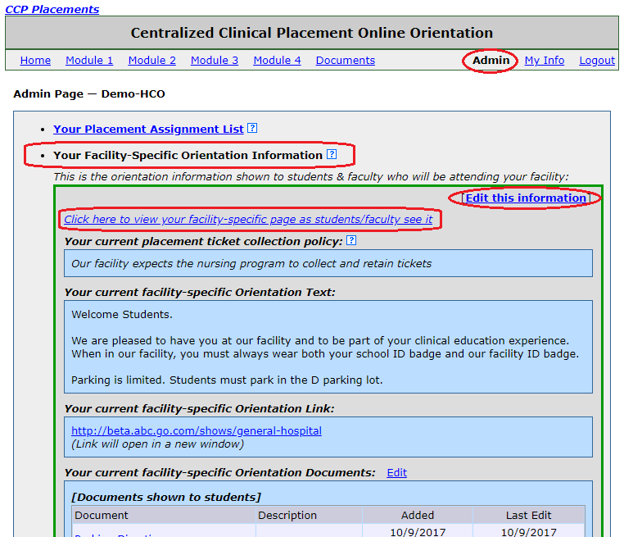
HCO Online Orientation Admin Updates (1)
The HCO Online Orientation Admin page has been updated to more clearly display your Facility-Specific Orientation Information (outlined in green box).
Use the “Click here to view your facility-specific page as students/faculty see it” link to see your information as students/faculty see it.

Slide 38
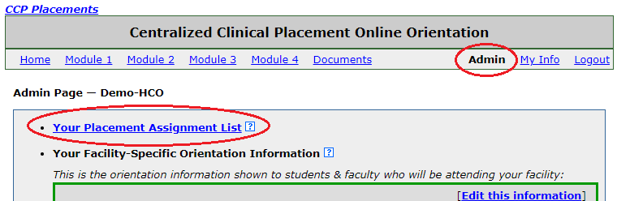
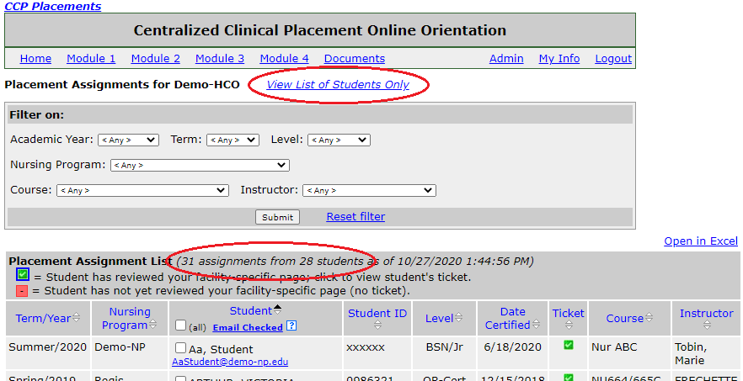
HCO Online Orientation Admin Updates (2)
Review: Your Placement Assignment List shows each assignment that students have entered for your HCO.
Some students may have more than one assignment. To see a list of unique students only, click the View List of Students only link (in development):

Slide 39
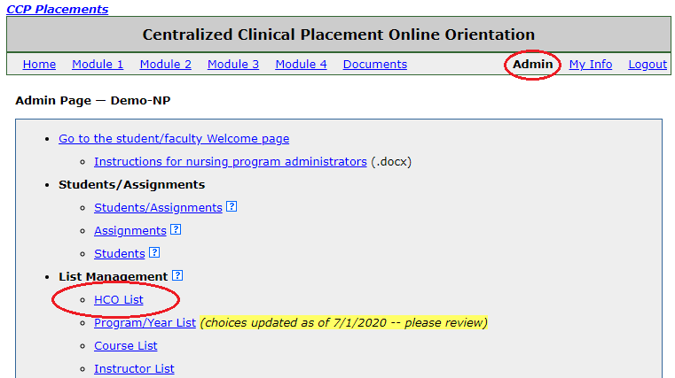
Nursing Program HCO List Updates (1)
Review:
  Nursing programs must manage the list of HCOs at which their students may be placed. This creates the list of HCOs that students can choose from when they enter their placement assignments.
  Nursing programs can add both participating (CCP member) HCOs and “self-managed” (not in CCP) HCOs to their list.
  The HCO list should be reviewed prior to each term and academic year.

Slide 40
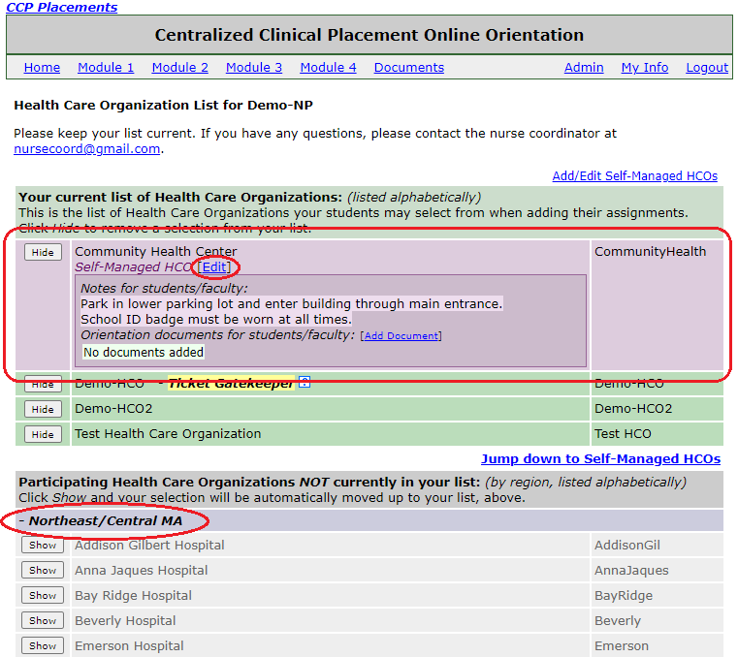
Nursing Program HCO List Updates (2)
Updates to HCO List page:
  Better highlighting of Self-managed HCOs and notes for students.
  Easier editing of self-managed HCO information.
  List of participating HCOs that have not been added are grouped by region.

Slide 41
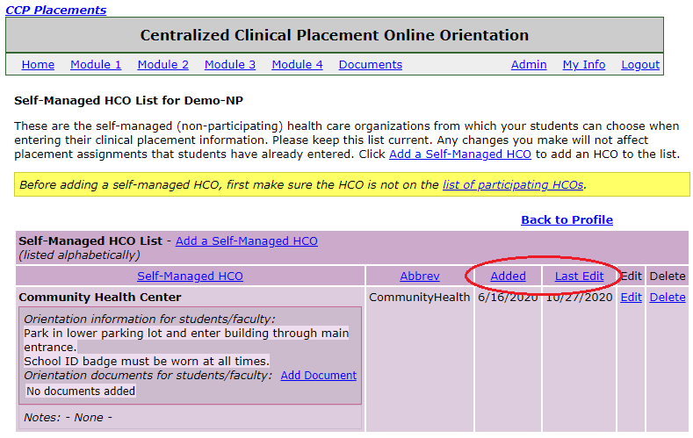
Nursing Program HCO List Updates (3)
On the Self-Managed HCO List page:
  Columns added to show date of Add and Last Edit.
  Ability to sort list by Name, Abbreviation, Add Date, or Last Edit date.

Slide 42
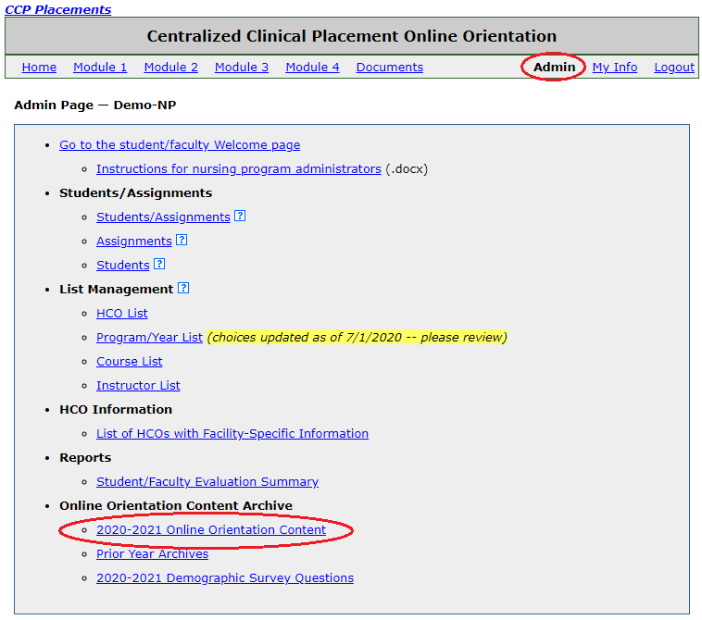
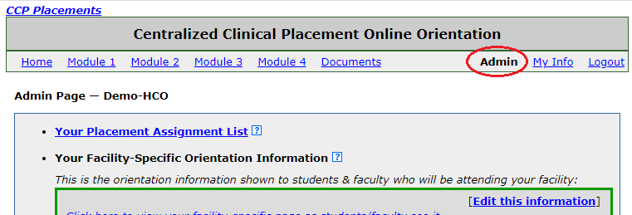
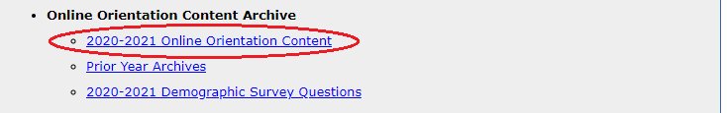
2020-2021 Online Orientation Content (1)
The Online Orientation content for the 2020-2021 academic year can be access via your Online Orientation Admin page.
Click the link in the Online Orientation Content Archive section.
Nursing Program Admin page:
HCO Admin page:
… … … … … … … …

Slide 43
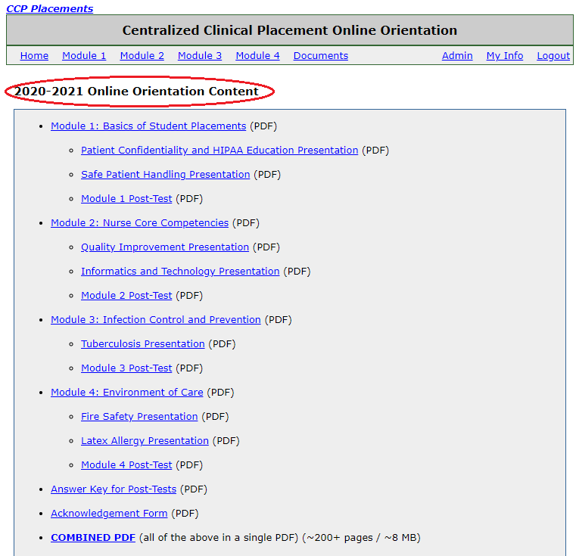
2020-2021 Online Orientation Content (2)
The Online Orientation Content page contains PDF links to the centralized online orientation material presented to students and faculty for the 2020-2021 academic year (7/1/2020 – 6/30/2021).

Slide 44
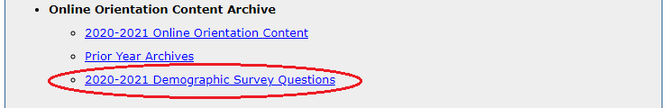
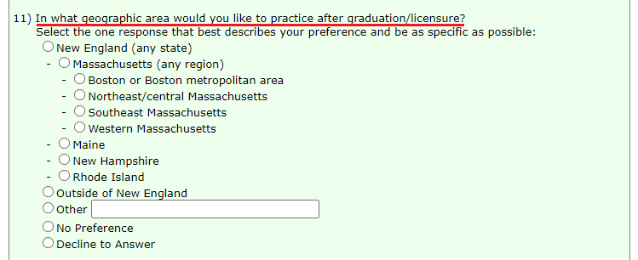
Demographic Survey – Location Preference (1)
Location preference question added to the AY 2020-2021 Demographic Survey.
Can view the Demographic Survey from your Online Orientation Admin page (link at the bottom of the page).

Slide 45
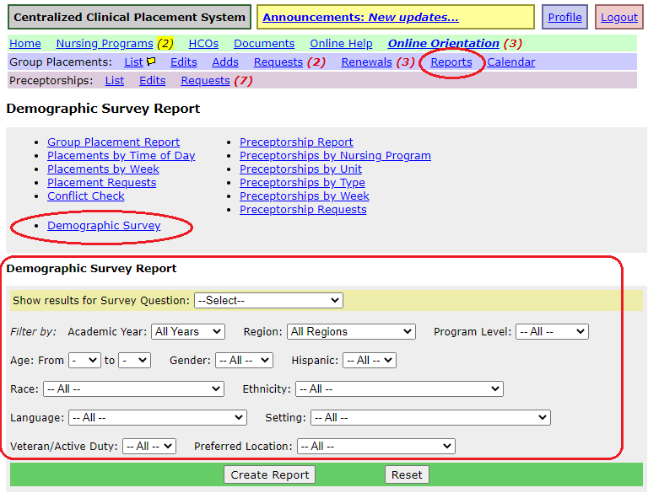
Demographic Survey – Report
Reminder: Can created reports of Demographic Survey data in the Reports section:
Report tools allow you to specify a survey question and filter results on one or more other survey responses.

Slide 46
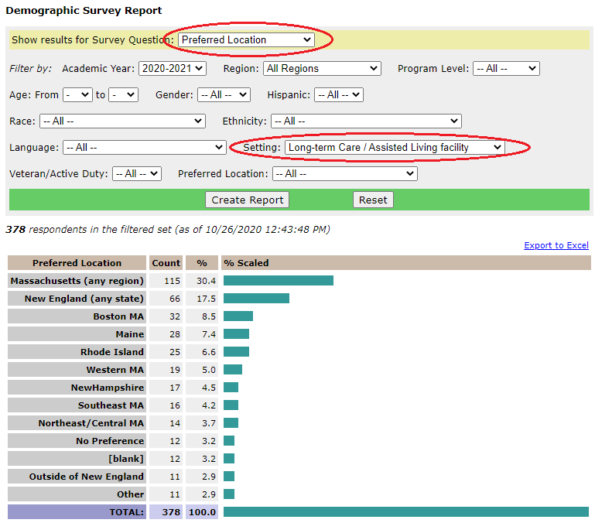
Demographic Survey – Report Example (1)
Example report of Preferred Location of students interested in working in a “Long-term Care / Assisted Living facility” practice setting (2020-2021 responses only):

Slide 47
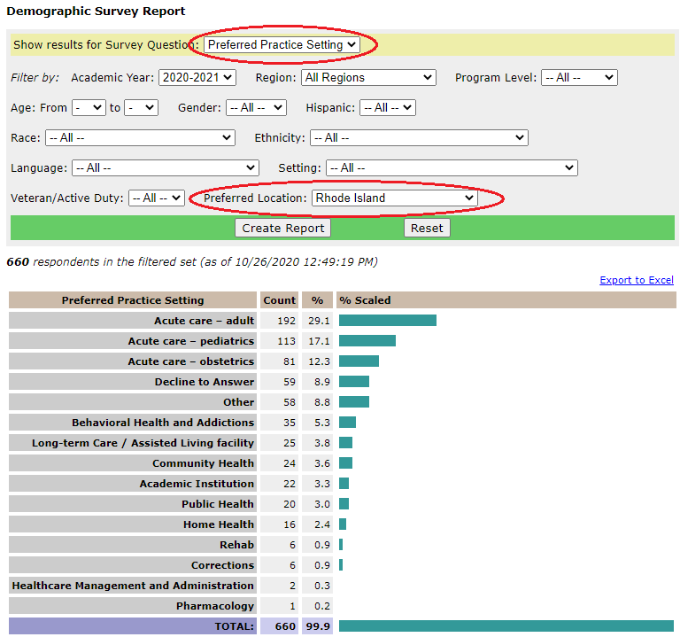
Demographic Survey – Report Example (2)
Example report of Preferred Practice Setting of students interested in working in Rhode Island (2020-2021 responses only):

Slide 48
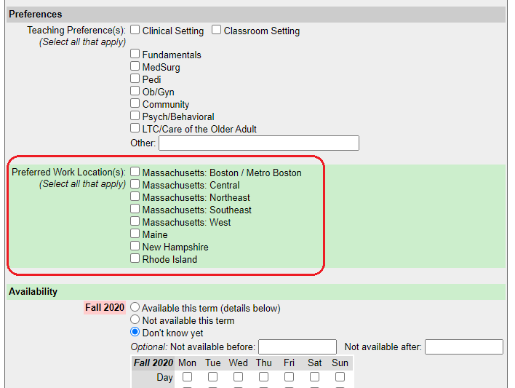
Faculty Database – Preferred Work Location
Review: the Faculty Database is a job-matching site on the CCP that allows faculty candidates to post profiles and nursing programs to post open positions.
Starting in this academic year, faculty candidates can enter one or more “Preferred Work Location(s)” as part of their profile.

Slide 49
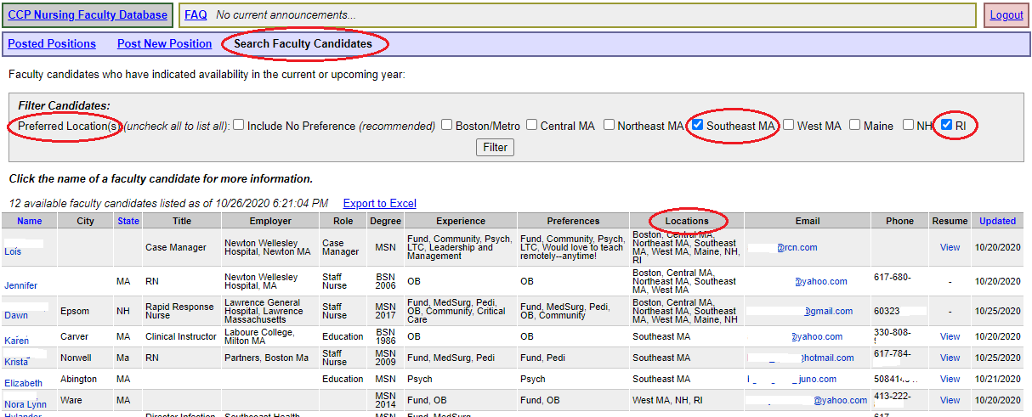
Faculty Database – Search by Preferred Location
Nursing programs can search for faculty candidates based on their work location preferences.
  Above example filters on candidate who prefer Southeast MA or Rhode Island.
Check “Include No Preference” to include candidates that have not entered a location preference.

Slide 50
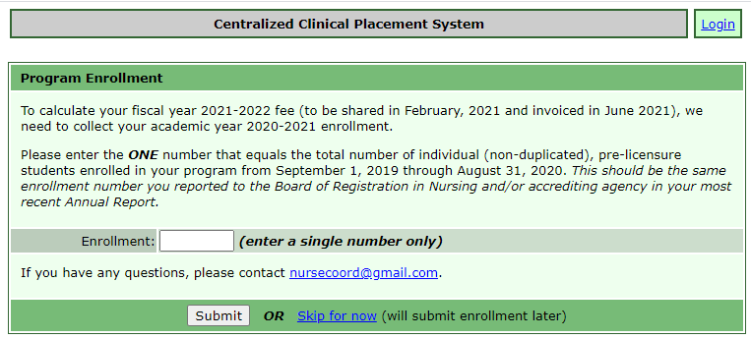
Sustainability – Program Enrollment Reporting
Nursing programs: In advance of fiscal year 2021-2022 fee preparation, we will collect your program enrollment number via the website.
Starting in mid-November, after logging in, you will be prompted for your reported 2019-2020 enrollment. The number will be shown on your profile.
Used to calculate your “capacity fee” for FY 2021-2022. As with previous years, you will be invoiced the lower of your capacity fee or your usage fee.

Slide 51
Proposal: Instructor/Faculty Naming Conventions
Review:
  Instructor/faculty names are entered in several places in the CCP:
    Placements and preceptorships
    Online orientation Instructor List (for placement assignments)
  Names can be entered inconsistently making it difficult to filter, search, and generate reports by instructor.
Proposal:
  Entering all instructor/faculty names in a [last name], [first name] format.
  Last name only is also acceptable.
  Titles and credentials (Professor, RN, PhD, etc.) should not be entered.
  Can use nickname instead of formal first name if it is generally used.
  Placeholder names (e.g. “TBD for NUR123”) okay if necessary.
  Additional information could be added but should be added only if necessary:
    “Lopez, Maria & Smith, John” (if two instructors for a placement)
    “Doe (Jones), Pat (if recent last name change)
  We would automatically convert names already in the database to this format where possible.

Slide 52
“Program-Specific” Orientation Information?
Review:
  Students must complete the centralized online orientation modules before they can enter their placement assignments.
  Health care organizations can post “facility-specific” orientation information that students must sign off on prior to receiving a placement ticket for the assignment they have entered.
Questions:
  Would it be useful for nursing programs to optionally be able to post “program-specific” information that students would need to sign off on prior to entering any placement assignments?
  Would it be helpful to allow students to do any sort of reporting on their placements?
    Hours tracking? (Is there a general/sample template?)
    Placement evaluations? (Is there a general/sample template?)
    Issue: how would nursing programs enforce?
  This is the opening of this discussion – aim is to collect feedback. Feel free to email thoughts to marietobin1@gmail.com.

Slide 53
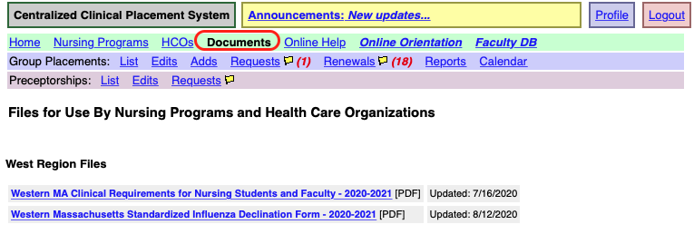
Open Forum – Western MA Clinical Requirements
  A reminder:
  To access these documents, login to the site.
  Click on the “Documents” link in the Home (green) toolbar.
Western MA Clinical Requirements
  The requirements can change from year to year.
  For 2020-2021, have posted:
    Western MA Clinical Requirements for Nursing Students and Faculty.
    Western MA Standardized Influenza Declination Form.

Slide 54
Meeting Check Out
Planning for upcoming West meetings:
  Winter 2021 (February)
    Will be a Zoom webinar/conference call.
    Will get back to you with possible dates.
  Spring 2021
  Will get back to you with possible dates
Group Check-out
54
54
54
54
Notes:
54
54

Slide 55
CCP Reminders

Slide 56
CCP Reminders
Keep the Database Current
  Prompt action by ALL clinical partners is necessary for accurate placement lists, unit calendars and ease of use.
  Alert clinical partners to significant changes/denials to placements as soon as you are aware of them. Let partners know of the changes/denials in CCP and by phone call or email.
  Winter/Spring 2021 Renewals
  EVERY placement needs a plan.
Nursing programs: Initiate renewal process.
  Start with Renewal Planning Worksheet.
  Worksheet supports the renewal process; easier and more accurate, use has been requested by the HCO’s.
  If a placement is not “Listed”, can’t assume that you have it.
Health Care Orgs
    Start with renewals, then review new opportunity requests.
    If you renew/approve a placement then it’s Listed = Confirmed.
    You need to renew Open placements; those with no nursing program partner.

