Slide 1
STATE FINANCIAL AID PROGRAMS 2020-2021 TRAINING WORKSHOPS
Office of Student Financial Assistance | September 15, 2020

Slide 2
State Financial Aid Training Workshop
ZOOM Meeting Protocol
Muting audio and turning your video off will result in a better connection
Questions may be submitted via chat
Every attempt will be made to respond to questions after each section, or at the conclusion of the presentation
As an option, you may submit questions directly to a specific presenter via email, or to OSFA’s general mailbox: osfaweb@dhe.mass.edu
If our Zoom connection experiences an interruption or other technical difficulties, please leave the meeting and then reconnect

Slide 3
2020-2021
PRESENTERS
Clantha McCurdy
Senior Deputy Commissioner
Robert Brun
Senior Associate Commissioner
Alison Connolly
Senior Associate Director
Stephanie Perez
Program Manager
Leslie Garcia
Assistant Director
Tim Cronin
GEAR UP Data Utilization Coordinator

Slide 4
2020-2021
Workshop Agenda
  9:30-9:35 Welcome & Introductions
  9:35-9:45 Impact of COVID-19
  9:45-10:05 DHE Policies, New Initiatives & Legislative Update
  10:05-10:25 Financial Aid Program Highlights
  10:25 – 10:30 Q&A
  10:30 – 10:50 Adopted & Foster Children Programs
  10:50-11:15 No Interest Loan Program
  11: 15-11:25 Policy Changes, New Services and MASSAid Enhancements
  11:25-11:50 MASSGrant Program Overview
  11:50-12:00 Wrap-up Discussion/Closing

Slide 5
2020-2021
COVID-19

Slide 6
Department of Higher Education
COVID-19
The onset of COVID-19 created challenges for higher education. As a response, OSFA implemented policies to provide relief and assistance to students and their families, and to institutions:
Last day in the office was Friday, March 13, 2020
Within two-weeks, OSFA had a fully functioning Remote Call and Operations Center, with an ability to conduct all business off-site
DHE/OSFA began to track and adjust policies for alignment with changes at the federal level, working closely with the Governor’s Office, Secretary of Education, campus leadership within the public and private higher education system, AICUM, etc.

Slide 7
Department of Higher Education
COVID-19
Collaborated with Governor to implement funding allocations for higher education under the CARES Act
Granted relief to institutions and/or students, based on certain federal policies or regulatory changes
Suspended all repayment and collection activities for the NIL borrowers, during the months of April, May June and July
Extended the priority deadline for various aid programs
  MASSGrant deadline extended to July 1, 2020
  Paraprofessional Teacher Preparation Grant deadline extended to August 15
  Early Childhood Educators Scholarship deadline to October 1st

Slide 8
Department of Higher Education
COVID-19 Emergency Fund
Governor’s Emergency Education Relief Fund (GEER Fund)
  $2.5m supplemental appropriation to public community colleges
  Emergency need-based assistance
  Two component allocation: base allotment and variable, based on FTE
  Full – or part-time students – must be enrolled in an eligible degree or certificate program
  Funds may be granted to cover educationally related expenses defined within the standard Cost of Attendance (books/supplies; room/board (rent); childcare; health care (insurance, emergency treatment); dental; technology expenses (computer, laptop, Wi-Fi); transportation; clothing and other personal expenses, etc.
  Assistance based on documented COVID related emergencies
  Cannot exceed $1000 per student for the academic year

Slide 9
New Initiatives & Legislative Update
Massachusetts Department of Higher Education
Office of Student Financial Assistance

Slide 10
Department of Higher Education
FY2020-21 Goals and Objectives
The Massachusetts Board of Higher Education aims to sustain and expand on Massachusetts’ unique leadership position in higher education as defined by the strength and reputation of our private and public postsecondary institutions and our nation-leading level of attainment among our adult citizens.
To further realize those goals and to ensure that public higher education opens doors of opportunity and fulfilment for traditionally underserved populations…
We elect to make our top statewide policy and performance priority:
Significantly raise the enrollment, attainment and long-term success outcomes among
under-represented student populations.

Slide 11
Department of Higher Education
Statewide Priority Objectives
Our singular focus is on ensuring that the public higher education system continues its historic mission of serving as a catalyst for social mobility and as a bulwark against social and income inequality. Policy decisions are driven by the expectation that students’ academic progress is our prime consideration.
To that end, Massachusetts must achieve these objectives:
Make college more accessible and
affordable for all Massachusetts residents
Close gaps in student opportunity
and achievement
Improve college completion rates

Slide 12
Department of Higher Education
A New Vision: EQUITY
Collaboration and research underway to produce a systemwide strategic plan placing equity for underrepresented populations as the top performance and policy priority for Massachusetts public higher education
Recent announcement of a $1.2m grant from the Lumina Foundation to support this work
Recognition as a Talent, Innovation and Equity (TIE) state, one of five in the country
Work began in 2019 with a four-day intensive internal staff training

Slide 13


Slide 14
Department of Higher Education
EQUITY AGENDA – Action Plan
The DHE will implement a five-step plan:
Policy Audit
  Audit and access all policies and initiatives
  Identify and remove those that exacerbate racial inequity
  Redesign the policy scheme to build a culturally sustainable public postsecondary system where students can thrive
Student Experience
Data & Evidence
Community Practice
Sustained Transformation

Slide 15
Department of Higher Education
EQUITY AGENDA – What it means for State Financial Aid
A Redesign of Massachusetts State Financial Aid to make higher education more accessible for all students by increasing effectiveness and efficiency:
Address the substantial unmet financial need facing many students and families
Consolidate programs with similar goals
Repackage the Massachusetts system of tuition waivers into a grant program
Apply lessons learned and innovations from pilot programs to existing aid programs
Improve communications regarding state financial aid programs for clarity and increased awareness
FY21 will result in an examination of all State Financial Aid policies to ensure that the above goal recommended can be achieved

Slide 16
Department of Higher Education
Equity Agenda
More information at:
www.mass.edu/equity
Join the DHE’s email list:
www.mass.edu/newsletter

Slide 17
Department of Higher Education
School Closings – A New Era
The Massachusetts Board of Higher Education is required by statute and regulation information to annually assess the financial information of private institutions of higher education for the purpose of identifying and monitoring institutions at risk of imminent closure, and mitigating the impact of closures on students, their families, faculty, staff and the community.
Between 2014 and 2020, eighteen (18) colleges in the Commonwealth have either closed or merged with another institution
Sudden closure of Mount Ida College resulted in the BHE convening a working group to determine how the DHE could better serve the students of the Commonwealth and mitigate the impact of future closings

Slide 18
Department of Higher Education
School Closings – A New Era
The Transitions in Higher Education: Safeguarding the Interest of Students (THESIS) report issued in 2018, accepted by the BHE in 2019
New legislation and regulation issued mandating the BHE/DHE annually assess the fiscal health of all private institutions located in Massachusetts to ascertain the risk of closure
Fiscal Assessment and Risk Monitoring (FARM) process
Seeks to protect students and the institution’s constituents by minimizing the disruption of closures
610 CMR 13.00 and M.G.L. c.69 S. 31B

Slide 19
Department of Higher Education - OSFA
Legislative Update – FY 21 Budget
Fiscal Year 21 Budget - Projected Funding Levels
        General Scholarship – 7070-0065
        $104 Million
        Represents lower of FY20 and Governor’s House I Budget
        House and Senate Ways & Means Budget not yet available
Foster & Adopted Fee Waiver Program 7066-0021
        $6,511,015 (FY 20 budget minus Supplemental appropriation)
        Foster Child Grant – 7066-0016
        $1,376,000
        High-Demand Profession Scholarship Program – 7070-0066
        $500,000 (FY20 budget, without Supplemental)
Final FY21 budget may result in funding reductions for various programs, if less than projected. In all cases, OSFA will preserve MASSGrant funding to avoid award revisions for high need students.

Slide 20
Department of Higher Education - OSFA
Legislative Update – FY 2021 Budget
7070-0065 General Scholarship Account
  MASSGrant
  MASSGrant Plus
  Early Childhood Educators Scholarship
  Paraprofessional Teacher Preparation Grant
  Gilbert Matching Grant
  Cash Grant
  Part-Time Grant
  Christian Herter Scholarship
  Washington Center Internship
  One Family, Inc. Scholars Program

Slide 21
Financial Aid Programs Highlights
2020-2021

Slide 22
Public College Programs
Commonwealth Commitment
Partnership between 2-year and 4-year public institutions
  First cohort of participating students – 2016-17
  Opportunity to complete bachelor’s degree at a cost savings that averages $5,090 over four years:
    Provides 10% tuition & fee rebate every semester to participants
    An additional MassTransfer tuition credit – bachelor’s program
Student must complete a minimum of 15 credits and earn a minimum 3.0GPA to receive the 10% rebate
Tuition freeze at two and four-year colleges for participants who complete the associates, transfers and earns the bachelor’s within two years
Commitment currently offers transfer pathways in twenty-four degrees programs
Rebates funded by DHE through financial aid appropriation and awarded to student at the end of term

Slide 23
Public College Programs
MASSGrant Plus
New initiative for FY19, viewed as an extension of the MASSGrant program, with additional benefits to students
First available in FY19 to Community College students, enrolled full-time (12 credit minimum) or part-time (6-11 credits)
Goal of this initiative is to address “unmet need” ensuring that community college students have sufficient resources to meet tuition/fees and a modest book/supplies cost
Awarded as a “last dollar” grant to provide students with resources sufficient to meet costs for tuition/fees and books – after other aid is considered
$7.3million annual budget for the program; anticipate similar level of funding for FY21 (fall 2020-spring 2021)

Slide 24
Public College Programs
MASSGrant Plus
Full-time (12 credits or more) and part-time (6-11 credits) students are eligible
FAFSA completed as of November 1st
Student must meet all other requirements for state aid (MASSGrant), such as residency, no prior bachelor’s degree or loan default
Institutions are able to submit a request for reimbursement of funds for each semester
2020-2021 process will be integrated in MASSAid

Slide 25
Public College Programs
Cash Grant Program
Need-based grant awarded to full or part-time students
30,000+ students are assisted through this program annually
$25.6 million allocated in FY 2021
Allocations are formula-driven, based on a BHE approved policy, first implemented in FY2012
Formula considers three-year average of key factors:
- Institutional enrollment
- EFC = O – Pell EFC – (revised annually, as required)
- EFC = Pell to 10,000 (equivalent to median income)

Slide 26
Public College Programs
Cash Grant Program
Notification of FY 2021 allocations sent via mail – no change anticipated - based on Governor’s approval of final budget
Funds scheduled for two equal disbursements, fall and spring (anticipated for September 18 and January)
Funds may be awarded to full and part-time students
Grants may be awarded up to the cost of tuition/fees (student) as determined by the campus (guidelines)
Institutions are required to reconcile and submit an aggregate report to OSFA at close of each fiscal year
Institutions must reconcile by August 31st each year

Slide 27
Public College Programs
Tuition Waivers
Over 26 various financial aid related waivers offered annually
Annual cost to the Commonwealth generally exceeds $60 million
Popular waivers include the following:
  John & Abigail Adams Scholarship
  Need-Based Tuition Waiver
  Categorical Waivers
    Applies to Veterans, Senior Citizens and Native Americans
    Recipient may possess a prior bachelor’s degree – Senior Citizens Waiver
    Institution must waive state-supported courses
    Encouraged to waive non-state supported costs
    Courses must be applied to an eligible certificate or degree program
    Requires recipient to be matriculated
  Foster Child Tuition Waiver
  Adopted Child Tuition Waiver
  National Guard Waiver
  Paul Tsongas Tuition Scholarship Waiver
  Mass Transfer Tuition Waiver

Slide 28
Public College Programs
Tuition Waivers
Need-Based Waiver is the largest of all waiver programs, averaging $17 million annually
FY 2021 allocation for the Need-Based Waiver is based on funding model (identical to formula used for the Cash Grant)
Expenditure level periodically increased to reflect changes in enrollment and eligibility demands
Clarification of FAFSA requirement for certain waivers issued in the Dear Colleague letter series; guidelines updated to reflect changes
Institutions are required to reconcile and report all awarded waivers as part of the annual year-end data submission
Year-End Financial Aid Data File includes identifier for a larger number of waivers

Slide 29
Public College Programs
John & Abigail Adams Scholarship
  Implemented in 2004 - with an initial cohort of 13,000 students designated to receive scholarship in first year of college, starting fall 2005
  An average of 18,000 students designated annually - roughly 30% of students from each new class take advantage of the scholarship
  Award equals value of tuition only – ranging up to $1,742
  Duplicate Adams Scholarship letters may be obtained from the MA Department of Elementary and Secondary Education: (781) 338-3625 OR (781) 338-3640
  Appeals granted only under rare or extenuating circumstances:
    Adams Scholarship Committee
  Massachusetts Department of Higher Education
  75 Pleasant Street, 3rd Floor - Malden, MA 02148
    Must include appeal, copy of transcript and documentation to support extenuating circumstance
    Note: Students should not be encouraged to appeal if circumstances are not extenuating

Slide 30
Public College Programs
John & Abigail Adams Scholarship
BHE approved guidelines, as amended:
  Provides up to six years for designated students to receive the eight semesters of tuition scholarship waiver:
    Allows greater flexibility to the student
    Eliminates “consecutive” semester enrollment requirement
    Student retains eligibility after gap year or less than full-time status
    In all circumstances, student must maintain a cumulative 3.0 GPA
    Transfer students must also have earned the 3.0 GPA for eligibility
    Recipients are required to complete the FAFSA annually and enroll full-time
  Extends eligibility to students who are high school graduates and a United States Citizen or a non-citizen authorized by the federal government to live and work in the United States on a temporary or permanent basis

Slide 31
Financial Aid Programs
Early Childhood Educators Scholarship
Created in FY 2006 and is considered a workforce development initiative because it supports employment shortages in the early childcare and development area
Average expenditure is approximately $2million last three fiscal years, anticipate an increase in funding for FY2021
Awards cover cost of tuition, fees and some related costs for up to three courses (9 credits) per semester for an undergraduate program, based on the annual budget
One-year minimum employment as an early educator or provider for eligibility
Award values unchanged in 2020-2021, but credits may be limited
Programs of Study more streamlined – related majors no longer permitted for new applicants – previous recipients grandfathered

Slide 32
Financial Aid Programs
Early Childhood Educators Scholarship
Maximum award amounts
Public University
  $500 per credit, maximum of $4,500 per semester
Private College/University
  $500 per credit, maximum of $4,500 per semester
State University
  $400 per credit, maximum of $3,600 per semester
Community College
  $250 per credit, maximum of $2,250 per semester

Slide 33
Financial Aid Programs
Early Childhood Educators Scholarship
Institutions may complete certification and payment process online via the MASSAid system
Certification opens:
  August 27, 2020 – Fall
  January 25, 2021 - Spring
Similar to process used for the MASSGrant program, certification and request for payment may be controlled by institution – within dates set by OSFA
Institutions should assign a contact for the ECE Scholarship program within the MASSAid system
Institution can also review student award status in MASSAid

Slide 34
Financial Aid Programs
Paraprofessional Teacher Preparation Grant
Provides grants to currently employed public school paraprofessionals who wish to become certified to teach at K-12 level
Recipients must meet a two-year minimum employment requirement as a paraprofessional in a Massachusetts public K-12 school
Grants may be awarded to paraprofessionals with less than two years of employment if enrolled in a high-need discipline (Mathematics, Science, Foreign Languages)

Slide 35
Financial Aid Programs
Paraprofessional Teachers Preparation Grant
Grants are awarded on a per credit basis, with a maximum semester/year total determined by institution type - public or private
Recipients must teach for a specified time, based on number of semesters awarded
OSFA continues to experience a reduction in the average number of student participants in this program
Possible related to school budgets – many facing funding challenges for support services (paraprofessionals)

Slide 36
Financial Aid Programs
Paraprofessional Teachers Preparation Grant
Maximum award amounts
Public University
  $625 per credit, maximum of $7,500 per academic year
Private College/University
  $625 per credit, maximum of $7,500 per semester
State University
  $450 per credit, maximum of $6,000 per semester
Community College
  $250 per credit, maximum of $4,000 per semester

Slide 37
Financial Aid Programs
Paraprofessional Teacher Preparation Grant
Institutions must complete the PTPG certification and payment process online in the MASSAid system
Similar to process used for MASSGrant program, certification and request for payment may be controlled by institution – within dates set by OSFA
Certification opens
  August 27, 2020 - Fall
  January 25, 2021 - Spring
Institutions should assign a contact for the PTPG program within the MASSAid system

Slide 38
Financial Aid Programs
Part-Time Grant
Formula allocation
Student EFC = 0-5711 (Pell Eligible)
6-11 Credits (or the equivalent)
Eligible Degree or Certificate Program
Awards Range from $200 - $850 (based on institution)
Student may receive maximum award in one semester
2021 allocation notification expected by Sept. 21, funds disbursed by October 1st

Slide 39
Financial Aid Programs
Tentative Part-Time Grant Payment
SCHOOL TYPE AWARD EFC
INDEPENDENT $200 $850 0 - 5711
PUBLIC UNIVERSITY $200 $850 0 - 5711
PUBLIC STATE UNIVERSITY $200 $650 0 - 5711
COMMUNITY COLLEGE $200 $550 0 - 5711
NURSING $200 $400 0 - 5711
PROPRIETARY $200 $400 0 - 5711
VOC TECH $200 $400 0 - 5711

Slide 40
Financial Aid Programs
Gilbert Grant
Institutional allocation – formula-driven and based on a three-year average of institutional expenditure for need-based aid
2020-2021 Institution Applications currently available – Deadline was July 26, 2020
Recipients must meet all eligibility criteria, including full-time enrollment
$200 - $2500 annual maximum award
Recipient must demonstrate a $500 minimum need to be eligible
Year-End data required and matched

Slide 41

Financial Aid Programs
Christian A. Herter Memorial Scholarship

Slide 42
Financial Aid Programs
Christian A. Herter Memorial Scholarship
Competitive scholarship awarded to students who have encountered unusual hardships or extenuating circumstances
Twenty-five high school (sophomore or junior) students are selected to receive scholarships upon earning a high school diploma annually
Scholarship is portable to colleges throughout the U.S.
About one-third of the recipients are enrolled in colleges outside Massachusetts each year
Massachusetts awards an average of $1.2 million in scholarships to students annually

Slide 43
Financial Aid Programs
Christian A. Herter Memorial Scholarship
Certification of eligibility and reporting of other recipient information integrated into MASSAid system
Institutions must provide Cost of Attendance and financial aid information to facilitate determination of scholarship eligibility
MASSAid process for Herter is aligned with other programs (Foster Grant, GEAR UP Scholarship)
Scholarship award is determined upon submission of student level data
Disbursements are paid via EFT

Slide 44
Financial Aid Programs
Christian A. Herter Memorial Scholarship
Herter Scholarship seeks to address unmet need – and reduce loan debt, where appropriate
Anticipated Certification:
  August 1 – Fall 2020 (currently available)
  January 02 – Spring 2021
Funds are disbursed via EFT, beginning August/September for fall; late January for spring – upon completion of certification
Institutions are required to reconcile awards each semester, and at the conclusion of the academic year

Slide 45
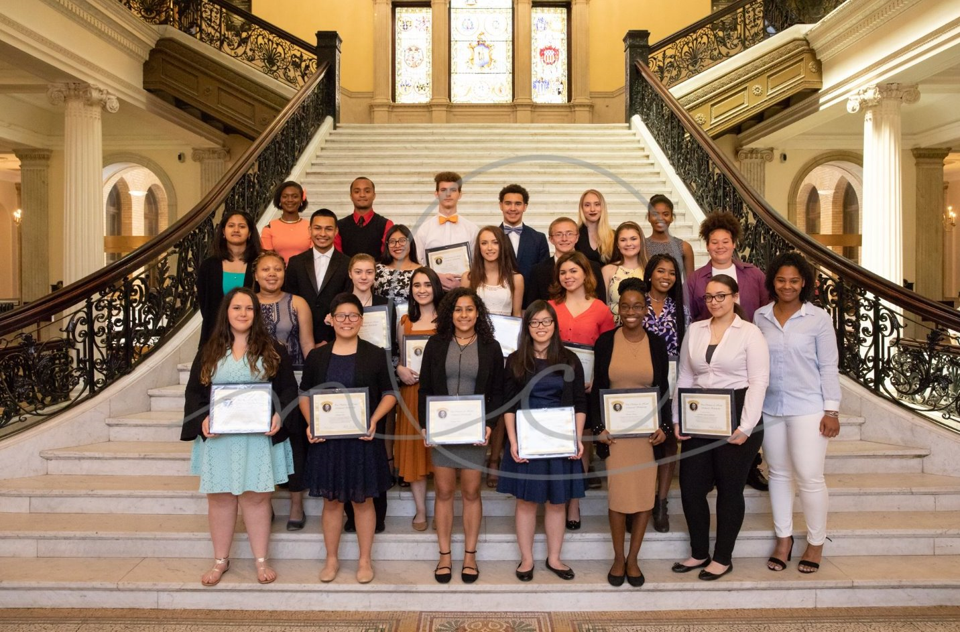
Financial Aid Programs
Christian A. Herter Memorial Scholarship

Slide 46
Financial Aid Programs
High Demand Scholarship Program
Purpose: to encourage degree completion in high demand disciplines to address workforce needs in the Commonwealth
Program initially funded and implemented in FY2013
Scholarship supports training and degree completion in disciplines that are deemed to be critical shortage areas (ex. STEM fields, health professions, accounting)
Recipients must be enrolled in a high demand degree or certificate program, as defined, in a Massachusetts public institution
Must demonstrate a commitment to the discipline

Slide 47
Financial Aid Programs
MHDS Program
Funding supports students across all sectors, UMASS, State University and community colleges that enrolled in designated disciplines
MHDA will be migrated to the MASSAid system for the 2020-21 academic year
Anticipate the online application process to begin in November 2020 for all students
FY21 will be directed to students in State Universities students, and to students enrolled in non-credit certificate training programs that may be expanded beyond STEM fields

Slide 48
Financial Aid Programs
MHDS 2021
Estimated FY21 appropriation: $500,000
FY2020 award eligibility open to state university students enrolled in STEM fields
Students must demonstrate commitment to their major through course selection and have a minimum GPA of 3.0
Students are required to complete an online application and submit an official transcript to be considered
Scholarships may be merit-based, or awarded to meet financial need
Program guidelines are available on OSFA’s website

Slide 49
Programs for Adopted and Foster Children
2020-2021

Slide 50
Financial Aid Programs
Adopted and Foster Child Fee Assistance Program
Provides for full tuition and fee waivers, based upon legislative appropriation, for foster children in the custody of the Department of Children and Families (DCF) and children adopted through this agency that choose to attend a Massachusetts public institution of higher education.
  Fee waiver awards are generally paid out as reimbursements for eligible billed fees.
    Schools can only request reimbursement for state-support supported credits (fees)
    UMASS CAMPUSES ONLY: due to tuition retention, schools can now request tuition and fees from OSFA
  FY2014 was the first year where 100% of all eligible fees were reimbursed
  The number of students assisted each year has shown a steady increase, growing from 550 in FY 2010 to 903 students in FY 2020

Slide 51
Financial Aid Programs
Adopted and Foster Child Fee Assistance Program
DCF Fee Assistance Totals
# of Students
Amount Paid

Slide 52
Financial Aid Programs
Adopted and Foster Child Fee Assistance Program
    Fall 2020 processing will begin on September 1, 2020 and extend until November 6, 2020
      Reminder email will be generated early September
    Spring processing will open on January 13, 2021 and extend until March 26, 2021
    Due to limited appropriation, OSFA will review any students submitted after the MASSAid deadline on a funds available basis with no guarantee of fee assistance awards

Slide 53
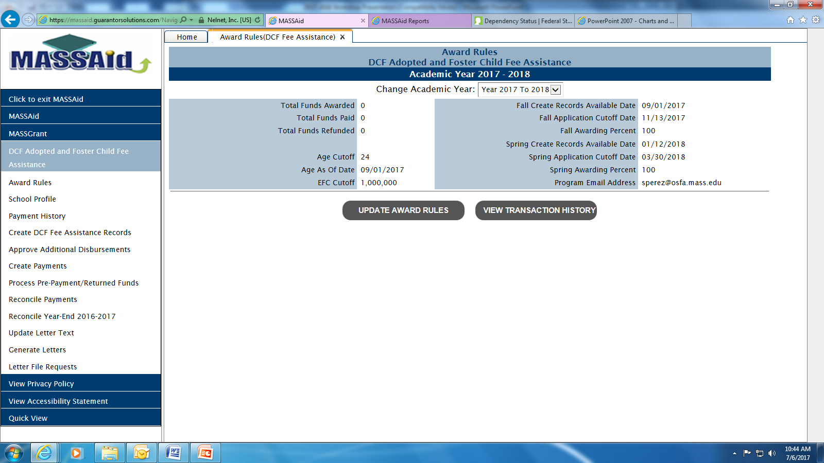
Financial Aid Programs
Adopted and Foster Child Fee Assistance Program

Slide 54
Financial Aid Programs
Adopted and Foster Child Fee Waiver Program
Adopted and Foster Child Fee Assistance Program FAQ’s
Students must be 24 or under as of September 1, 2020 to receive funding during 2020-2021
  If the student turns 25 during the academic year he/she may be awarded for both fall and spring semesters
Out-of-state students who were adopted through the MA DCF by an eligible MA resident or eligible MA state employee may participate in the fee assistance program
  Out-of-state students must have a current FAFSA on file and have submitted DCF eligibility documentation to their campus
  Out of state students are only eligible for fee assistance equivalent to the in-state resident rate and are responsible for any billed fees above that amount
  Campus must submit a hard copy of the students FAFSA to OSFA to complete eligibility review

Slide 55
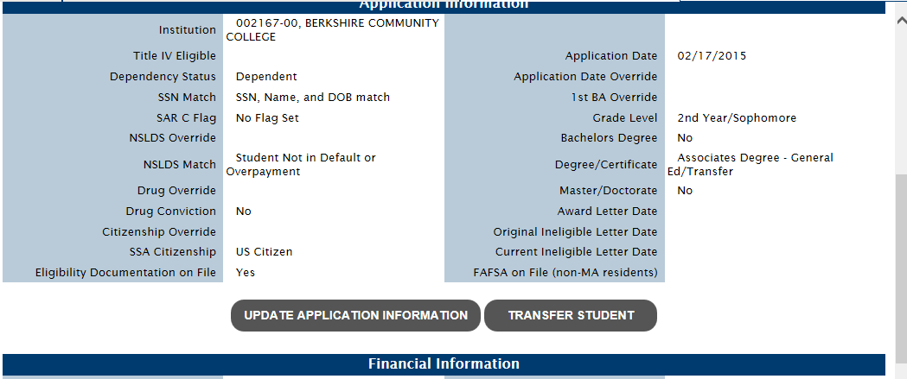
Financial Aid Programs
Adopted and Foster Child Fee Assistance Program
    DCF Eligibility documentation is tracked by MASSAid
      A student that has had eligibility documentation submitted by another institution and transfers does not need their paperwork re-submitted

Slide 56
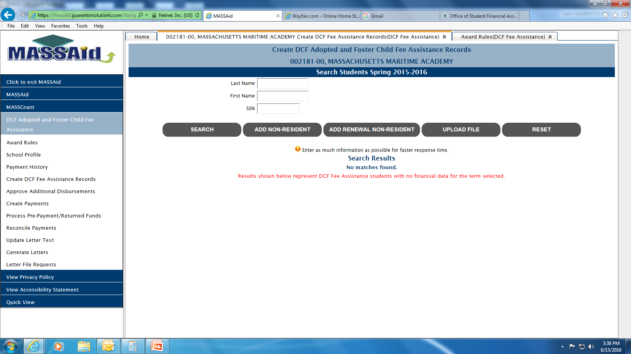
Financial Aid Programs
Adopted and Foster Child Fee Assistance Program
Creating DCF Records:
Notes:
All eligible students need to have a record created in MASSAid. Record creation needs to be completed for both fall and spring semesters. School administrators may add students manually by entering in last & first name along with the SSN or by using the upload file option. Please use the add non-resident option for all out-of-state students and “add renewal non-resident” for returning out-of-state students. When adding records for students, please do not include those that are ineligible due to no state supported credits, the system will not allow you to enter 0 as an award value.

Slide 57
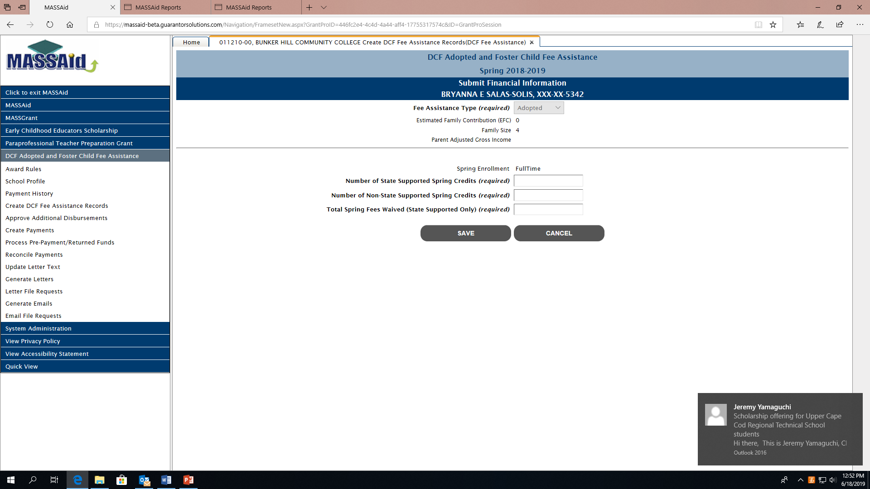
Financial Aid Programs
Adopted and Foster Child Fee Assistance Program

Slide 58
Financial Aid Programs
Adopted and Foster Child Fee Assistance Program
School users can only create Fee Assistance records for students that have their institution listed on their MASSAid account
Fee Assistance records should not be created for students that do not have any eligible fees that can be requested for reimbursement
Records need to be created for both fall and spring semesters
  Students that have a fall record will automatically appear on your list when you go to create spring records
Please run ‘Eligible Students’ and ‘Ineligible Students Report’ when you are done creating records

Slide 59
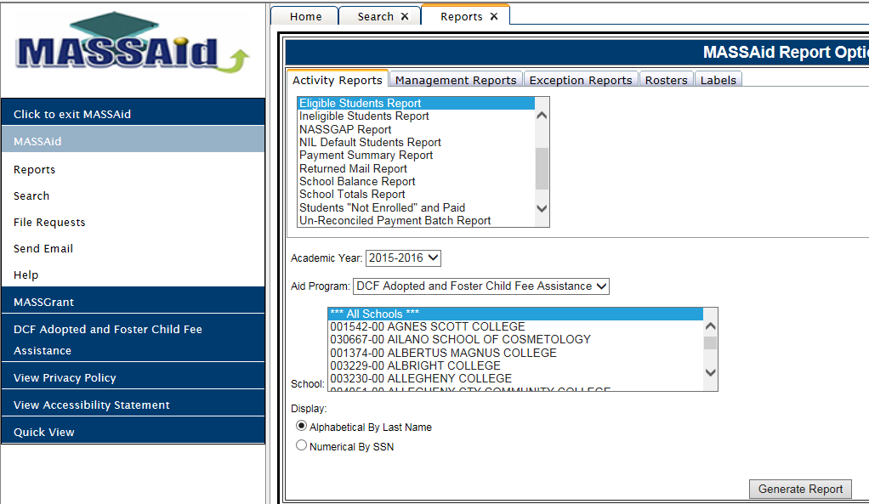
Financial Aid Programs
Adopted and Foster Child Fee Assistance Program
Notes:
After creating records for students, please remember to run an “ineligible students report” to see which students, if any, may need to submit eligibility documentation, a copy of their FAFSA, etc. You should also run an eligible students report to compare the schools internal list of students and fees to those that were entered in MASSAid.

Slide 60
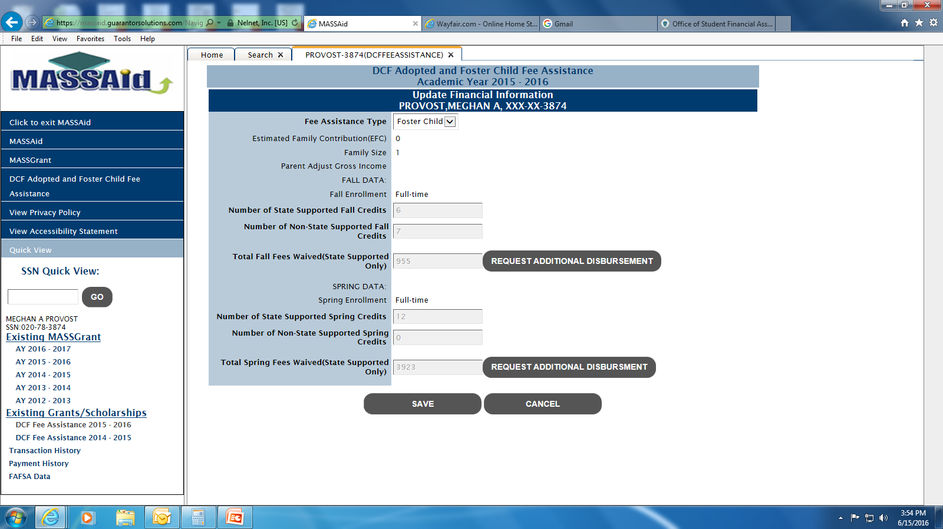
Financial Aid Programs
Adopted and Foster Child Fee Assistance Program
Requests for Additional Disbursements:
Notes:
If a student is in a “PAID” status and the school needs to request additional funds, the school administrator will need to access the student’s DCF record in MASSAid (via SSN quick view or search) and use the “update financial information” option which will bring you to this screen. Requests for additional disbursements will be reviewed based on budgetary appropriation.

Slide 61
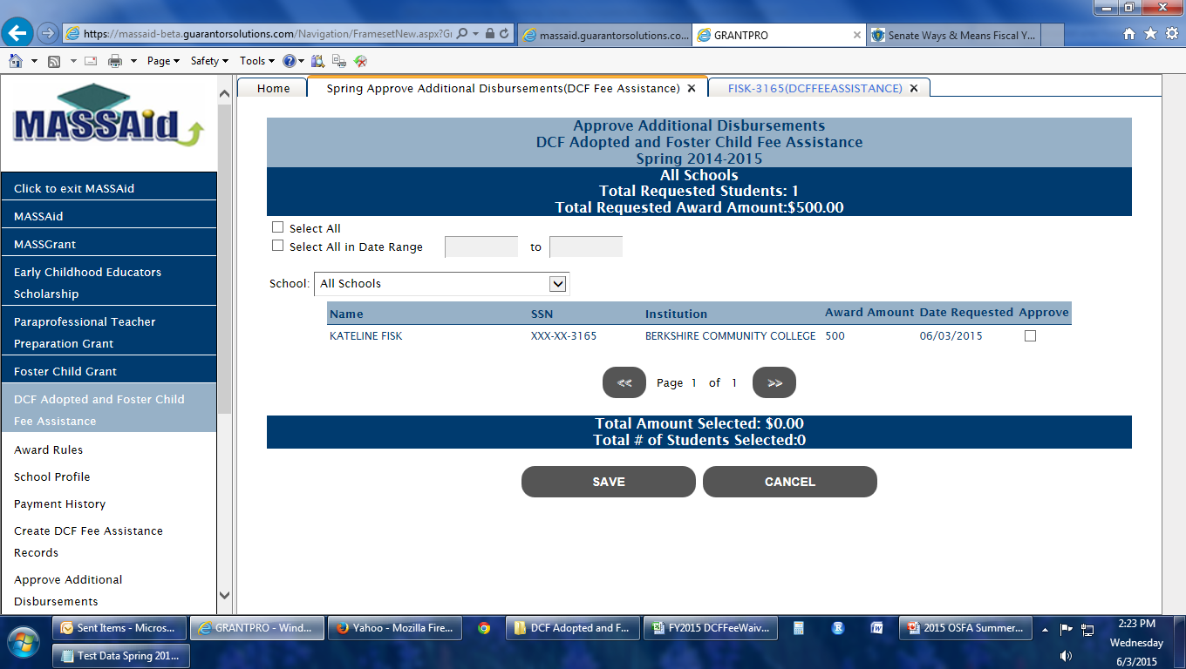
Financial Aid Programs
Adopted and Foster Child Fee Assistance Program
Requests for additional disbursements are approved based on the availability of funds.

Slide 62
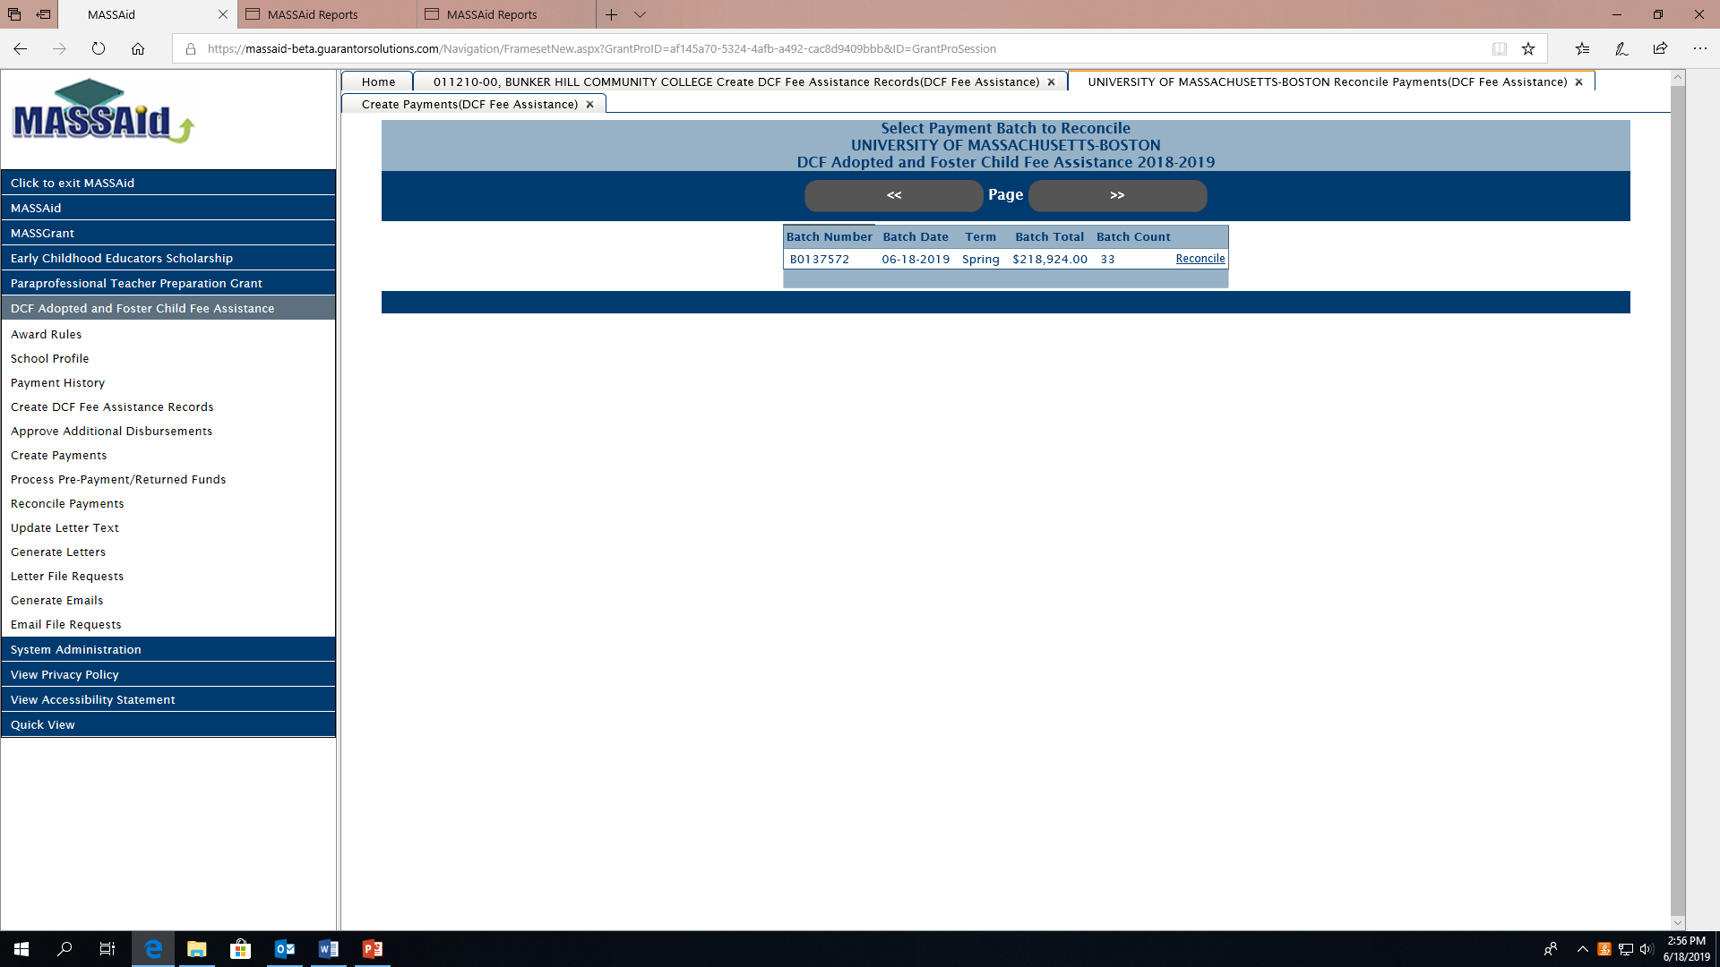
Financial Aid Programs
Adopted and Foster Child Fee Assistance Program
Schools have 30 days to reconcile payments
Schools must also complete year-end reconciliation

Slide 63
Financial Aid Programs
Adopted and Foster Child Fee Waiver Program
Students cannot receive fee assistance for summer credits
DCF eligibility documentation must originate from the Department of Children and Families. OSFA has no ability to provide this documentation to students
  Students should contact DCF to obtain their certificate of eligibility
Students can use fee assistance funds for international credits, but only if the credits are considered state supported
  Campus must be collecting tuition and fees on behalf of the Commonwealth and not the international institution
Students that are selected for verification must complete this process for continued eligibility under the DCF Fee Assistance Program

Slide 64
No Interest Loan

Slide 65
2019-2020 Activity Summary
No Interest Loan
Allowed Schools to extend the loan period so that all Promissory Notes could be received and processed
Final 2019-2020 NIL Disbursement Rosters were created by OSFA July 3rd
2019-2020 NIL Reconciliation Rosters are now available for you to download
Year | Dollars Disbursed | # of Students
2018-2019 | $4,398,450 | 1835
2019-2020 | $4,305,204 | 1536

Slide 66
2019-2020 Activity Summary
No Interest Loan
In April letters were mailed to all borrowers in repayment providing guidance on DHE’s response to the Covid-19 crisis
All borrowers who were in standard repayment received a deferment April-July. The deferment does not go against the 36 months a borrower is eligible to receive
Borrowers were not charged late fees during this time
All credit bureau reporting was paused March-July
All collection agency placements and new activity was paused April-July
All intercept activity was paused March 26- July 1st.

Slide 67
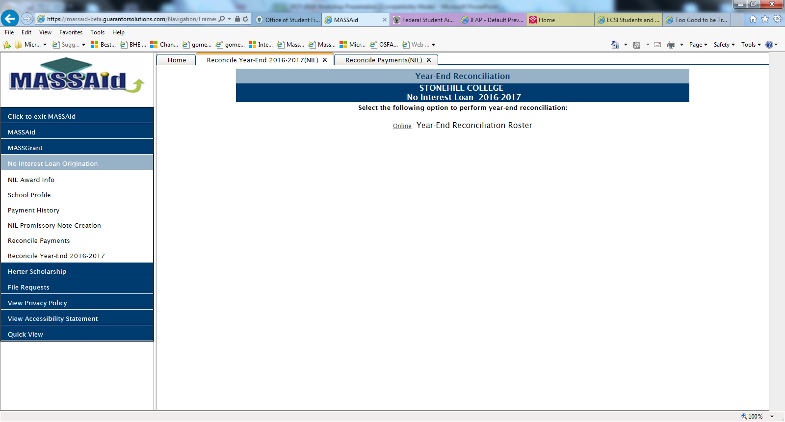
No Interest Loan
No Interest Loan Year-End Reconciliation

Slide 68
No Interest Loan
2020-2021 Loan Origination
2020-2021 NIL FAFSA filing deadline is March 12, 2021
EFC Eligibility Range 0-15,000
Loan Amounts
    Minimum $1,000
    Maximum $4,000
2020-2021 Anticipated Allocation Forms were sent to schools mid-June and were to be returned to OSFA by June 30th
2020-2021 Allocation Notifications will be mailed out to institutions as soon as possible

Slide 69
No Interest Loan
2020-2021 Loan Origination
A survey was sent to schools in July regarding how schools will originate this year
We will not have electronic signatures for 20-21
Borrowers will be able to print their Note. They will then have to return to school. School Official will need to sign and return to OSFA
Updates to student dashboard on MASSAid will reflect the status of the account. It will advise student to reach out to Financial Aid Office and determine next steps

Slide 70
No Interest Loan
Student Eligibility
Permanent legal resident of Massachusetts, United States citizen or eligible non citizen
Enrolled full time
EFC must fall within 0-15,000 range
Enrolled in a certificate, associate or bachelors degree program
Not have received a prior bachelors degree or its equivalent
In compliance with Selective Service Registration Requirements
Not in default of any federal or state loans or owe a refund for any previous financial aid received
Maintain satisfactory academic progress

Slide 71
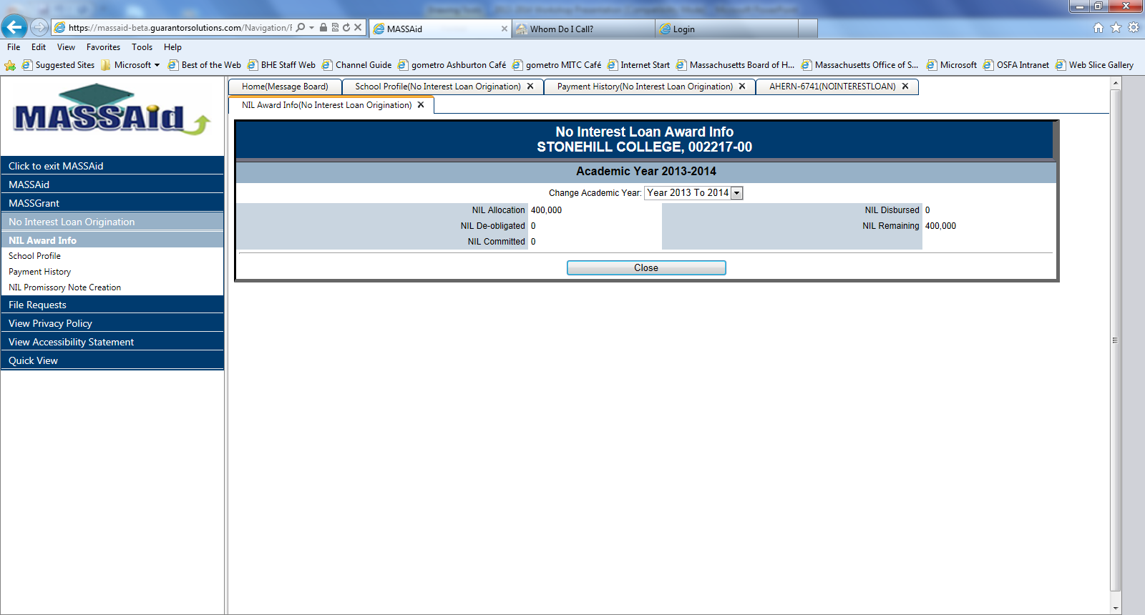
Promissory Note Creation
No Interest Loan

Slide 72
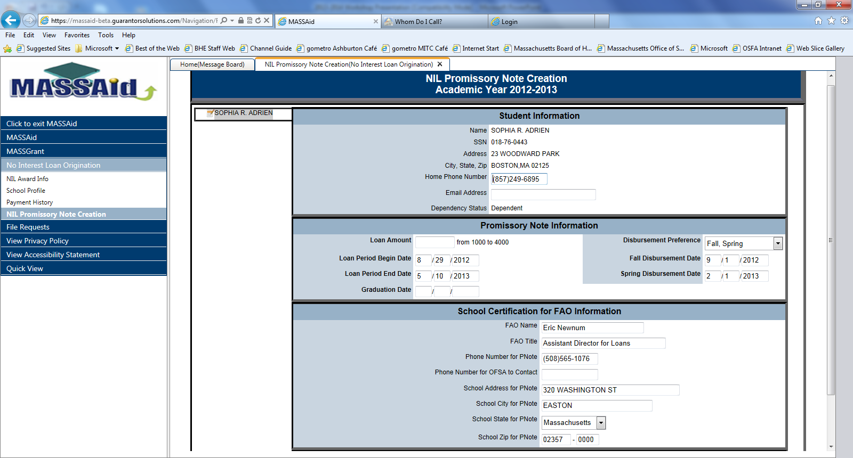
Promissory Note Creation
No Interest Loan

Slide 73
Promissory Note Creation
No Interest Loan
Loan Period
  Loan Processing Cycle is from August 1 – June 30
  Borrower’s Loan Period must fall within this date range
  Loan Period must coincide with period of enrollment for the academic year
Disbursement Dates
  Schools control when loan disburses by populating fields with desired dates
  Loan Periods > 155 days require at least 2 disbursements

Slide 74
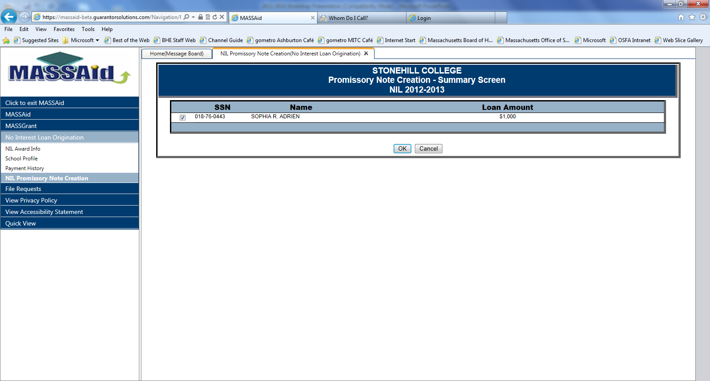
Promissory Note Creation
No Interest Loan

Slide 75
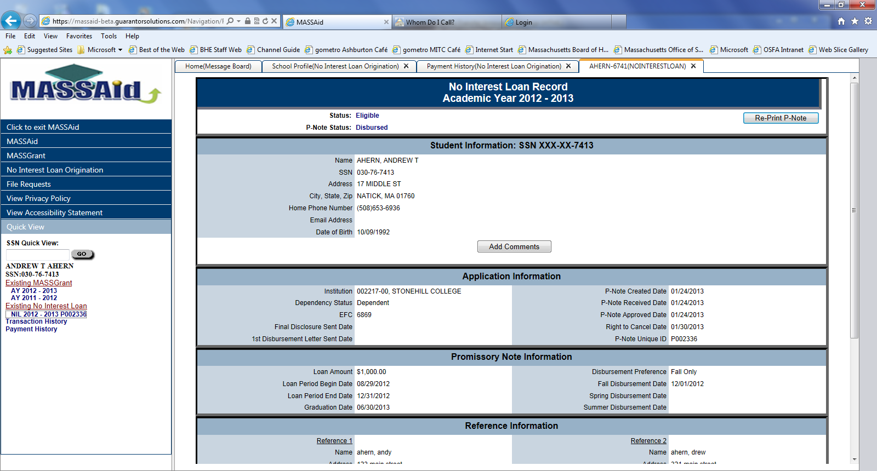
Promissory Note Creation
No Interest Loan

Slide 76
Promissory Note Submission
No Interest Loan
OSFA must receive an intact fully completed ORIGINAL COPY of the promissory note (as printed on the note)
Promissory note must be printed on the promissory note paper which cites the Terms & Conditions of the loan
All promissory notes capture emails displayed in MASSAid
Borrower must provide two (2) unique U.S. references with zip codes (business addresses will not be accepted)

Slide 77
Promissory Note Submission
No Interest Loan
Borrower must sign full legal name as it appears on the promissory note and date appropriately
Promissory Note must be signed by school official
Self-Certification Form must accompany Original Promissory Note
Promissory Note must be received by OSFA prior to the loan period end date to be eligible for a disbursement
Denied promissory notes will be returned to School Official’s attention and reflected on Student’s MASSAid Dashboard

Slide 78
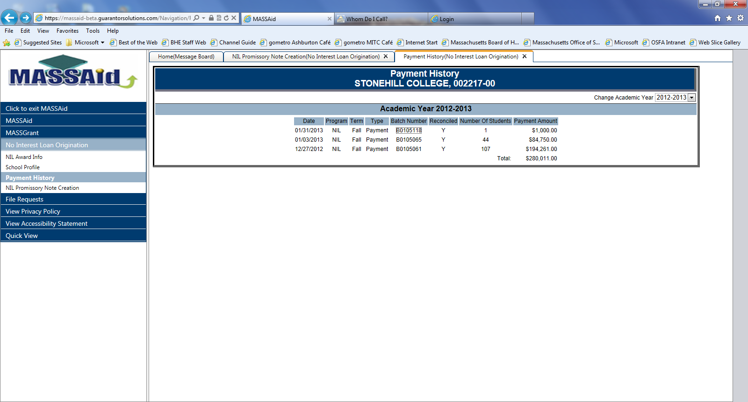
Loan Origination
No Interest Loan
Borrower must sign full legal name as it appears on the promissory note and date appropriately
Promissory note must be signed by school official
Self Certification Form must accompany Original Promissory Note
Promissory note must be received by OSFA prior to the loan period end date to be eligible for a disbursement
Denied promissory notes will be returned to School Official’s attention

Slide 79
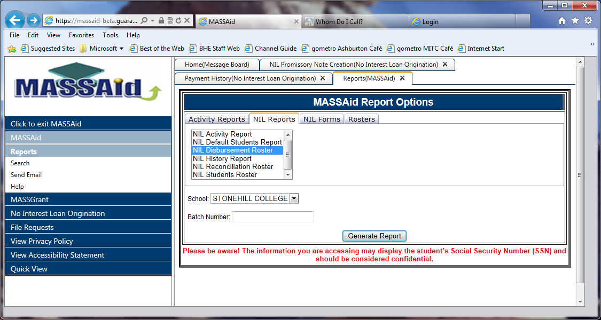
Loan Origination
No Interest Loan

Slide 80
Loan Origination
No Interest Loan
Cancellations
  May be performed in real time in MASSAid
  Must be done PRIOR to disbursement
  Funds from cancelled disbursements revert to school’s allocation
Refunds
  Once disbursement occurs, if student is no longer eligible, school must refund monies to OSFA
  Refunded monies DO NOT revert to school’s allocation
Timely Submission of Promissory Notes
  Facilitates accurate Exit Interview processes

Slide 81
Truth in Lending Act
No Interest Loan
At the time of origination, the system will automatically create a borrower specific Massachusetts No Interest Loan Offer
School must provide this to student to review prior to signing the promissory note. The Massachusetts No Interest Loan Offer Form does not need to be returned to OSFA
At the time of approval, OSFA will automatically create a borrower specific Massachusetts No Interest Loan Disclosure that will be mailed to each borrower
The Loan Disclosure will provide three (3) business days for the borrower to decline the loan. Loans will be disbursed after the three day period

Slide 82
Clearinghouse Updates
No Interest Loan
Heartland ECSI runs a Clearinghouse interface file every weekend. The file that is sent to the Clearinghouse includes all borrowers ECSI shows in an enrolled status
If there is a match and the Clearinghouse shows that borrower to be withdrawn, less than half-time, or graduated, ECSI creates an Exit for the borrower
If an account is in a past due status, the Clearinghouse information will not update account
It is important schools are accurately and timely reporting to the Clearinghouse

Slide 83
Default Management
No Interest Loan
Reports
Expected Separation Dates
    OSFA mails throughout the year
    Reports can be generated at any time on ECSI’s WebX system
    Opportunity to update separation dates
A March mailing included the current In-School report to allow schools to make any updates and the fiscal year 2019 cohort default rate
  By request, OSFA mails schools a list of defaulted borrowers

Slide 84
Default Management
No Interest Loan
  If the default rate exceeds 30% the institution must file a Loan Default Management Plan with OSFA by June 30 and achieve 100% return rate on on-line Exit Interviews to be considered for continued participation, no later than July 15th
  If the default rate exceeds 10% the institution must achieve 100% return rate on on-line Exit Interviews to be considered for continued participation, no later than July 15th
  If the default rate is less than 10% the institution must achieve at least 75% return rate on on-line Exit Interviews to be considered for continued participation, no later than July 15th
  Any school that does not achieve 100% return on all Exit Interviews by July 15th and have a prior year default rate in excess of 30% can receive no more than 75% of their highest allocation in the program in the last five years

Slide 85
Default Management
No Interest Loan
OSFA extended the July 15th deadline this year
OSFA continues to work with schools to help them reach the Exit requirements
OSFA has been sending monthly reminder emails to students that have not yet completed their Exit Interviews
OSFA has also been calling borrowers to remind them to complete their Exits

Slide 86
Default Management
2018-2019 Exit Interview Overview
No Interest Loan
 | Total Borrowers Separating 7/1/2018-6/30/2019 | Completed Exits | Current in Repayment | In Deferment | In Default
Private Institutions | 582 | 397 | 532 | 22 | 28
State Universities | 451 | 295 | 383 | 31 | 37
Proprietary | 19 | 13 | 11 | 0 | 8

Slide 87
No Interest Loan
Default Management
Common Practices for Exiting Students
  No Interest Loan notices mailed or emailed to students by financial aid offices. These include amount that was borrowed, Exit instructions, and login information
  Placing holds on Graduation Tickets
  Placing holds on Transcripts and/or Diplomas
  Constant calls and emails to borrowers until 100% Exit completion is reached

Slide 88
Default Management
No Interest Loan
All Exits are generated electronically by ECSI
Sixty days prior to separation, ECSI sends an email to borrowers with their username, password, and instructions to complete their Exits
Schools are encouraged to frequently remind students of this responsibility
Encourage borrowers to register for ACH payment at the time they are completing their Exits

Slide 89
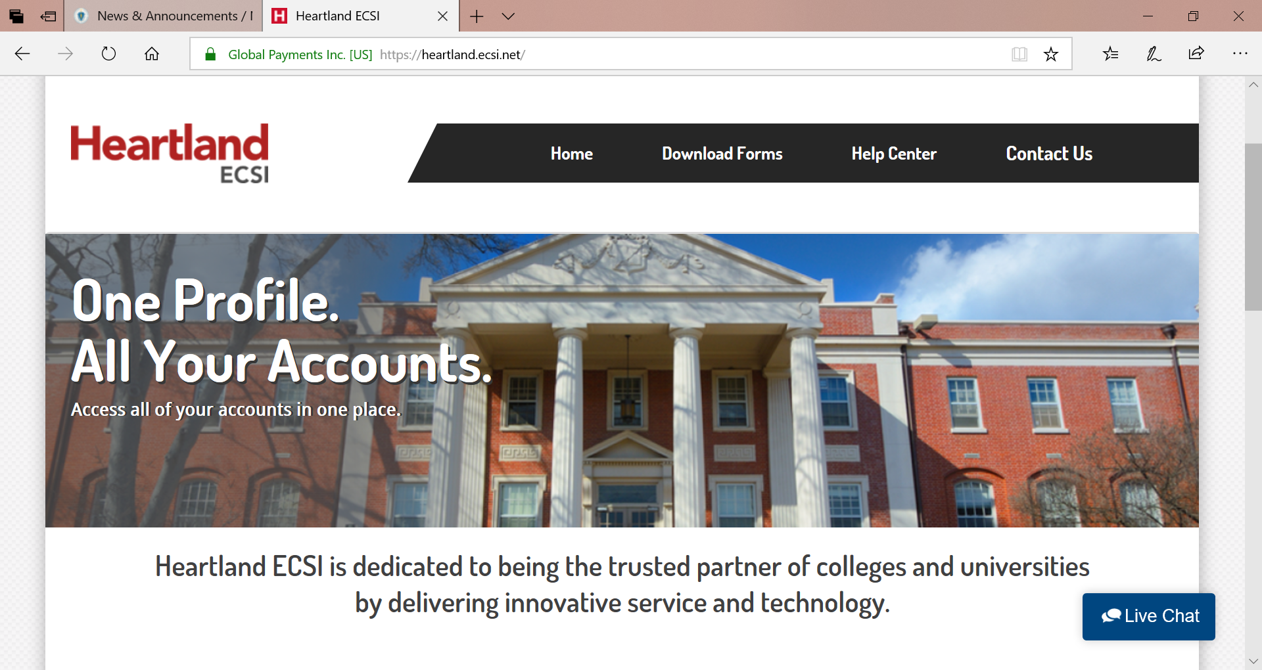
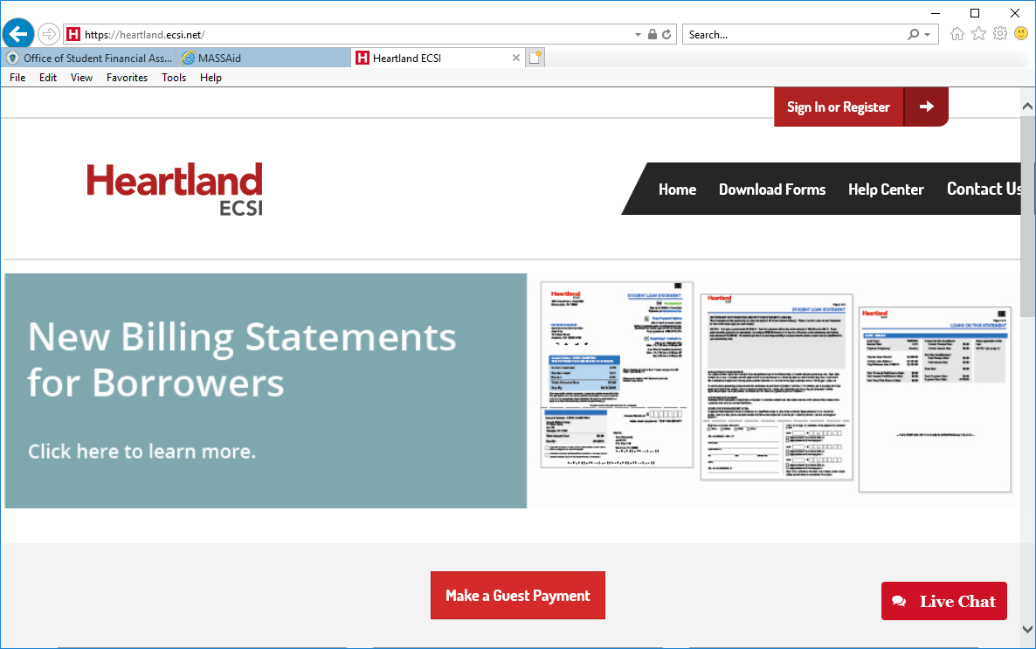
Loan Servicing
No Interest Loan
https://heartland.ecsi.net

Slide 90
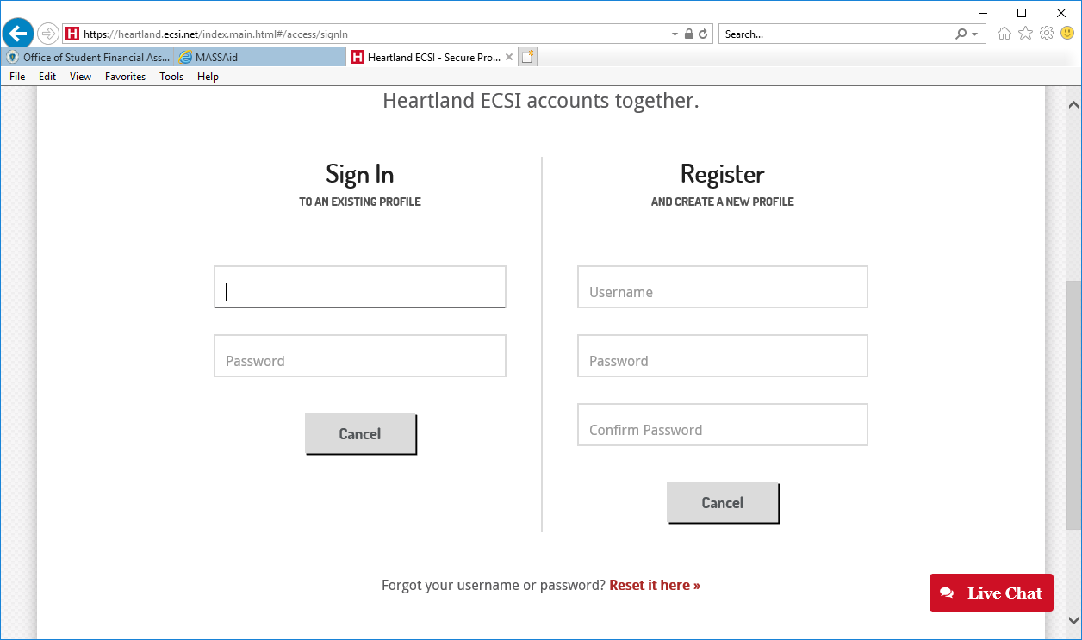
Loan Servicing
No Interest Loan

Slide 91
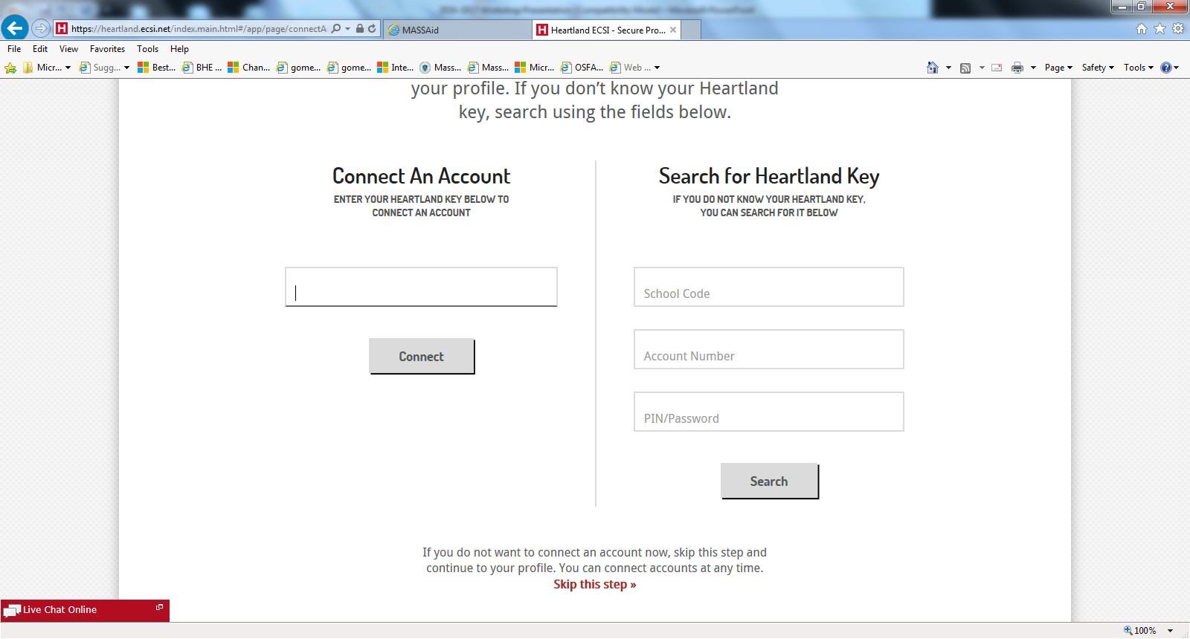
Default Management
No Interest Loan

Slide 92
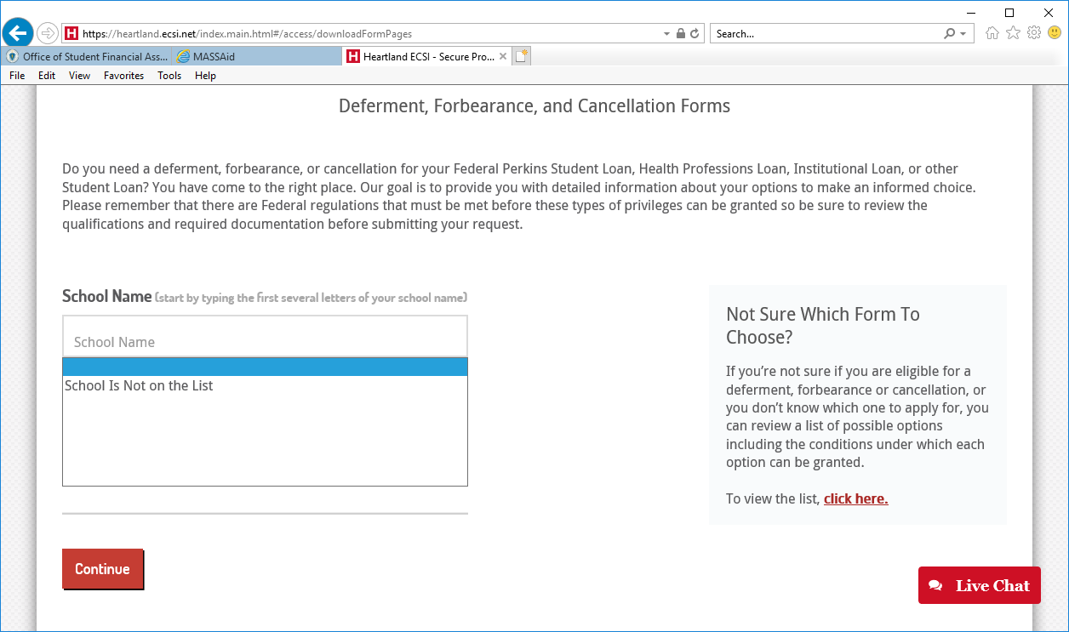
Default Management
No Interest Loan
Notes:
Can change password/phone/address at anytime and select if they want it to appear on certain accounts.
But IT WOULD BE DESIRABLE FOR ALL ACCOUNTS TO HAVE SAME INFO SO OSFA’S INFO IS UPDATED ON SAL

Slide 93
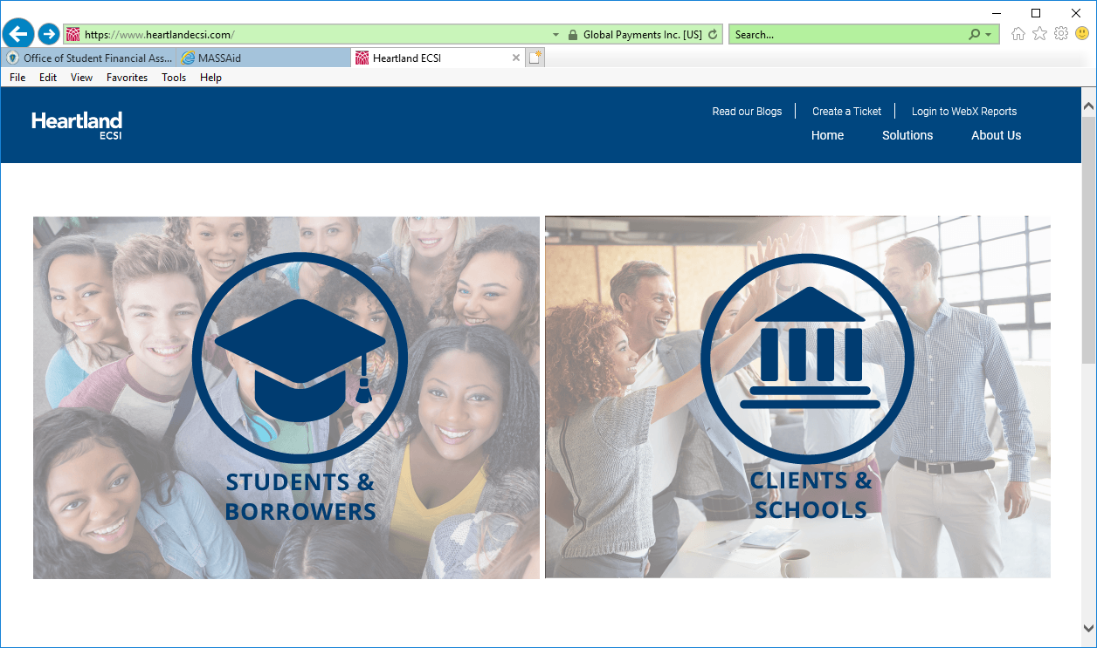
Default Management
No Interest Loan
www.heartlandecsi.com

Slide 94
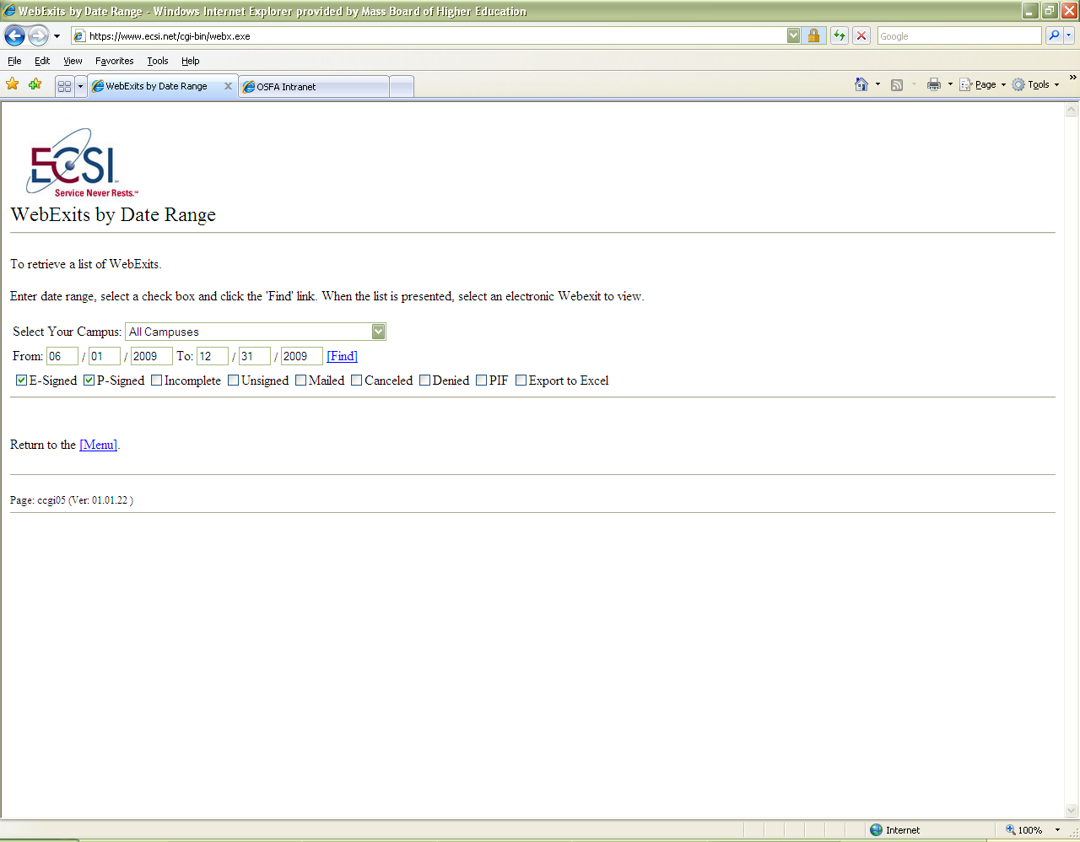
No Interest Loan
Default Management

Slide 95
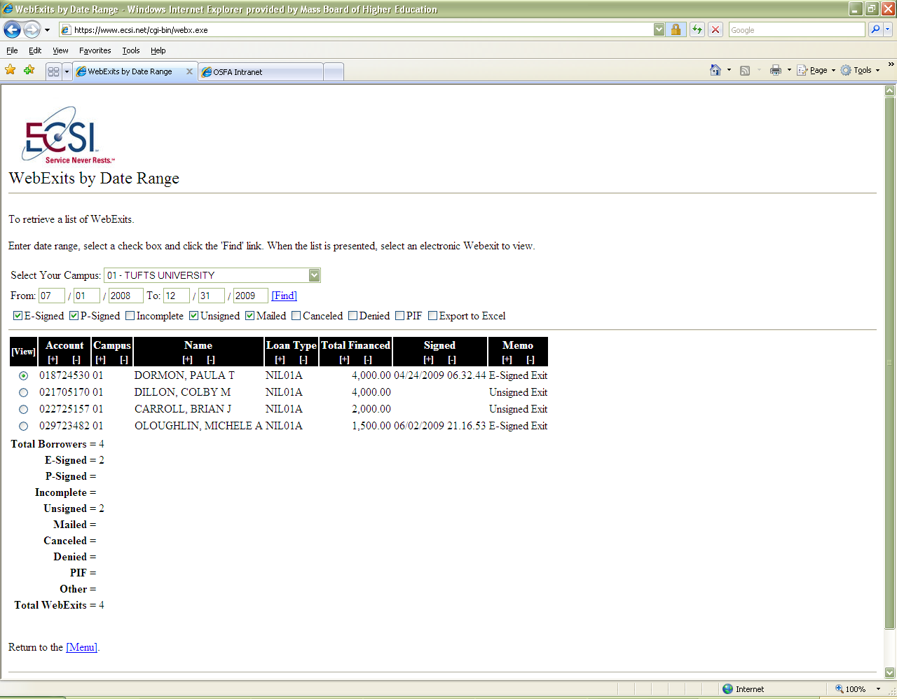
No Interest Loan
Default Management

Slide 96
No Interest Loan
Default Management
Common Practices for Preventing Default
  Students must participate in mandatory Exit Counseling Sessions where loans are broken down by type and repayment options
  After receiving the default list—school mails borrower past due letter
  Staff reviews Delinquent Rosters monthly and reaches out to students by mail or phone. If school has different address, updates are made to OSFA and ECSI. Also check to see if they are past due on Perkins Loans or other loans through the school
  If student enters into default, a hold is placed on their transcript

Slide 97
Default Management
No Interest Loan
Preventing Fraud
  Making students aware of scams targeting schools
    Advertisements, Fake Facebook messages, Bad PR or Credit Reports
Students should not pay a fee for help managing debt
Links to help students with questionable companies
  https://www.consumerfinance.gov/complaint/
  https://www.ftccomplaintassistant.gov/#&panel1-1
  https://studentaid.ed.gov/sa/types/scams

Slide 98
Wellness Program
No Interest Loan
Wellness Program
  Each month OSFA mails to institutions a report of borrowers who are up to 90 days past due
  Once a loan is disbursed a letter is mailed to borrowers along with a brochure reminding them of loan terms and conditions
  OSFA mails a post-card to borrowers during their grace period, as an additional reminder of their loan and billing servicer
  OSFA also emails students during their grace period
  Monthly OSFA calls, mails and emails 30, 60 and 90 day past due borrowers

Slide 99
Helpful Reminders
No Interest Loan
  When contacting ECSI, school code for all OSFA programs = 4F
  OSFA DOES NOT remove accounts from collections once placed with an agency
  Accounts are FULLY accelerated @ 120 days past due
  Students have a 6 month, one-time only grace period
  NIL is not a Federal loan – therefore cannot be rehabilitated

Slide 100
Helpful Reminders
No Interest Loan
  NIL CANNOT be consolidated
NIL does not appear on NSLDS
Students in default may have any state funds intercepted
Students must complete a Commonwealth of Massachusetts exit interview
Borrowers must complete exit interview EVEN IF they are continuing in the fall in a graduate program (must apply for deferment)

Slide 101
Contact Information
No Interest Loan
Heartland-Educational Computer Services, Inc (ECSI)
  Schools/Institutions
  Phone 1-800-437-6931
Borrowers
    MDHE
    C/O ECSI
    100 Global View Drive
    Warrendale, PA 15086
      Phone: 888-549-3274
      Fax: 866-291-5384
      Email: clientsupport@ecsi.net
      Web: www.heartlandecsi.com
OSFA
Alison Connolly
617-391-6073
aconnolly@dhe.mass.edu

Slide 102
Participating in Massachusetts State Financial Aid Programs in 2020-2021
What’s new?

Slide 103
Participation Agreement
2020-2021 Program Participation Agreement
OSFA published a new Participation Agreement that all Massachusetts institutions are required to complete and sign to maintain eligibility to participate in state-funded programs
Participation Agreement takes effect as of award year 2020-2021
Participation Agreement extends eligibility from July 1 to June 30 of each award year
New Participation Agreement was mailed to financial aid offices in August

Slide 104
Audit and Attestation
Audit Guide and Reporting
State Financial Aid Programs Audit Guide last revised in June 2014 remains in effect for fiscal year ending in 2020 reporting
In light of COVID-19, OSFA extended regulatory relief to many institutions that were required to submit FY20 Attestation Reports
Instead, those schools are able to delay their attestation reporting to FY21 and allowed to submit a copy of their Federal A-133 Single Audit that covers Title IV aid for FY20
Any extension allowed by USDOE to institutions to submit their FY20 Federal audit reports, in light of COVID-19, will automatically apply to their reporting to the DHE

Slide 105
Audit and Attestation
Audit Guide and Reporting
OSFA will be revising and publishing a new version of its current Audit Guide ahead of reporting for FY21
The revised Audit Guide will be published on-line between now and the spring of 2021
The revised Audit Guide will likely incorporate new Commonwealth of Massachusetts reporting requirements with respect to institution’s financial health and school closing

Slide 106
Audit and Attestation
Audit Guide and Reporting
Institutions will continue to electronically submit their attestation reports to OSFA via the Executive Office of Education’s Drop Box at:
https://gateway.edu.state.ma.us/
To add or remove EOE Drop Box users, institutions should submit requests to:
Judi Kennedy
jkennedy@dhe.mass.edu
OR
Robert Brun
rbrun@dhe.mass.edu

Slide 107
COVID-19
The Massachusetts Response
OSFA has been adapting some of its policy areas to changes in Federal financial aid guidelines since the spring 2020 academic period, in response to the COVID-19 pandemic
In particular, OSFA has endeavored to remain in step with changes in Federal student aid guidelines in areas of eligibility for financial aid, refund calculation, loan payment deferment, to name a few
OSFA has provided regulatory relief to many Massachusetts institutions in the area of audit and attestation reporting

Slide 108
Covid-19
The Massachusetts Response
In award year 2020-2021, OSFA will continue to monitor and adopt, whenever possible, COVID-19 related revisions to Federal student aid guidelines, for as long as they remain in effect.
Some of the areas that OSFA will be monitoring are as follows:
1. Distance Education and Eligibility for Financial aid
2. Length of Academic Period
3. Definition of Enrollment Status
4. Enrollment Status Changes
5. Return of Title IV Funds

Slide 109
2021 Processing Systems
MASSAid and Other Services
The Massachusetts Executive Office of Education (EOE) renewed the MASSAid contract with Nelnet
EOE and OSFA look to bring all financial aid programs under one umbrella
Programs to be migrated to OSFA from ancillary systems are:
1. MASSGrant Plus (fall 2020)
2. High Demand Scholarship (fall 2020)
3. Commonwealth Commitment (winter 2020)
4. John and Abigail Adams Scholarship (spring 2021)

Slide 110
2020-2021 Processing System
MASSAid and Other Services
OSFA has implemented a feature that enables students to upload documentation directly to MASSAid, as of spring 2020
Students now have access to their own MASSAid dashboard that provides, in real-time, a snapshot of their application and eligibility, on a per program basis
OSFA will soon be testing text messaging to students, as a MASSAid feature
OSFA is exploring electronic signature with our vendor, and looks to have that component in MASSAid down the road

Slide 111
2020-2021 Processing System
MASSAid and Other Services
OSFA , Nelnet, EOE and the Office of the State Comptroller are working together to bring full automation to OSFA’s financial aid payment system
The above automation will soon enter phase 2 of the testing process
OSFA will be able to submit disbursement files directly to the Commonwealth’s accounting system through an interface that will also facilitate outbound files back to MASSAid
MASSAid will ultimately display information such as date, payment number, amount, etc. for schools to access via their own MASSAid dashboards
The fully automated payment system will be launched this fall

Slide 112
2020-2021 Processing
An Overview of the 2020-2021 Applicant Pool

Slide 113
2020-2021 Processing
On-time FAFSA Filing Pool
The 2020-2021 on-time MASSGrant FAFSA filing date was extended to July 1
Award Year | Number of Applications (met July 1 deadline)
2020-2021 | 269,424
2019-2020 | 268,279
2018-2019 | 256,551
2017-2018 | 257,741
2016-2017 | 241,911

Slide 114
On-Time MASSGrant Eligible Students
An 8-year History
Roughly 7.2% increase in 2020-2021 number of eligible students (as of 08/19/20)
Award Year | EFC 0-200 | Eligible EFC>200 | Total Eligible
2020-2021 | 45,883 | 29,108 | 74,991
2019-2020 | 43,445 | 26,117 | 69,562
2018-2019 | 47,681 | 29,802 | 77,483
2017-2018 | 50,026 | 29,347 | 79,373
2016-2017 | 43,734 | 26,726 | 70,460
2015-2016 | 53,976 | 32,162 | 86,138
2014-2015 | 55,303 | 33,158 | 88,461
2013-2014 | 60,643 | 35,346 | 95,989

Slide 115
On-time MASSGrant Eligible Students
A 5-year Overview by 2 EFC Groupings
(as of 08/19/20)
Award Year | Eligible EFC 0-200 | Eligible EFC>200 | Total Eligible
2020-2021 | 45,883 | 29,108 | 74,991
2019-2020 | 43,445 | 26,117 | 69,562
2018-2019 | 47,681 | 29,802 | 77,483
2017-2018 | 50,026 | 29,347 | 79,373
2016-2017 | 43,734 | 26,726 | 70,460

Slide 116
2020-2021 Processing
MASSGrant Eligible Students by Dependency Status
A 6-year history (as of 08/19/20)
Award Year | Dependent | Independent | Total Eligible
2020-2021 | 43,127 | 31,864 | 74,991
2019-2020 | 42,319 | 27,243 | 69,562
2018-2019 | 44,291 | 33,192 | 77,483
2017-2018 | 44,259 | 35,114 | 79,373
2016-2017 | 39,798 | 30,671 | 70,460
2015-2016 | 47,853 | 38,285 | 86,138

Slide 117
2020-2021 Processing
Eligible Student Group by School Type
(as of 08/19/20)
School Type | Eligible Students
MA Private | 17,393
University of Massachusetts | 16,335
MA Public Universities | 12,243
MA Community Colleges | 25,932
MA Proprietary | 1,009
MA Vocational Technical | 228
MA Nursing | 719
Out of State | 1,132

Slide 118
2020-2021 MASSGrant Processing
Challenges Meet Opportunities

Slide 119
2020-2021 Processing
Processing Activities
2020-2021 MASSGrant FAFSA filing deadline was extended to July 1.
OSFA maintained its practice of sending e-mail eligibility notifications to students throughout the summer
OSFA continues to mostly operate remotely throughout the pandemic
OSFA set up a virtual call-center with 4 rotating staff members who answer calls and assist students during normal business hours

Slide 120
2020-2021 Processing
Processing Activities
Students and schools have the standard 21-day period to resolve discrepancies
OSFA continues to receive ISIR transactions (new and correction) daily and uploads them at night
OSFA recognizes that there could be delays at schools in handling cases that require professional judgement
OSFA will handle requests for special consideration on a case by case basis
There are certain provisions in OSFA’s FY21 MASSGrant funding scenario that should enable consideration of records that miss the 21-day deadline, in due course

Slide 121
2020-2021 Processing
Correcting Discrepancies and Tracking Eligibility
Students can make certain updates to their MASSGrant records on-line and have their eligibility recalculated in real-time
In 2020-2021, students are able to upload documentation to MASSAid for MASSGrant, Early Childhood Educators Scholarship and Paraprofessional Teachers Preparation Grant programs, directly to MASSAid
In 2020-2021, students are able to track their eligibility status in MASSAid, in real-time, via programs’ dashboards
OSFA currently is working with Nelnet to incorporate text messaging to students in its processing workflow

Slide 122
2020-2021 Processing
Correcting Discrepancies and Tracking Eligibility
MA residency discrepancy (student and/or parent) requires student to submit documentation directly to OSFA
Schools are able to clear the following ineligible reasons in MASSAid on behalf of students in batch format:
1. Citizenship
2. Prior Bachelor’s Degree Received
3. Answered “YES” to Drug Question
4. Loan Default and/or Owe Refund on Federal Aid
Institutions are subject to the same 21-day period to correct discrepancies on a student’s behalf

Slide 123
2020-2021 Processing
MASSGrant and Other Shared Ineligible Reasons
Student not meeting Massachusetts residency requirements
Parent(s) not meeting Massachusetts residency requirements
Maximum number of semesters of eligibility reached
EFC and/or dependency status could not be determined (Missing Information)
FAFSA received by Federal Processor after 07/01/2020
Expected Family Contribution exceeds 5711

Slide 124
2020-2021 Processing
MASSGrant and Other Shared Ineligible Reasons
Applicant has prior bachelor’s degree
Student’s Name, Date of Birth and/or Social Security Number Mismatch
In default of Massachusetts No Interest Loan
Christian A. Herter Memorial Scholarship recipient
Student in default of Federal Title IV loan or owes refund on a Federal grant

Slide 125
2020-2021 Processing
MASSGrant and Other Shared Ineligible Reasons
Student answered “yes” to question 23 on FAFSA
Student owes refund to State financial aid programs
Student enrolled less than full time (only if student had updated his/her assumed status of full-time )
Student not meeting United States citizenship status requirements

Slide 126
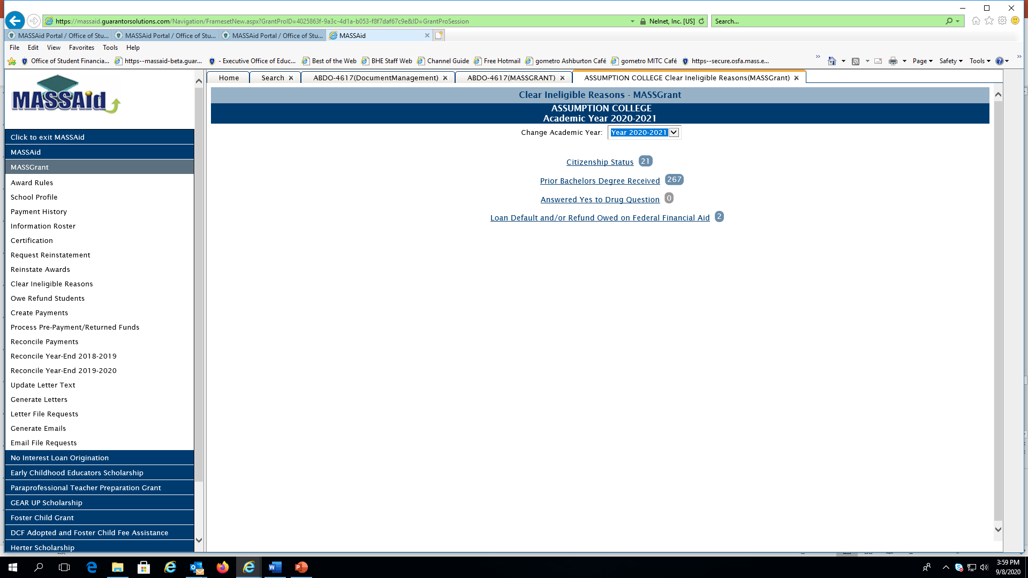
2020-2021 Processing
Clear Ineligible Reasons in MASSAid

Slide 127
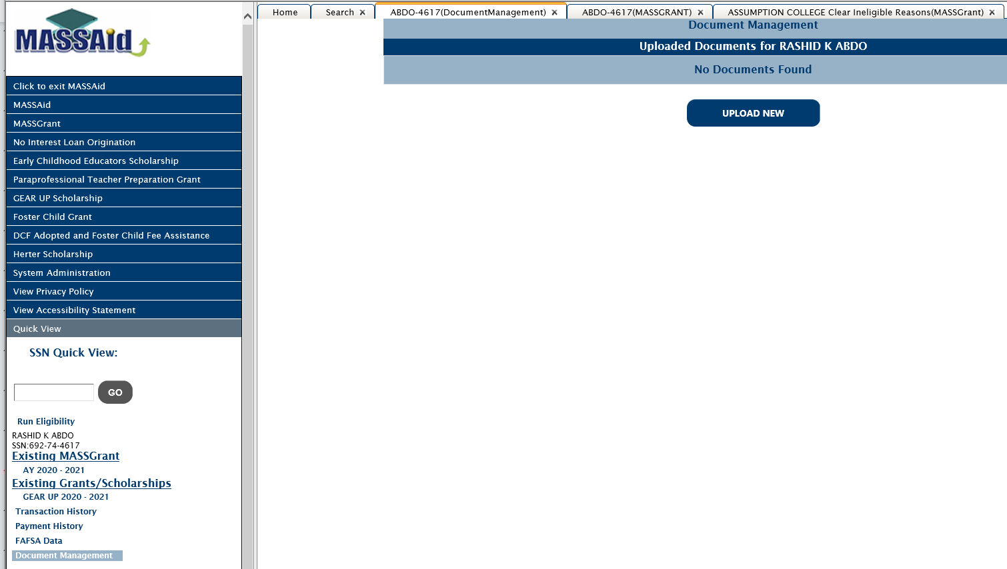
2020-2021 Processing
Clear Ineligible Reasons

Slide 128
2020-2021 Processing
Accessing MASSAid
School users have either “View Only” or “Update” access to MASSAid, as directed by financial aid offices
At the time of first logon, school users are required to change their password and recommended to register their computer
A school user is automatically locked out of the system after 3 unsuccessful login attempts
If a school needs to add/remove a user or unlock a user account, it should contact Alex Gediman or Robert Brun at agediman@doe.mass.edu and rbrun@dhe.mass.edu, respectively

Slide 129
2020-2021 Processing
MASSGrant Award Notification
Although a FY21 Massachusetts State Budget is not yet available, OSFA will continue to prioritize the MASSGrant program under any funding scenario for award year 2020-2021
The 2020-2021 MASSGrant Payment Schedule will be identical to that of 2019-2020
MASSGrant award amounts and eligibility can fluctuate as updates continue to occur in MASSAid
OSFA will begin sending 2020-2021 MASSGrant e-mail award notifications to students within one week
A final 2020-2021 MASSGrant Payment Schedule will be released on OSFA’s website within the same timeframe

Slide 130
2020-2021 Processing
MASSGrant Certification and Payment

Slide 131
2020-2021 Processing
MASSGrant Certification & Payment
MASSGrant fall 2020 certification begins on 09/14/20
MASSGrant spring 2021 certification to begin on 01/11/2021
MASSGrant records are ready for payment as soon as they are certified as eligible
Schools have option of certifying via on-line screen or through a file download/upload process
The certification file upload process has specific file layout requirements

Slide 132
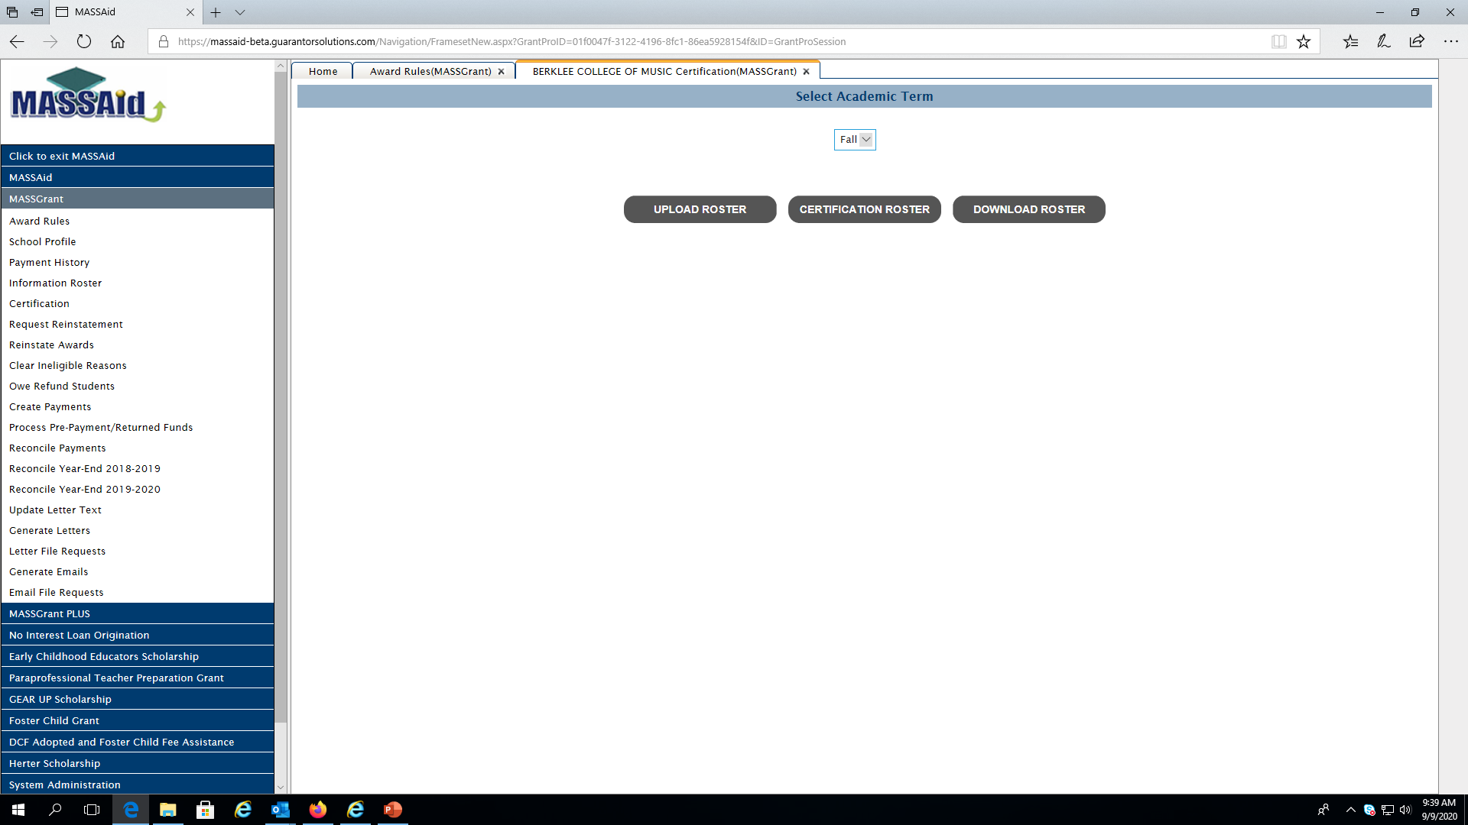
2020-2021 Processing
MASSGrant Certification Options

Slide 133
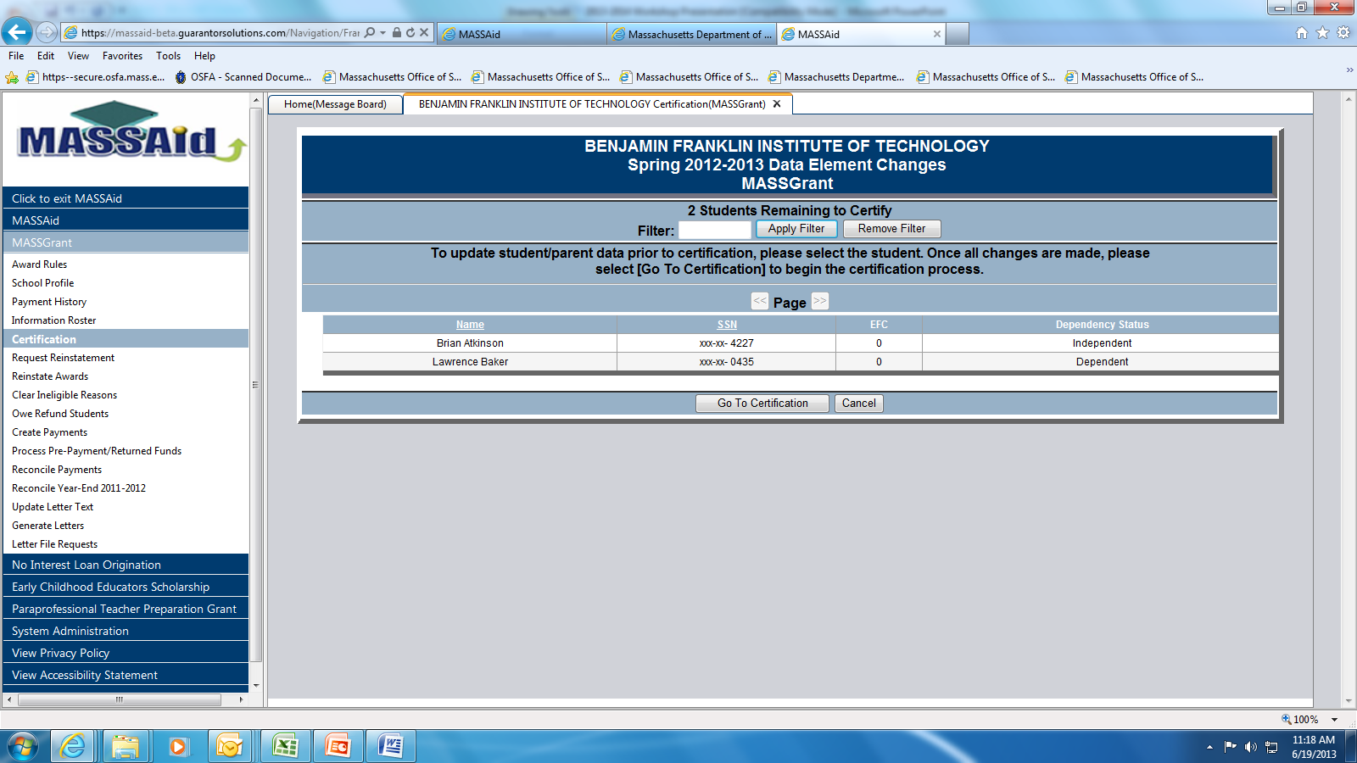
2020-2021 Processing
MASSGrant Certification Process

Slide 134
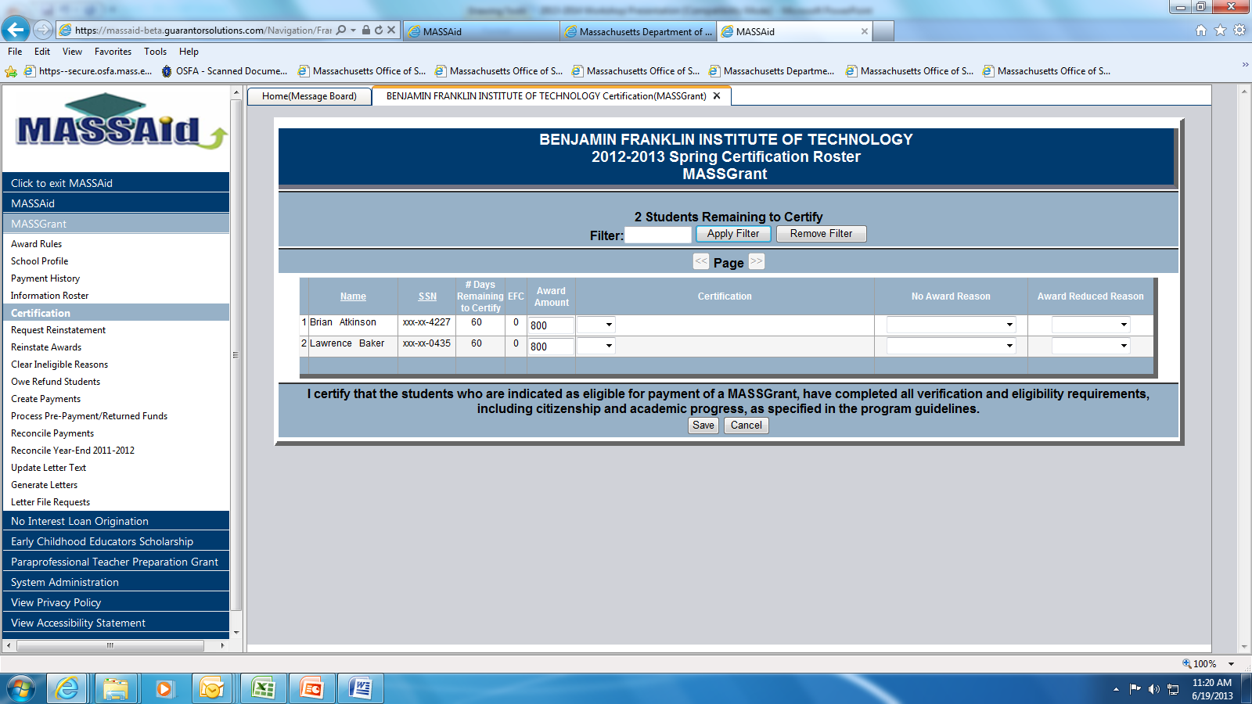
2020-2021 Processing
MASSGrant Certification Process

Slide 135
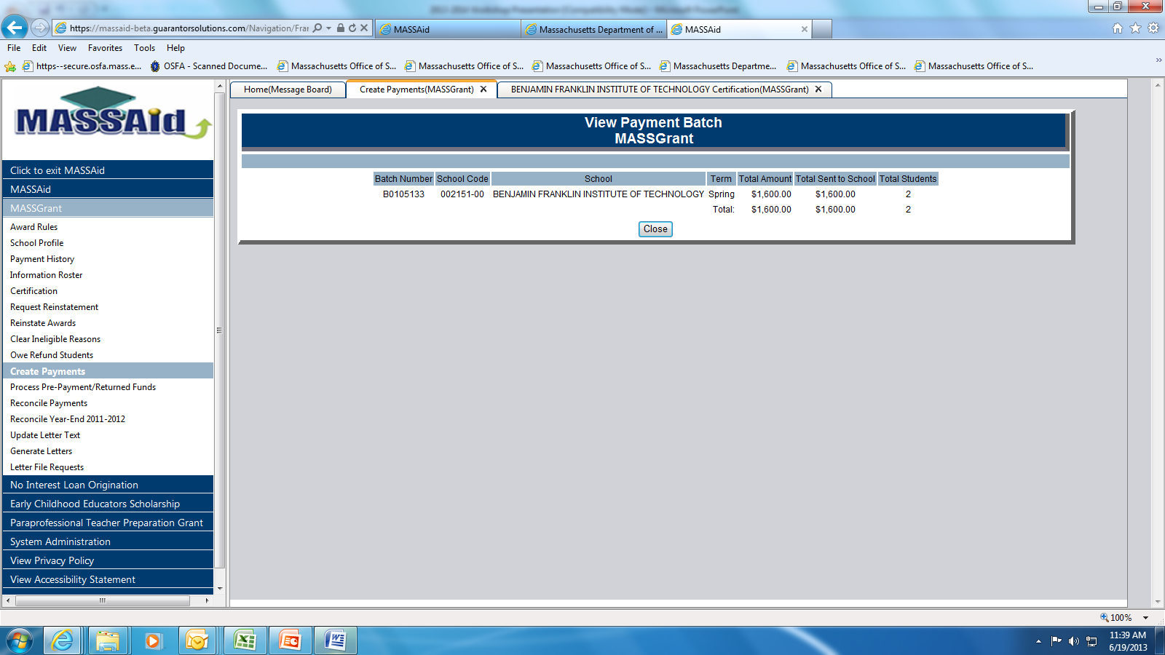
2020-2021 Processing
MASSGrant Batch Payment Roster

Slide 136
2020-2021 Processing
MASSGrant Certification and Payment
Schools have 60 days from start of certification period to certify a student’s eligibility who has a “Ready to Certify” status
OSFA has the flexibility to extend the number of days for certification on a school by school basis
OSFA will continue to track, on a term by term basis, Federal changes to determination and/or calculation of period of enrollment length, enrollment status, approved leave and withdrawal, and how they may impact eligibility for all state aid, throughout the ongoing pandemic
OSFA intends to adapt those changes to our guidelines, as often as we can.
We invite schools to contact us whenever clarification is needed

Slide 137
2020-2021 Processing
MASSGrant Award Reinstatement
Awards previously certified as ineligible or that remain un-certified as of the expiration of the 60-day period are automatically available for requests for reinstatement
OSFA approves all requests for reinstatement based on the availability of funding
Reinstated awards must again be certified by the institution within a 20-day period
Schools are limited to one reinstatement request of each award in each term

Slide 138
2020-2021 Processing
Certification and Payment
OSFA typically generates payment batches on a weekly basis
MASSGrant users automatically receive an e-mail notification when OSFA generates a payment batch for their institution
A payment batch is generated for an institution as long as it has students in a “Ready to be Paid” status
Institutions that prefer to receive payment batches at times that they wish to select, should contact OSFA
Payments are sent to schools directly from the Treasury

Slide 139
2020-2021 Processing
Payment Processing Changes
Fully automated payment process will finally be implemented in 2020-2021
Automated payment process currently is in development with release to production expected during the fall term
Payment request files are to be sent directly to the Commonwealth’s accounting system via a file transfer protocol
Automated process is to facilitate both inbound and outbound files that will provide actual payment information to be posted on MASSAid for school to use

Slide 140
2020-2021 Processing
MASSGrant Reconciliation
Schools are required to reconcile payment batches within 30 days of their creation
Reconciliation of MASSGrant payments can occur via an on-line screen or through a file download/upload option
The reconciliation file upload function is subject to specific file layout requirements
Any refunds associated with a change in eligibility or occasioned by the reconciliation process automatically carry over to the next payment batch, unless a check is received at OSFA for those refunds prior to the next payment batch

Slide 141
2020-2021 Processing
MASSGrant Reconciliation
Any payment that is not reconciled for a period of more than 30 days or any other specified time frame will result in OSFA not being able to generate the next payment batch for the institution
Schools are also required to perform a year-end payment reconciliation process
The year-end reconciliation process can occur via an on-line screen or a year-end reconciliation file download/upload option
The year-end reconciliation file download/upload option has very specific file layout requirements

Slide 142
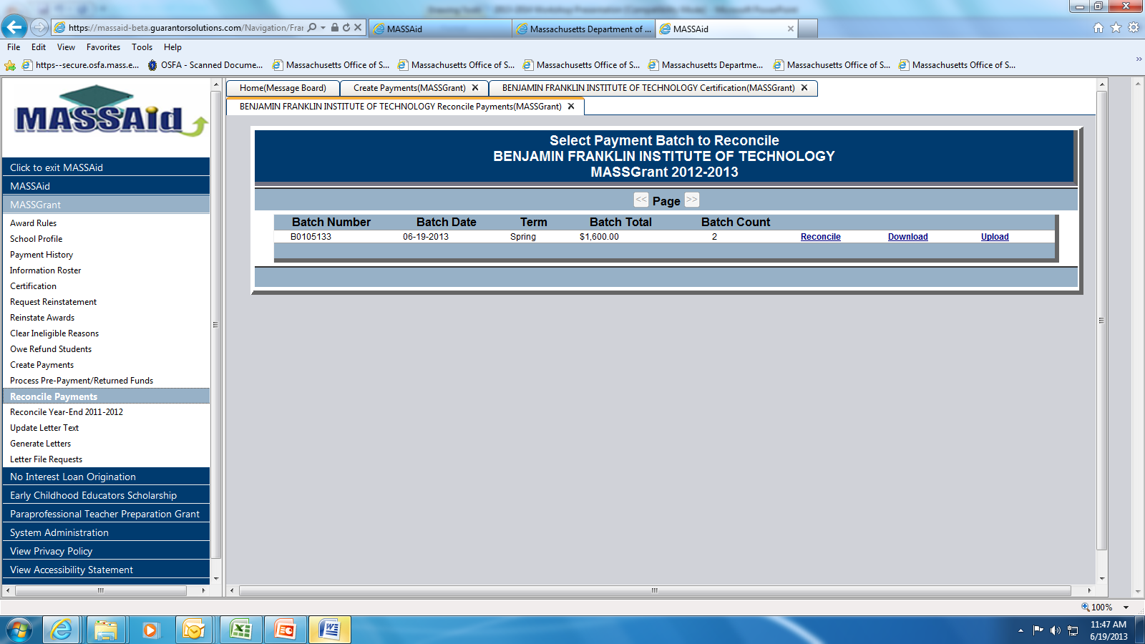
2020-2021 Processing
MASSGrant Payment Batch Reconciliation

Slide 143
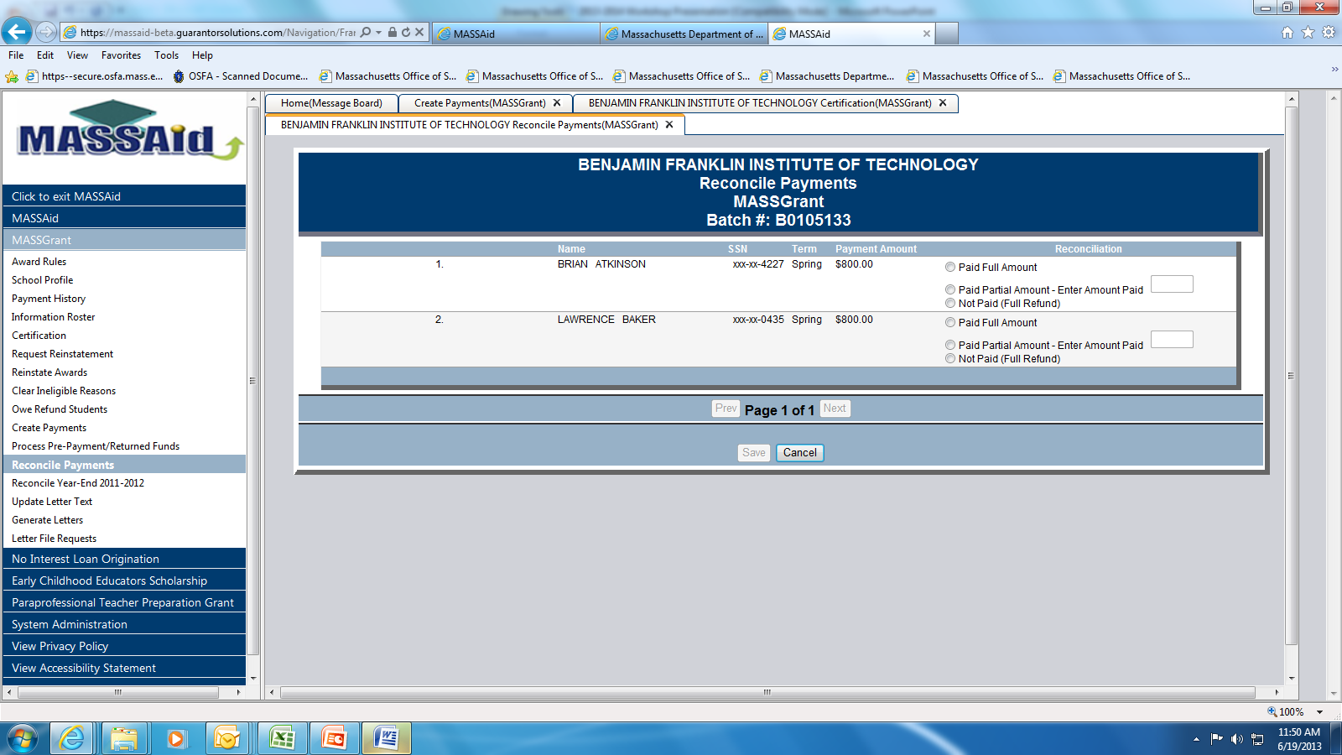
2020-2021 Processing
MASSGrant Payment Batch Reconciliation

Slide 144
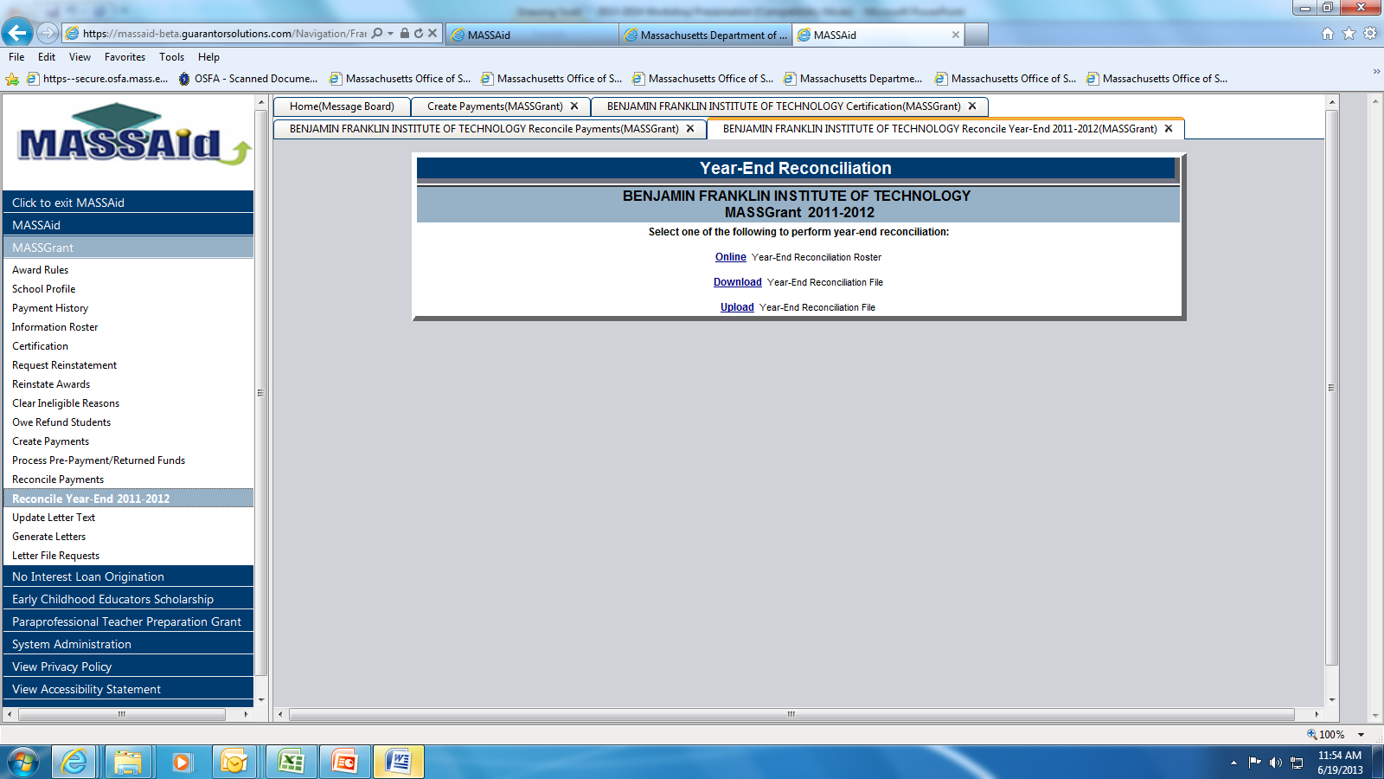
2020-2021 Processing
MASSGrant Year-End Reconciliation

Slide 145
2020-2021 Processing
Mailing of Refund Checks
Schools can access OSFA’s Refund Form via the following link:
https://secure.osfa.mass.edu/year_end_report/yearendrefundform.jsp
All refund checks and any other correspondence from schools should be sent to the current Malden address below:
  Massachusetts Office of Student Financial Assistance
  75 Pleasant Street, 3rd Floor
  Malden, MA 02148

Slide 146
2021 Processing
Other Program Updates
The GEAR UP Scholarship program will award a maximum of $800 to eligible students
The Foster Child Grant program will award a maximum of $6000 to eligible students
The MASSGrant Plus, Commonwealth Commitment and High Demand Scholarship are migrating to MASSAid in 2020-2021

Slide 147
FY 20 Year End Data File Submission
An Update

Slide 148
Fy20 Year-End Data File
Target Dates
Fy20 year-end financial aid data file layout will be released on OSFA’s website on 09/25/20
Deadline for Massachusetts institutions to submit FY20 year-end data file is November 30, 2020
There are no expected changes to the FY20 file layout

Slide 149
2020-2021 Processing
State Financial Aid Programs Guidelines
*****
All 2020-2021 updated Massachusetts State Financial Aid Programs Guidelines and Procedures will be available on-line on OSFA’s site, very shortly
*****

Slide 150

Now Open Remotely!
75 Pleasant Street, Malden, MA 02148

