Slide 1
Broadening Access to Engineering and Computer Science
STEM Council Meeting
July 20, 2016

Slide 2
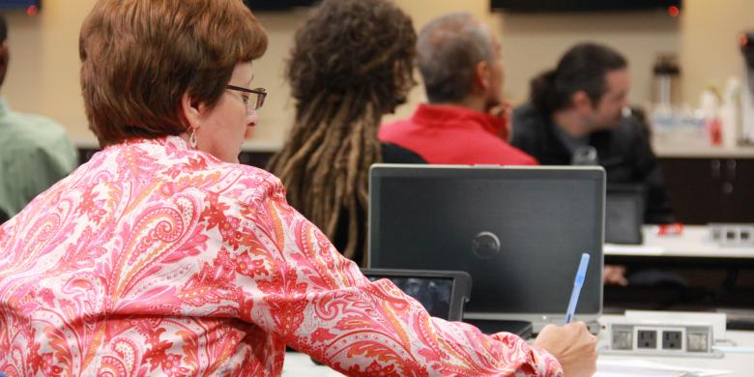
STEM Advisory Council’s Priorities:
Expand Work-Based Learning Programs
Develop and expand STEM Early College Career Pathways
Broaden and Deepen Computer Science & Engineering Initiatives
Deepen pipeline of well-trained STEM teachers and school leaders particularly in computer science and engineering
Strengthen student foundational skills, particularly computational skills

Slide 3
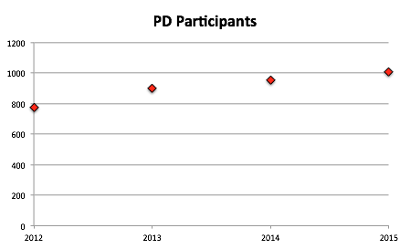
The STEM Education Center at WPI
Established in 2012
Project based STEM professional development

Slide 4
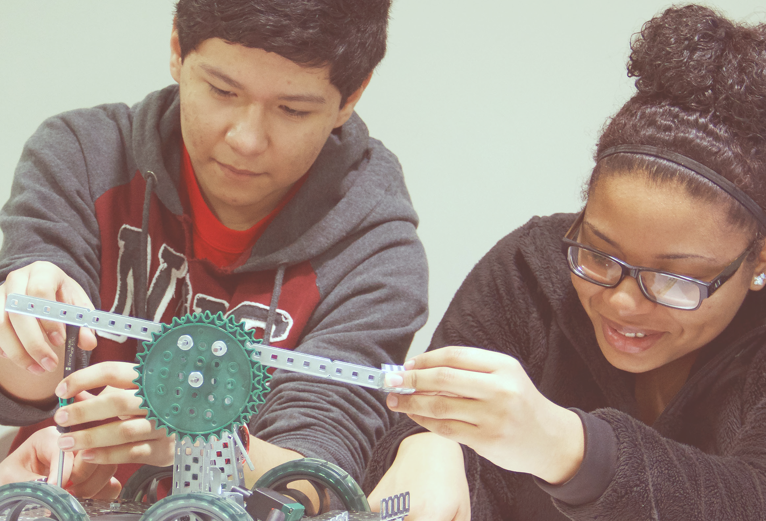
Project Lead The Way
Empower students to thrive in an evolving world
Through pathways in computer science, engineering, and biomedical science, K-12 students learn problem-solving strategies, critical and creative thinking, and how to communicate and collaborate. Students apply knowledge from a variety of disciplines as they engage in hands-on activities, projects, and problems reflective of real-world scenarios and careers. PLTW is shaping the innovators, creators, and designers of today and tomorrow.

Slide 5
PLTW K-12 STEM Curriculum
Engineering
9 Courses
Computer Science
4 Courses
Biomedical Science
4 Courses
Gateway
10 Units
Launch
24 Modules

Slide 6
PLTW K-12 STEM Curriculum
Gateway 10 Units – 9 weeks long
Design & Modeling
Automation & Robotics
Intro to Computer Science 1
Intro to Computer Science 2
Energy & the Environment
Medical Detectives
Science of Technology
Magic of Electrons
Flight & Space
Green Architecture

Slide 7
PLTW K-12 STEM Curriculum
Computer Science
Intro to Computer Science
Computer Science Principles
Computer Science A
Cybersecurtity
Biomedical Science
Principles of Biomedical Science
Human Body Systems
Medical Interventions
Biomedical Innovation
Engineering
Intro to Engineering Design
Principles of Engineering
Aerospace Engineering
Civil Engineering & Architecture
Computer Integrated Manufacturing
Computer Science Principles
Digital Electronics
Environmental Sustainability
Engineering Design & Development

Slide 8
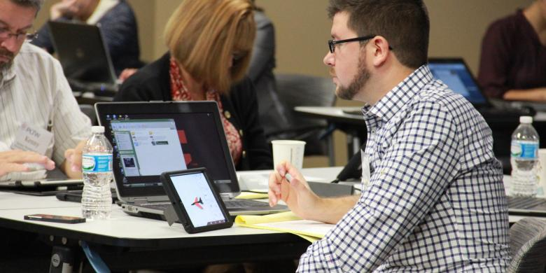
Project Lead The Way
Professional Development for Teachers
Teachers play an immeasurable role in empowering students to lead their own learning. PLTW’s goal is to provide teachers with the support and resources they need to devote more time to inspiring students.
Through professional development, teachers learn how to lead the engaging PLTW experience in their classrooms. They learn to facilitate and coach and become comfortable in these roles as their students soar to new heights. PLTW’s approach to professional development infuses a new way of teaching into the classroom.

Slide 9
Enhancing Access and
Inspiring Motivation
Education in the Medway Public Schools

Slide 10
Our Problem of Practice
“In the 21st century, scientific and technological innovations have become increasingly important as we face the benefits and challenges of both globalization and a knowledge-based economy. To succeed in this new information-based and highly technological society, students need to develop their capabilities in STEM to levels much beyond what was considered acceptable in the past.”
~National Science Foundation
Notes:
This slide will include the need to enhance the STEM pipeline, the future need in the job market, etc

Slide 11
Two approaches:
Pedagogical Shifts
&
Co-Curricular Enhancements

Slide 12
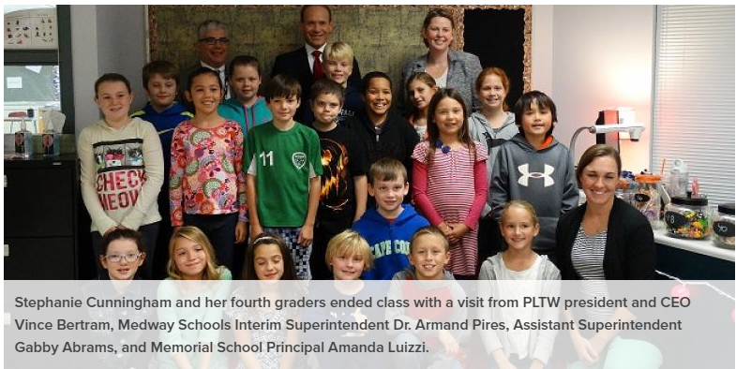
Project Lead the Way
“What is more important – to ensure that all the content of the lesson is covered, or to give the students the time to work through procedural road blocks and find solutions on their own?” from a conversation with Stephanie Cunningham, 3-4 grade science teacher during a visit with Vince Bertram, PLTW CEO

Slide 13
Medway Public Schools Adopts Project Lead the Way (PLTW)
Introduction to Engineering Design…………………………....2009- present
Digital Electronics………………………………………………………………..2011-2013
Principles of Engineering……………………………………………....2010-present
Biotechnology (no longer offered).................................................2011-2013
7th/8th grade Automation and Robotics (optional)..............2012-2016
7th/8th grade Design and Modeling (optional).......................2012-2016
Civil Engineering and Architecture………………………………..2014- present
Principles of Biomedical Science…………………………………...2015-present
Engineering Design and Development………………………....2015-present
Human Body System……………………………………………………..2015-present
Launch Units - Grades 3-4……………………………………………..2015-present
7th Grade Design and Modeling (req.)..........................................2016-2017
“PLTW has provided Medway an accelerated pathway to improved instructional practice based on a project based learning/inquiry approach that we would not have otherwise achieved as quickly.”
A. Pires, Superintendent
The standards for learning still guide the way...
Notes:
This slide will feature a brief description of the program elements as well as a timeline of our implmentation, etc
DIGITAL ELECTRONICS dropped due to insufficient enrollment BIOTECHNOLOGY course was changing and we chose to add the BIOMEDICAL Pathway instead)

Slide 14
Commitment to an
Instructional Coaching Model
2009-10: Addition of Instructional Coaches at elementary schools, STEM and Humanities’ Coaches at middle school
2011-12: Addition of first Technology Integration Specialist (second added in 2012-13)
2012-13: Appointment of dedicated Science Specialist, grades 3-4 (second added in 2014)
2013-14: Transition from high school department heads to STEM and Humanities Education Leaders
We believe that if people just come and have their ‘sit and git,’ no matter how good the sit and git is, it’s not real until you are side-by-side with somebody who can help you think through the skills and processes in your own site with your own teachers… You can’t just have the [formal professional development sessions] without the coaching, nor can you have the coaching without the [professional development sessions].
~A. Markholt, Center for Instructional Leadership, 2008

Slide 15
A Culture of Improved Student Learning
Rigor and Relevance
Standards-based learning experiences (technology standards, science and math content standards, practice standards)
Utilizing appropriate technologies
To make learning accessible for all
To vary the media of instruction (increase student engagement)
1:1 in all grade 3-4 science classrooms; access to devices on demand throughout district
Relevance
Learn software that can be used outside of school: Google, Autodesk Inventor, Rivit
Integration of community professionals into PLTW and other classes
Contexts that mirror those found in STEM careers
Commitment to informing students of the variety of ways STEM integrates into a diverse set of careers
Notes:
This slide will feature our vision to change student learning experiences based on standards not just build in activities that are fun and engaging for activity sake

Slide 16
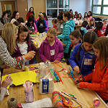
Co-Curricular Enhancements
STEM Saturday for Girls
Grant funded and sponsored
Grades 2-8 - over 200 participants
High school volunteers
Community presenters and practitioners: hands-on learning
Keynote speaker: Dr. Monica Linden, The Science of the Brain
Girls Who Code
National program for girls in grades 5-12
Volunteer “instructor” and advisor from school
Women in STEM Event
Modeled after event at Ponagansett High School, RI
Planned and implemented by two senior and two junior girls
Women in STEM careers from chemical engineers to neurologists spoke to students about their careers in a workshop format.

Slide 17
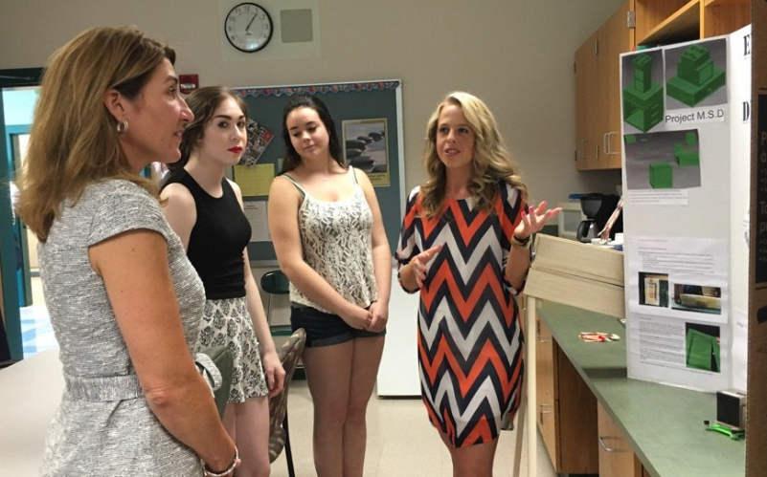
Must Haves...
Core values that include (growth mindset) understanding of the power of instruction - spending more time on the “how to”
Courageous and willing professional staff
Meaningful, job embedded, and on-going professional learning
Grant funding and technical support - LINDE Family foundation, WPI
Generous confidence, support, engagement, and funding from School Committee and community
Deep knowledge of core, essential technologies
(mobile devices, 3D printers, etc.)
Patience...it’s always a work in progress…

