Slide 1
Student Success Through Quality Instruction
Discussion with AMCOA
September 29, 2017

Slide 2
Where MA needs to be
55%
72%
Percent of Massachusetts adults with a postsecondary degree or certificate in 2014¹
Percent of Massachusetts jobs requiring postsecondary education by 2020²
Sources: ¹“A Stronger Nation,” Lumina Foundation, 2016; ²Goal 2025, Lumina Foundation

Slide 3
The instructional black box?
Goals & Objectives
Essential Learning Outcomes
Inquiry and analysis
Critical & creative thinking
Written & oral communication
Quantitative reasoning
Teamwork & problem solving
Civic knowledge & engagement
Instruction
Teach the arts of inquiry & innovation
Engage the big questions
Connect knowledge with choices and action
Foster civic, intercultural, and ethical learning
Outcome Measure
VALUE
Rubric
Topic selection
Knowledge, research
& views
Design process
Analysis
Conclusion
Limitations & implications
?

Slide 4
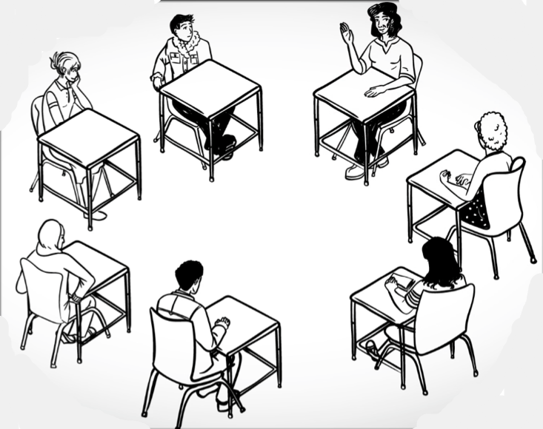
The “student success” agenda
Supplemental Instruction/Tutoring
Guided Pathways
Predictive
Analytics
High-impact Practices
Quality Instruction?
Authentic Assessment
Financial
Supports
Course and Program Redesign
Advising

Slide 5
Instructors’ sizeable impact
200:1
The typical college student spends 200 hours with instructors each semester; by comparison, students see their advisor for about an hour.²
Using evidence-based practices, one instructor can benefit 120-180 students per year, or more.¹
Sources: ¹Assumes a course load of 4 to 6 courses per year with an average of 30 students per course; ²”The Evolving Role of Faculty in Student Success,” EAB, 2016

Slide 6
The changing academic workforce
Today
1969
Tenure-Track Positions: 482,000 faculty (33.5%)
Non-Tenure Track: 103,000 faculty (21.7%)
(102,858)
(482,090)
Tenure-Track Positions: 371,000 faculty (78.3%)
Non-Tenure Track: 957,000 faculty (66.5%)
(956,984)
(371,142)
474,000 faculty
1,439,000 faculty
Sources: Kezar and Maxey, Association of Governing Boards of Universities and Colleges, 2013; National Center for Education Statistics, 2017

Slide 7
ACUE’s purpose and approach
Prepares and credentials college educators in evidence-based teaching practices necessary for student success.
Endorsed by the American Council on Education, one of the nation’s most influential higher education associations.

Slide 8
ACUE’s Course: Comprehensive and evidence-based
Designing an Effective Course and Class
Establishing Powerful Learning Outcomes
Aligning Assessments With Course Outcomes
Establishing a Productive Learning Environment
Leading the First Day of Class
Using Active Learning Techniques
Using Active Learning Techniques in Small Groups
Promoting Higher Order Thinking
Assessing to Inform Instruction and Promote Learning
Aligning Activities and Assignments With Course Outcomes
Preparing an Effective Syllabus
Planning an Effective Class Session
Promoting a Civil Learning Environment
Connecting With Your Students
Motivating Your Students
Engaging Underprepared Students
Helping Students Persist in Their Studies
Embracing Diversity in Your Classroom
Using Active Learning Techniques in Large Classes
Delivering an Effective Lecture
Planning Effective Class Discussions
Facilitating Engaging Class Discussions
Integrating Civic Learning Into Your Course
Providing Clear Directions and Explanations
Using Concept Maps and Other Visualization Tools
Teaching Powerful Note-Taking Skills
Using Advanced Questioning Techniques
Developing Self-Directed Learners
Developing Fair, Consistent, and Transparent Grading Practices
Developing and Using Rubrics and Checklists
Providing Useful Feedback
Checking for Student Understanding
Using Student Achievement and Feedback to Improve Your Teaching
1
2
3
4
5

Slide 9
Adopted by institutions nationwide
Salem State
University
Miami Dade
College
California State University, Los Angeles
Goucher
College
Rutgers University-Newark
City College of San Francisco
Connecticut State Colleges and Universities
University of the District of Columbia
The University of
Southern Mississippi
Colorado State
University
Kansas State
University
University of
Missouri
North Carolina Central University
West Virginia
University
Eastern Connecticut State University
Northern Arizona University
Housatonic Community College
The University of Montana-Western
University of
Nevada, Reno
Texas Woman’s University
Naugatuck Valley Community College
Delta State
University
Southern Connecticut State University
The City College of
New York
Kansas City Kansas Community College
Park
University
University of Arkansas Pulaski Technical College
Arizona State
University
New Jersey City
University
Baker
University
Notes:
Customers not listed:
Donnelly
University of Central Missouri
Sam Houston State
Eastern Maine Community College
West Virginia Wesleyan
Sacramento State
UD Mercy
Broward
San Francisco State
CSU East Bay
UNC Wilmington
Sonoma State

Slide 10
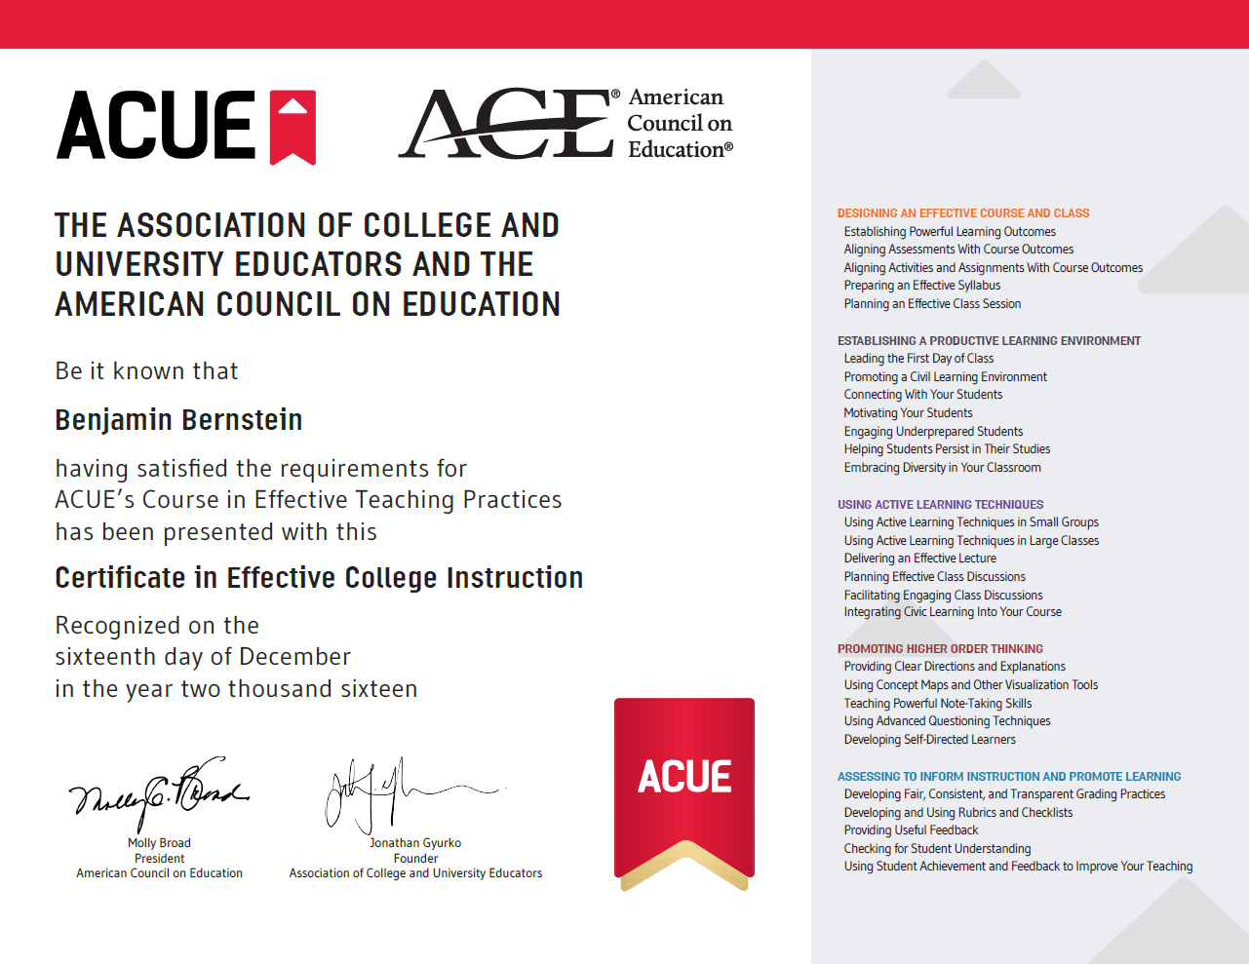
ACUE’s Certificate in Effective College Instruction
ACUE’s Certificate distinguishes instructors who are prepared to teach and institutions that are improving student outcomes through great teaching.

Slide 11
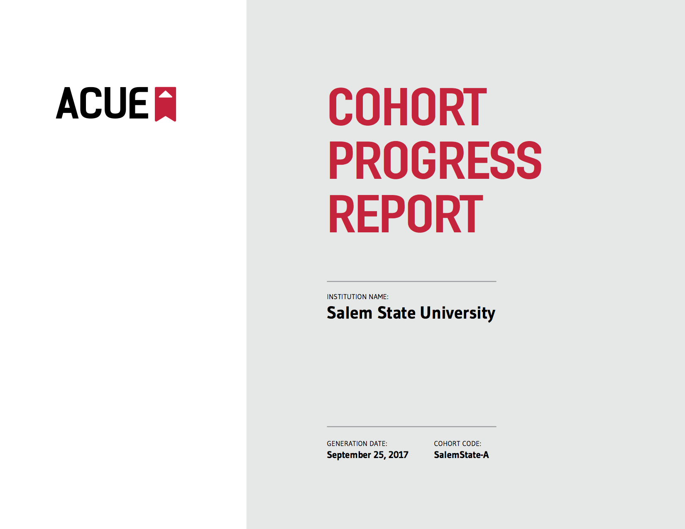
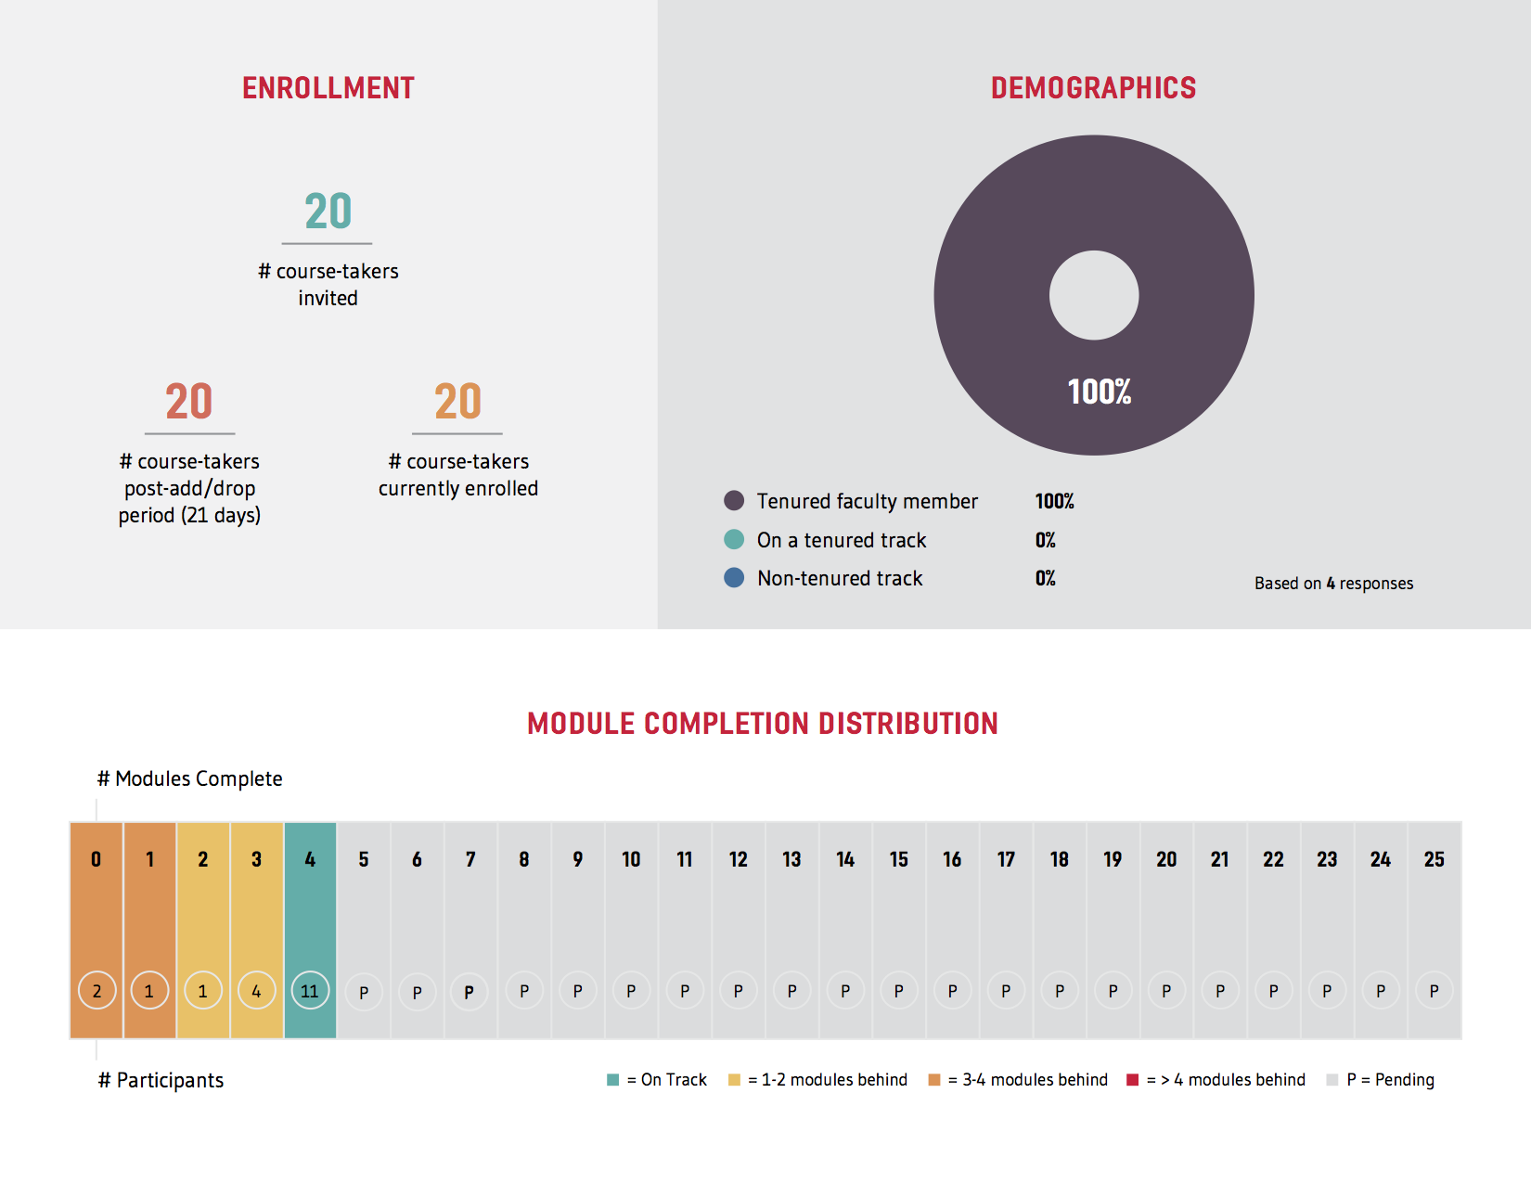
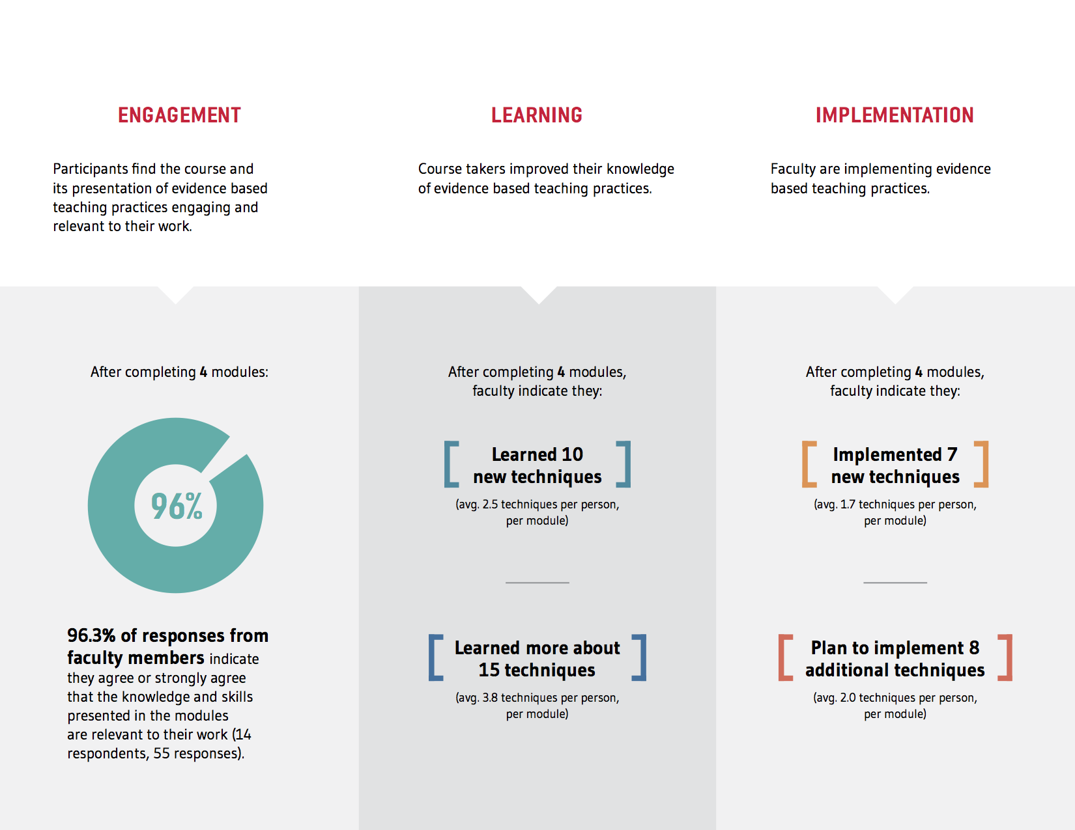
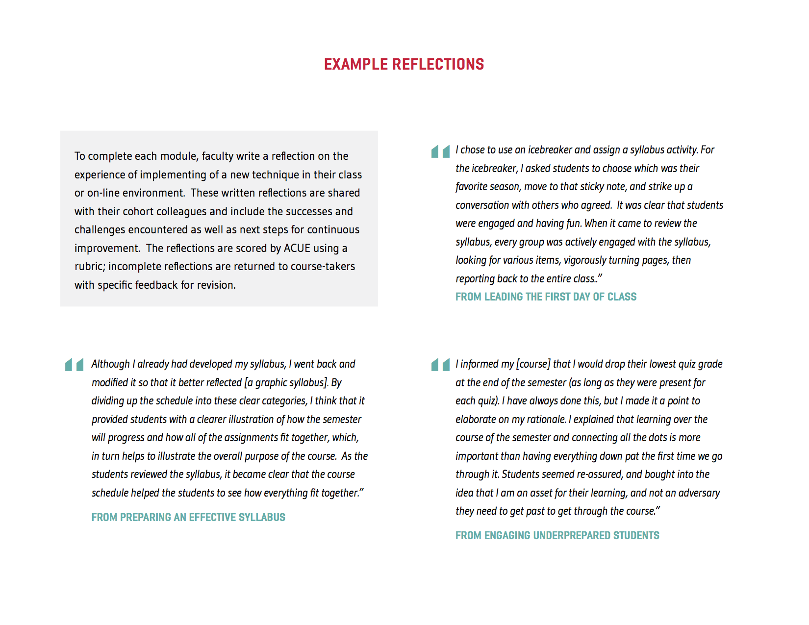
Real-time accountability
In four weeks at Salem State:
96% of faculty find the course relevant
Faculty have:
Completed 4 modules
Learned avg. 10 new techniques
Deepened knowledge 15 more
Implemented 7 new techniques
Plan to implement 8 more

Slide 12
Faculty and student impact
GPAs
25%
Cal State-LA
For 1,000 CSU-LA students taught by ACUE- and CETL-supported faculty in classes with historically high DFW rates:
Students’ GPA rose 24.5%, from 2.48 to 3.09
D grades, Fs, and withdrawals declined by 47%
Miami Dade College
Among 1,300 students taught by ACUE-credentialed faculty, student satisfaction topped 96%, significantly above the college average
Rutgers University-Newark
Faculty teaching 2,000 students reported:
an average 64 percentage point increase in their confidence using evidence-based teaching practices
a 52 point increase in their ability to impact student outcomes
Nationwide
In a survey of over 500 participating faculty:
98% find course content relevant
96% refined their teaching
95% recommend the program to their peers
DFWs
47%
>
Student
satisfaction
96%
Faculty confidence
260%+
>
Faculty
engagement
96%

Slide 13
Salem State and ACUE
Neal DeChillo, Ph.D.
Associate Provost for Academic Affairs
Salem State University
Marc Ebenfield
Director, Center for Teaching Innovation
Salem State University

Slide 14
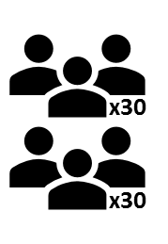
Partnership services
ACUE Academic Lead
Collaborative Program Design
Course Facilitator Preparation
Course-taker Recruitment and Orientation
Ongoing Course Support
Enroll and Prepare Faculty Cohorts
Score Required Assignments
Issue Badges and Credentials
Measure Educational Impact and Financial Return
ACUE Community of Professional Practice

Slide 15
Course experience
Promoting Higher Order Thinking
Module 4e:
Developing Self-directed Learners

Slide 16
Next steps
Expand the conversation to include key campus leaders
Arrange a course experience for stakeholders on your campus
Design a high-impact partnership
Technical assistance for PIF grant proposals

Slide 17
Q & A

