Slide 1
Refinement Year Results (2016-2017) – 1/19/2018

Slide 2
Study Participation and Representativeness
These slides summarize results from the Refinement Year of the Multi-State Collaborative to Advance Quality Student Learning involving 13 states using common rubrics to assess more than 7,000 pieces of student work.

Slide 3
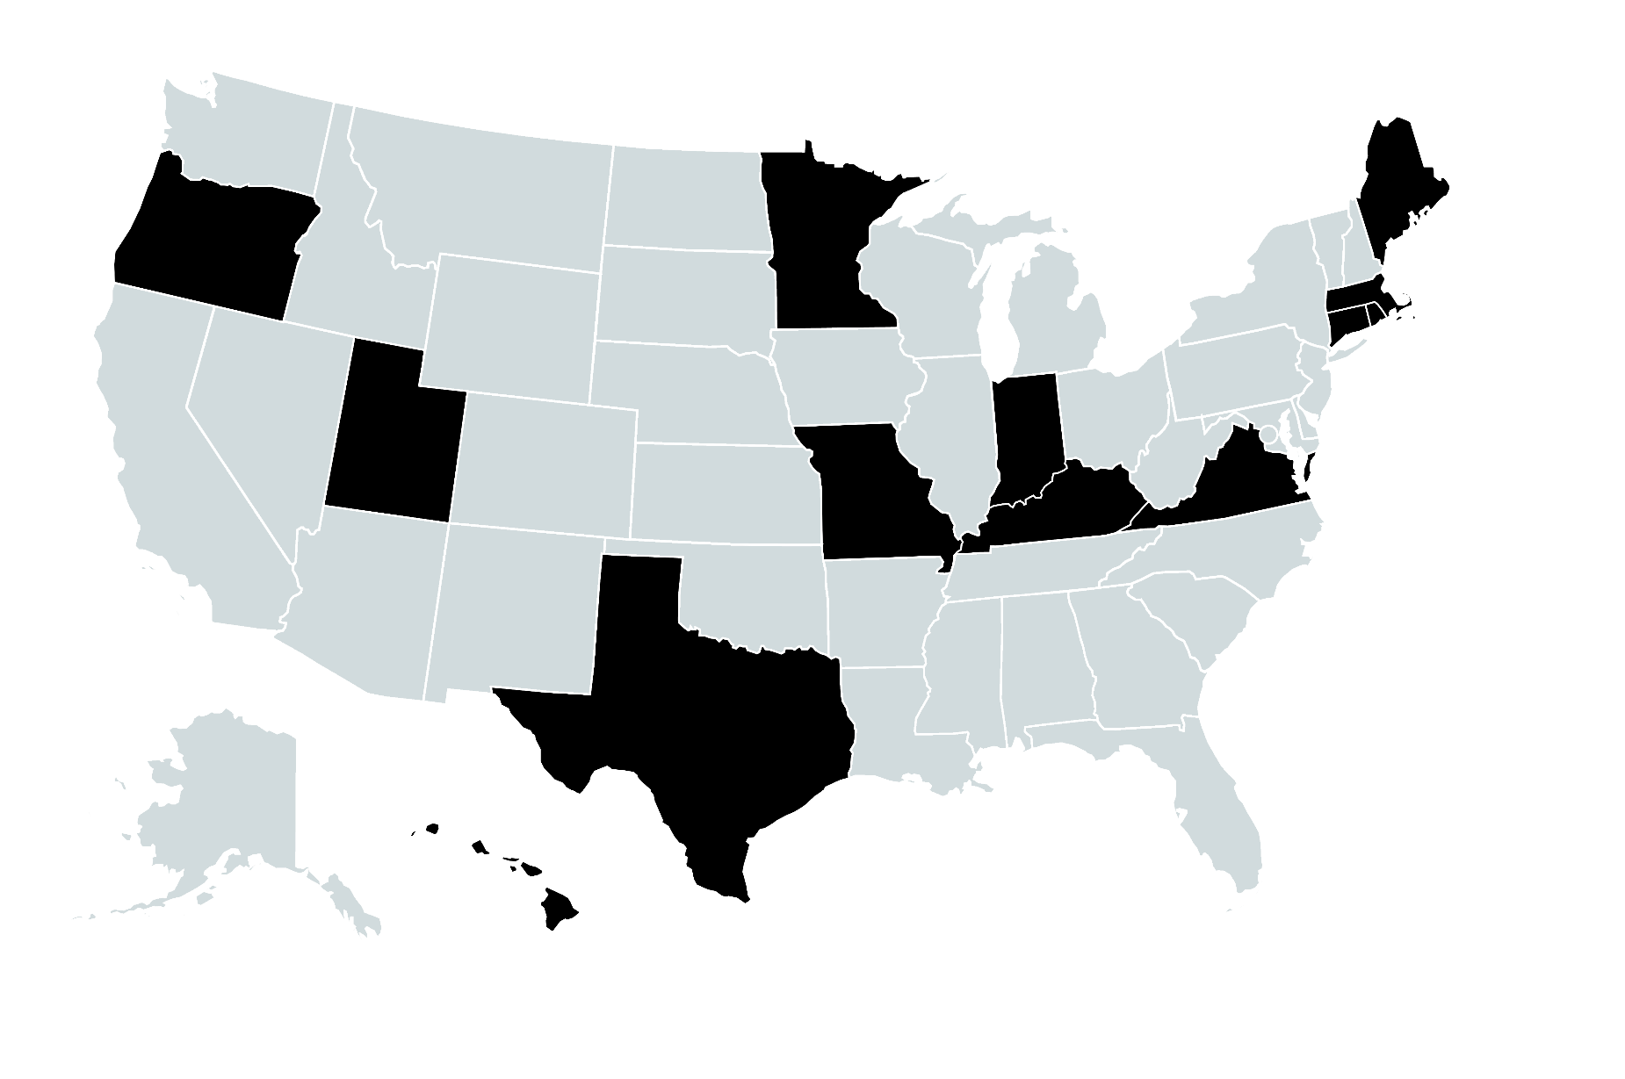
Participating States
13 States
Connecticut, Hawaii, Indiana, Kentucky, Maine, Massachusetts, Minnesota, Missouri, Oregon, Rhode Island, Texas, Utah, and Virginia

Slide 4
7,386 papers were submitted
All students were near graduation. By the time that students graduate, are they proficient in writing, presenting, and interpreting data? Are they proficient at thinking critically?
 | Critical Thinking | Quantitative Literacy | Written Communication | Total
Associates | 1,131 | 449 | 982 | 2,562
Bachelors | 2,024 | 782 | 2,018 | 4,824
Total | 3,155 | 1,231 | 3,000 | 7,386
Note: Excludes “early” students, students with an unknown degree level, duplicates, and students with credits outside of the MSC project range.

Slide 5
Representativeness: Gender
MSC Project Sample Demographics Relative to Graduating Students at Participating Institutions
IPEDS MSC
IPEDS MSC
IPEDS MSC
IPEDS MSC
IPEDS MSC
IPEDS MSC
Comparison data used are 2015 IPEDS graduates (associates, bachelors) at participating institutions.
Notes:
The number of female and male students who submitted papers is generally reflective of the overall number of females and males in their two year and four year institutions.

Slide 6
Representativeness: Age
MSC Project Sample Demographics Relative to Graduating Students at Participating Institutions
Comparison data used are 2015 IPEDS graduates (associates, bachelors) at participating institutions.
Notes:
At two year institutions, the age ranges of students who submitted papers are consistent with their overall institutional profiles. Four year institutions had slightly more older students than their institutional profiles.

Slide 7
Representativeness: Race/Ethnicity
MSC Project Sample Demographics Relative to Graduating Students at Participating Institutions
IPEDS 67% White
MSC 71% White
Comparison data used are 2015 IPEDS graduates (associates, bachelors) at participating institutions.
Notes:
At two year institutions, the ethnic backgrounds of students who submitted papers almost perfectly matched the institutional profiles.

Slide 8
Representativeness: Race/Ethnicity
MSC Project Sample Demographics Relative to Graduating Students at Participating Institutions
IPEDS 68% White
MSC 68% White
Comparison data used are 2015 IPEDS graduates (associates, bachelors) at participating institutions.
Notes:
At four year institutions, the MSC project sample demographic match is very close to the demographic of graduating students at those institutions

Slide 9
Massachusetts 2016-17
Distribution of Student Scores

Slide 10
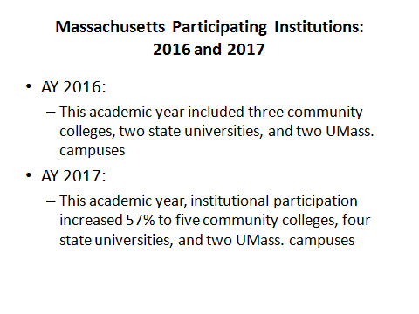

Slide 11
Multi State Collaborative Sample Sizes
 |  | 2015-2016 | 2016-2017 | Net Change (%)
Project Level
2yr colleges | Critical Thinking | 840 | 1,283 | 443 (52.7%)
 | Written Communication | 919 | 990 | 71 ( 7.7%)
 | Quantitative Literacy | 576 | 381 | 195 (-33.9%)
 | Total – 2yr colleges | 2,335 | 2,654 | 319 (13.7%)
4yr colleges | Critical Thinking | 2,056 | 2,006 | 50 ( -2.4%)
 | Written Communication | 1,936 | 2,123 | 187 ( 9.7%)
 | Quantitative Literacy | 787 | 748 | 39 ( -5.0%)
 | Total – 4yr colleges | 4,779 | 4,877 | 98 ( 2.1%)
Massachusetts Level
2 yr colleges | Critical Thinking | 108 | 312 | 204 (189%)
 | Written Communication | 123 | 281 | 158 (128%)
 | Quantitative Literacy | 24 | 38 | 14 ( 58.3%)
 | Total – 2yr colleges | 255 | 631 | 376 (147%)
4 yr colleges | Critical Thinking | 378 | 484 | 106 ( 28.0%)
 | Written Communication | 259 | 372 | 113 ( 43.6%)
 | Quantitative Literacy | 43 | 111 | 68 (158%)
 | Total – 4yr colleges | 680 | 967 | 287 (42.2%)

Slide 12
Massachusetts Critical Thinking Distribution - 2017
2-Year Institutions
4-Year Institutions

Slide 13
Massachusetts Written Communication Distribution - 2017
2-Year Institutions
4-Year Institutions

Slide 14
Massachusetts Quantitative Literacy Distribution - 2017
2-Year Institutions
4-Year Institutions

Slide 27
Suggested Action Items
Writing:
More focus on Syntax & Mechanics and Sources of Evidence (Written Communications) in the 1st and 2nd years
More activities related to Written Communications in 3rd and 4th year courses, programs, and majors (except in Syntax and Mechanics)
Resume or enhance existing “writing across the curriculum” activities
Faculty training on sources and evidence
Quantitative Literacy:
Increase activities related to Quantitative Literacy in 3rd and 4th year courses, programs, and majors
Employ quantitative literacy across the curriculum in addition to general education courses
Provide training for faculty on how to employ Quantitative Literacy in curriculum and assignment design at all levels
DHE to launch regional Quantitative Literacy faculty workshops in 2018

Slide 28
Suggested Action Items
Artifact & Assignments:
Focus on a high degree of fit between the VALUE Rubric and the assignment design, especially in writing and quantitative literacy
Continue to be selective in artifacts submitted and alignment with VALUE Rubrics

Slide 29
How Do We Address the Issues of Quality and Equity Without the MSC Going Forward?
Dr. Lane Glenn
President, Northern Essex Community College
Chair, Task Force on Statewide Assessment
January 19, 2018

Slide 30
How do we address the issues of quality and equity without the MSC going forward?
Forego the MSC/VALUE Institute due to cost
Each institution addresses the issue on an ad hoc basis
Continue to participate in the MSC/VALUE Institute on a periodic basis (e.g., every three years) on a shared cost basis between the DHE and the institutions
Other approaches?

Slide 31
How do we assess the issues of quality and equity without the MSC going forward?
Forego the MSC/VALUE Institute due to cost:
No method to assess institutional quality and address equity
Weakens the ability of institutions to demonstrate the assessment of educational quality
Loss of statewide perspective and the ability to effect policy
Inability to fully meet state legal (Chapter 15A, Section 32) for assessing quality
Loss of national perspective

Slide 32
How do we address the issues of quality and equity without the MSC going forward?
Each institution addresses the issue on an ad hoc basis:
Could still meet institutional assessment needs
Saves the cost of the VALUE Institute (projected to be at least $4,500 per institution for 2018-2019) assuming the use of lower cost vendor or a local solution
Forego statewide perspective and the ability to impact policy
Weakens the state’s ability to meet its legal and performance measurement requirements
May forego national perspective if a local approach is employed versus the VALUE Institute

Slide 33
How do we assess the issues of quality and equity without the MSC going forward?
Continue to participate in the MSC/VALUE Institute on a periodic basis (e.g., every three years) on a shared basis between the DHE and the institutions:
Enables institutions to meet their institutional assessment needs
Enables the state to meet its legal and performance measurement requirements
Provides institutions time to implement changes before assessing the impact
Enables the state to address statewide policy issues
Shares the cost and responsibility between the institutions and the state

Slide 34
How do we assess the issues of quality and equity without the MSC going forward?
Other Approaches?
Each institution do their own approach, be it VALUE Institute, another vendor, or a local solution:
Issues of consistency
Issues of data comparability
Each institution provide their local data to DHE to be aggregated and reported on a statewide basis:
Issues of system comparability
Issues of institutional data privacy
DHE will need to obtain a technical platform to process the data an to add technical/statistical expertise to generate reporting
Issues of additional costs

