Slide 1
Program Assessment from the Lens of a Department Chair: A Journey from Compliance to Engagement
Dr. James W. Dottin
Department Chair
Business Administration
Middlesex Community College

Slide 2
Guiding Question: What do you want to take with you when this presentation ends?

Slide 3
Critical Event #1: Disruption of the Status Quo
Summer 2014 – Formulation of A Strategic Innovation Vision for Positive Development of the Department Faculty
Fall 2014 - Department Introduction to the Assessment Process
An Assessment Strategy: Means to the Ends
Dynamic Change: Status Quo to Disruption
1st Compliance / Acceptance
2nd Skepticism / Hesitancy
3rd Resistance: Overt/Passive

Slide 4
Critical Event #2: Assessing the Assessor
Development of the Faculty ability to produce consistent work across the department’s curriculum
Resulting in an assessment process that stressed self-examination versus external examination
To measure the individual and collective progress of the Department through Shared Goals

Slide 5
Change – An Uncomfortable Interative Process
Planning for the Change
Development of Contingency Scenarios
Valuing Fulltime and Adjunct Faculty as Equals

Slide 6
Critical Event #3: Innovation - A Self-Reflective Process
Self-Identifying Measurable Factors
Evaluation
Re-Evaluation
Self-Reflection

Slide 7
COURSES MAPPED TO PSLOs | Use critical thinking and creative problem solving to analyze and develop solutions to real world problems. | Develop effective professional and technological business communication skills. | Demonstrate their abilities to analyze global and cultural business practices. | Develop an ethical framework and value the dimensions of social responsibility for professional decision-making. | Develop leadership, teambuilding and interpersonal skills that are essential to their professional success.
BUS 110 | 4 I D 4 D 3 C | 3 I I 5 D 2 C | 4 I I 5 D | 4 I D 5 D 1 C | 3 I D 2 D
CAP 101 | 1 I I/D 1 D | 1 I I/D 4 D | 1 I I/D 4 D 1 C | 1 I I/D 4 D | 1 I I/D 3 D
BUS 210 | 1 I D 4 D C | 1 I D 4 D D | 1 I D 4 D I 1 C | 1 I D 4 D C | 1 I D 3 D C
BUS 221 | 1 C C | 1 D D | 1 I I | 1 I D | 1 D D
BUS 240 | 2 I D 1 D 1 C | 2 I C 1 D 1 C | 2 I D 1 D 1 C | 2 I D 2 D | 2 I C 1 D 1 C
BUS 223 | 1 C C | 1 D D | 1 I I | 1 I D | 1 D D

Slide 8
Critical Event #4: Finding Common Ground
PSLO: | Critical Thinking and Creative Problem Solving
Draft minimal common language for course outcome | Analyze and apply critical thinking and creative problem solving skills to real-world management issues. Analyze business problems from multiple perspectives, using evidence.
Assignment examples that might require students to demonstrate their Competency with this PSLO | Case studies Final project Short questions and answers using research Stakeholder perspectives (all of them)
Academic Freedom Use as a Defensive Tool of Resistance
Exposure of Weaknesses
Collaborative Sharing of Assignment Redesign
Business Retreat – Introduced “Backward Design” process for SLOs
Additional Professional Development Training Needed for Department Faculty

Slide 9
WORKSHEET #2
Course: BUS210:
For each PSLO for which there is a course expectation that students demonstrate Competency:
PSLO: | Critical Thinking and Creative Problem Solving
Draft minimal common language for course outcome | Analyze and apply critical thinking and creative problem solving skills to real-world management issues. Analyze business problems from multiple perspectives, using evidence.
Assignment examples that might require students to demonstrate their Competency with this PSLO | Case studies Final project Short questions and answers using research Stakeholder perspectives (all of them)

Slide 10
Critical Event #5: Taking Ownership of the Process
Every Departmental Meetings / Assessment Topic on the Agenda
Assessment Projects
Development of Common Course Outcomes
Business Retreat
Assignment Redesign Sessions
Assessment Day – Engagement
Collection of Artifacts (All Identifiers Removed)
Selection – Selected Random Sample
Scoring
Discussion
Revising
Using Rubrics - NILOA
Critical Thinking
Global
Ethics & Social Responsibility
Scheduling Time to Assess
Assessment Activities

Slide 11
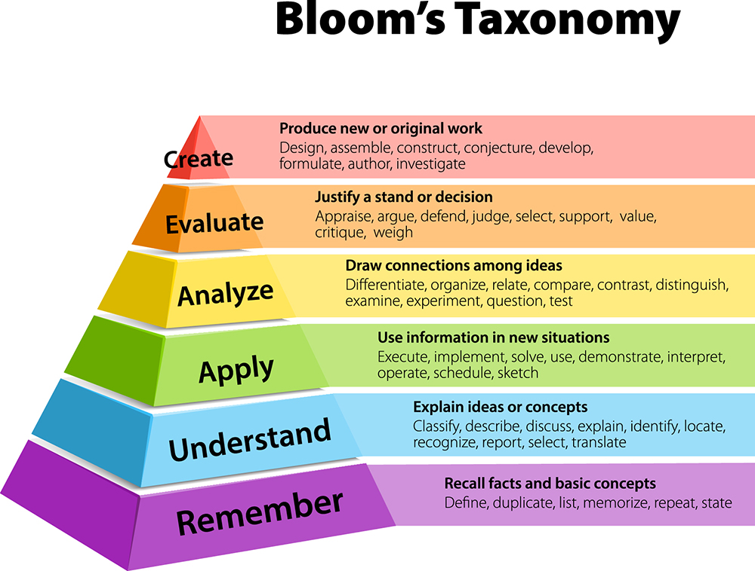
Common Course Student Learning Outcomes: Principles of Management
Identify the management functions.
Analyze complex management issues and provide alternative solutions.
Analyze the organization’s ethical and social practices impacting managerial decisions.
Evaluate domestic and global management practices within the cultural framework of the global economy.
Formulate management solutions from diverse viewpoints through collaborative activities.

Slide 12
Critical Event #6: Closing the Loop: An Engagement Follow-Up Process
Continuous Measurability of Our Students to the Institutional, Program, Course and Assignment Benchmarks to produce the desired results
Assessment Next Step is Student Follow-Up After Leaving the Institution
Taking Corrective Action Where Necessary

Slide 13
Future Critical Event #7: Development of An Assessment Culture
ISLO:
PSLO:
SLO:
What would this Assessment Culture Model look like?
Your Responses to the Question
“What are you looking to take with you when you leave this presentation?”
ALO:

Slide 14
Special Thanks To: Lane Glenn, Chair, Task Force on Statewide Assessment & President of Northern Essex Community College Phil Sisson, VP of Academic & Student Affairs Middlesex Community College
Robert Awkward Director of Learning Outcomes Assessment Board of Higher Education

