Slide 1
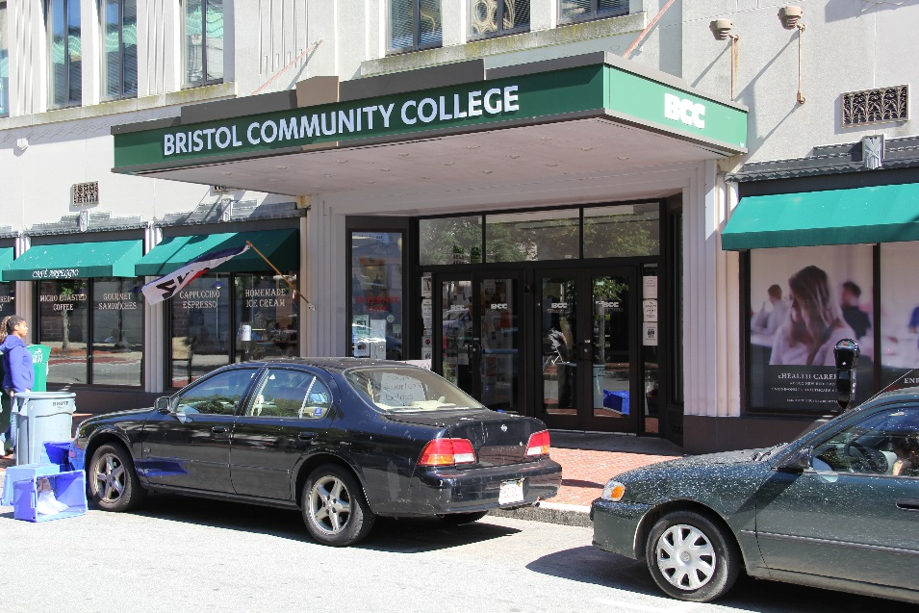
Identifying Opportunities for Civic Learning on Campuses and Across the System The Bristol Community College Experience
Suzanne M. Buglione, Ed.D,
Dean of the Lash Division of Teaching and Learning

Slide 2
Assessing and Convening
2014: Civic Engagement Fellow Summer Project
Low-hanging fruit – History & Government
2015: Creation of Civic Learning Team
Civic Engagement, Social & Behavioral Science, Center for Teaching & learning, Central Academic Affairs, Registrar & Institutional Research
Meets three times per semester (monthly)

Slide 3
Assessing and Planning
2015: Civic Learning Team:
Definitions & Goal Setting
Focus on Courses with Engagement: Application, Persistence (83.28%)
Majority of Civic Learning with Engagement (CLE) courses so students actively participate in civic life through an experiential project, assignment, or hands-on service, where possible.
No Optional
Focus of Academic versus Co-Curricular: Tracking & Assessment
Focus on both section-level (without engagement) & course-level (with engagement) designation
Government 111 (U.S. Government) & History 113 (U.S. History to 1877): Most common, faculty champions

Slide 4
Assessing and Planning
2015: Civic Learning Team
Concerns
Scaling up Service-Learning (Engagement) coupled with needed funds for training & support
Process for designation
Implementation Plan
Created Workplan
All Academic Meetings & Faculty/Staff Senate
Course Designation and Designation Checklist using DHE Definitions
Instituting Zero Credit Lab for CL with Engagement – Spring 2017

Slide 5
Civic Learning 2015-2016
Pilot Civic Learning with Engagement courses
6 courses Fall 2015, 6 courses Spring 2016 - History 113, Government 111
86 students Fall, 58 students Spring
Zero Credit Lab model for CL with Engagement
Applications to faculty in Fall 2016 for Spring 2017
Model: Flexible lab with fee $35, $500 additional, OER stipended
No applicants
Develop Civic Learning Repository
DHE funds & Summer Projects

Slide 6
Civic Learning & Civic Engagement
Civic Learning Repository: a collection of curriculum materials, project and assignment ideas, and community partners

Slide 7
Civic Learning 2016-2017
Pilot Civic Learning with Engagement courses
4 courses Fall 2016, 4 courses Spring 2017 - History 113, Government 111
49 students Fall, 58 students Spring
Retool of Model for CL with Engagement
Applications to faculty in Spring 2017 for Fall 2017 – 4 accepted!
Model: Additional hour that’s flexible with fee $35, $350 additional, OER stipended. Have found Open Stax resources!

Slide 8
Civic Learning 2016-2017
Course-Level Designation
Process:
Recommended by CL Team, Department Discussion
Educational Effectiveness SLO Subcommittee – Governance
History 114 (U.S. History from 1877) & Government 251 (State & Local Government) added
Pilot Civic Learning with Engagement courses
4 courses Fall 2016, 4 courses Spring 2017 - History 113, Government 111
49 students Fall, 58 students Spring

Slide 9
Civic Learning – Next Steps
Assess
CL and CL with Engagement Data: 984 students
Pre and Post Surveys
Expand Course Designation
Sociology, Criminal Justice, Paralegal, Human Services, Nursing, Business
Coupled with Training & Support
Continue Pilot Model Civic Learning with Engagement courses
Explore Co-Curricular
Develop General Education Language denoting Requirement

Slide 10
Civic Learning – Lesson Learned
Be inclusive
Use structures creatively
Infuse training & support
Assess & plan for incremental growth
Tailor to your institution
Thank you!

