Slide 1
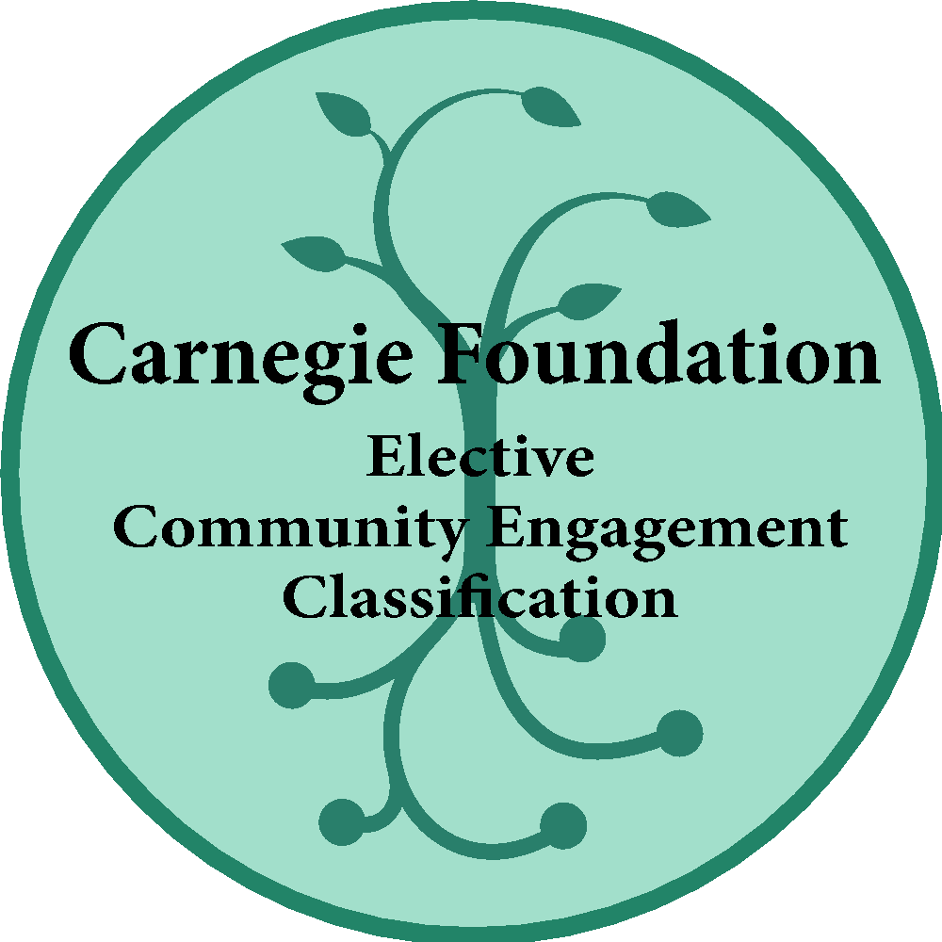
Bristol Community College
Public institution located in southeastern Massachusetts in the cities of Fall River, New Bedford, Attleboro and Taunton.
Fall ‘17 Enrollment: 7,637 (56.4% PT)
Retention Rate: 61.2%
46% Receive Pell; 26% Receive Loans
White: 69.7% Students of Color: 27% (Region 16%)
Top Enrolled Program: General Studies (38%)

Slide 2
Bristol Community College: Assessing Civic and Service-Learning
Formative – Civic Learning Team
Institution-Wide Membership:
Civic Engagement, Social & Behavioral Science, Center for Teaching & Learning, Central Academic Affairs, Registrar & Institutional Research – just added Student Services
Three meetings/semester
Strategy:
Build on Service-Learning – Required Engagement
Low-hanging Fruit
Conversations - All Academic Meetings & Faculty/Staff Senate
Course Designation and Designation Checklist using DHE Definitions
SLO Subcommittee of Educational Effectiveness Committee
Review Data & Restrategize

Slide 3
Bristol Community College: Assessing Civic and Service-Learning
Summative & Formative Assessment
Course-Level By Faculty:
SLOs & Reflection
Summative Assessment
DHE Reporting:
CL and CLE/Service-Learning Data - Courses, Students
Strategy:
# Course Designation
# Pilot Courses and faculty to cultivate or train
NSLVE Data Changes
Co-Curricular Engagement (future)

Slide 4
Bristol Community College: Assessing Civic and Service-Learning
Summative Assessment
Outcomes:
Pre and Post surveys with students in courses
4 Domains: Academic, Career, Personal Development, Community Engagement
Diaz-Gallegos, D., Furco, A., & Yamada, H. (1990). Higher education service learning surveys. Retrieved from http://www.servicelearning.org/filemanager/down-load/HEdSurveyRel.pdf.

Slide 5
Bristol Community College: Assessing Civic and Service-Learning
Outcomes: Pre and Post surveys with students in courses
Academic (retention and graduation)
81% of students reported that their participation in the service component enhanced their understanding of the course material
“I expected it to strengthen my understanding of the course which it did”
“It feels good to make a difference through scholarly work”
Career (job offers)
I feel well-prepared for my future career – increased with statistical significance
“I enjoyed being involved in developing network connections for new business professionals”
“These endeavors will undoubtedly serve me in my practice as clinician

Slide 6
Bristol Community College: Assessing Civic and Service-Learning
Outcomes: Pre and Post surveys with students in courses
Personal Development (self-efficacy, teamwork)
What happens is my own doing – increased with statistical significance
“I knew it was going to be challenging and time consuming, but I also knew that I would walk away feeling accomplished and like I made a difference in a child's life”
“This service-learning project encouraged me to "come out of my shell, collaborate with others, exercise leadership roles, and to think creatively”
Community Outcomes (intention to continue, partnership with orgs in the region that has reciprocity – you teach our students, provide them with experience and we provide you with help, innovation)
85% of students reported that they intend to continue to serve their community in the future
“I enjoy working in the community and educating others. This service project gave me that opportunity”
“I enjoyed making a difference in the community and their feedback was positive”

Slide 7
Bristol Community College: Assessing Civic and Service-Learning
Summative Assessment
Outcomes:
Persistence: 11% gains
Retention: 7% gains
16% gains with male students
Learned that students are taking these courses in their 2nd year of college

Slide 8
Bristol Community College: Assessing Civic and Service-Learning
Lessons Learned
Be inclusive
Use structures creatively
Infuse training & support
Assess & plan for incremental growth
Tailor to your institution
Commit to it

Slide 9
Bristol Community College
“We are going to impact a student so they can have an impact on their community, that they can remake the conditions of their own daily existence…I think that if they’re taking their Pre-Calc and their Calculus and their ‘this and that’, and they get that degree in Engineering Technology, and off they go to UMass Dartmouth, I don’t think that’s really going to connect them.
If it’s a first generation, Guatemalan kid from New Bedford who lives in an area where there’s a need for social reconstruction, and he or she is not engaged in that process, and doesn’t have the ability to get engaged in that process, I think that’s a problem…it’s our job…How can our students, how can they have the cultural capital to exist, succeed & impact their communities?”
Chief Academic Officer

