Slide 1
Continuing to Advance the Culture of Assessment in Massachusetts
Dr. Patricia Marshall, Deputy Commissioner for Academic Affairs & Student Success
Dr. Lane Glenn, President, Northern Essex Community College
Dr. Robert Awkward, Director of Learning Outcomes Assessment
Board of Higher Education — March 21, 2017

Slide 2
Why Assess Learning Outcomes?
Student Learning Outcomes Assessment Update
Achievement & Completion
Student learning
Transfer
Accreditation
Public accountability
Statutory responsibility
Employer needs

Slide 3
Brief History
Student Learning Outcomes Assessment Update
Working Group on Student Learning Outcomes and Assessment established the following in January 2010:
External factors
Have faculty drive assessment
Avoid standardized tests
Address lack of assessment culture
Create assessment initiative

Slide 4
Common Framework
Student Learning Outcomes Assessment Update
Authentic Student Work
LEAP Essential Learning Outcomes
  Critical & Creative Thinking
  Quantitative Literacy
  Written & Oral Communication
LEAP VALUE Rubrics

Slide 5

Massachusetts Organizing Structure
Student Learning Outcomes Assessment Update
Massachusetts Task Force on
Statewide Assessment
Chair: Dr. Lane Glenn, President,
Northern Essex Community College
Providing broad oversight for Massachusetts
State Level
Amcoa Team
Advancing assessment of student learning on public campuses; strengthening campus
assessment capabilities
Chair: R. J. Awkward
MSC Steering Committee
Representing MA in the Multistate Collaborative to develop a multistate program of assessment
Chair: R. J. Awkward

Slide 6
From Campus to State to
Multi-State Level of Assessment
Student Learning Outcomes Assessment Update
Campus-Level Assessment Initiative
Why Multiple Levels? Need to Build Upon
Campus-Level
Assessment
System-Level Assessment Initiative
Need for a Need for
Common Inclusive and
Framework Shared Leadership
Multi-State Collaborative (National)

Slide 7
Comprehensive Delivery Approach
Student Learning Outcomes Assessment Update
National Level | State Level | Campus Level
LEAP Framework | Task Force on Statewide Assessment | Institutional, program and course learning outcomes
Essential Learning Outcomes | Amcoa Team | Assessment Committee
VALUE Rubrics | Annual Assessment Conference | Assessment Day
Multi-State Collaborative Survey | MassTransfer Pathways | Assignment Design Workshops
 | Regional Professional Development | Campus Professional Development
 | Identification of Tools & Resources | Designation of Assessment Fellow(s)

Slide 8

Association of American
Colleges & Universities (AAC&U)
Student Learning Outcomes Assessment Update
LEAP (Liberal Education &
America’s Promise)
State Initiative
  Large scale collaboration
  Transformational change
  Educational alignment to raise quality
Essential Learning Outcomes
VALUE (Valid Assessment of Learning in Undergraduate Education) Rubrics

Slide 9

Multi-State Collaborative Sponsors
Student Learning Outcomes Assessment Update
State Higher Education
Executive Officers
Association
Association of American
Colleges & Universities

Slide 10
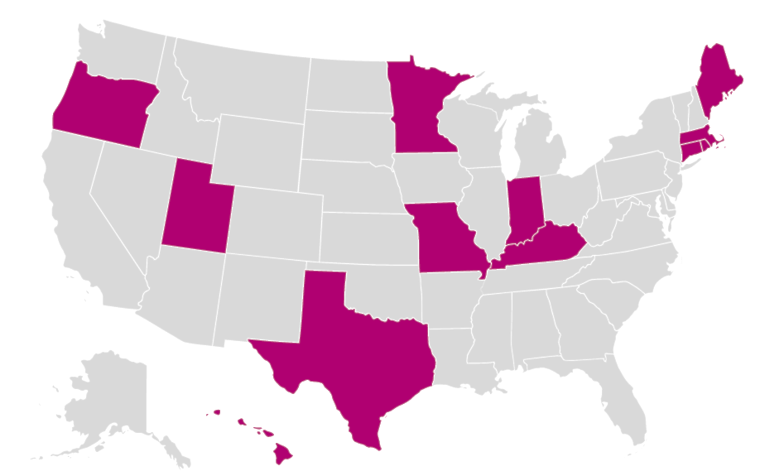
Multi-State Collaborative States
Student Learning Outcomes Assessment Update
12 States
Connecticut, Hawaii, Indiana, Kentucky, Maine, Massachusetts, Minnesota, Missouri, Oregon, Rhode Island, Texas, and Utah

Slide 11
Multi-State Collaborative Benefits
Student Learning Outcomes Assessment Update
MSC
Authentic student artifacts
Use of LEAP VALUE Rubrics
Compare data on multi-levels
Use to create campus strategies

Slide 12
Assessment Testimonial
Student Learning Outcomes Assessment Update
“Quinsigamond Community College’s participation in the [MSC] positively impacted our campus…
in various ways. Most importantly it caused the Quinsigamond Outcomes Research for Excellence (QORE) Team to reconsider how we could
better support faculty when they are designing, implementing and assessing assignments.”
A. Beaudry, Professor of English & Academic Technology Facilitator, Quinsigamond Community College, February 13, 2017

Slide 13
Massachusetts LEAP State Initiative
Student Learning Outcomes Assessment Update
Massachusetts Task Force on
Statewide Assessment
Chair: Dr. Lane Glenn, President,
Northern Essex Community College
Providing broad oversight for Massachusetts
State Level
Amcoa Team
Advancing assessment of student learning on public campuses; strengthening campus
assessment capabilities
Chair: R. J. Awkward
MSC Steering Committee
Representing MA in the Multistate Collaborative to develop a multistate program of assessment
Chair: R. J. Awkward

Slide 14
Annual Assessment Conference
Student Learning Outcomes Assessment Update
April 21, 2017: Sixth Annual AMCOA Assessment Conference
Selected national guest presenters:
  Dr. Susan Albertine, Senior Scholar, AAC&U (Keynote)
  Dr. Natasha Jankowski, Director, NILOA and Research Assistant Professor, Department of Education Policy, Organization and Leadership at the University of Illinois Urbana-Champaign

Slide 15

MassTransfer Pathways – Phase II
Student Learning Outcomes Assessment Update
Still to be initiated for Spring 2017:
Biology
Chemistry (General)
Economics
English
Sociology
In Progress:
Psychology
Faculty Review:
Chemistry (Organic)
History
Political Science
Completed:

Slide 16
Benefits of Statewide Coordination of Assessment
Student Learning Outcomes Assessment Update
Co-creation of knowledge
Minimizes duplication
Advances equity
Accreditation support
Institutional effectiveness

Slide 17
Assessment Testimonial
Student Learning Outcomes Assessment Update
“Participating in AMCOA keeps UMass Lowell in touch with our colleagues across the state and across segments, and provides a forum to discuss not only student learning outcomes assessment, but the related work each of our campuses is doing to promote students’ success around issues of transfer, professional development, student support, and pedagogy.”
Paula Haines, Director of Curriculum Assessment & Accreditation,
UMass Lowell, February 8, 2017

Slide 18
Future Initiatives
Student Learning Outcomes Assessment Update
MassTransfer Pathways (remaining disciplines)
Performance Measurement System Review
Information on assessment on DHE website
Campus education and professional development
Increased participation and utilization of MSC; especially small institutions
NILOA’s Excellence in Education Certification
Learning Assessment Research Consortium

Slide 19
Discussion

