Slide 1
Civic Engagement
Course Design
John Reiff, Director of Civic Learning and Engagement

Slide 2
In 2012 in Massachusetts:
The Board of Higher Education added this goal to its strategic plan for public higher education:
  PREPARING CITIZENS:
  Providing students with the knowledge, skills and dispositions to be active, informed citizens.

Slide 3
2014: The Board passed a Policy on
Civic Learning with this definition:
Civic learning means the acquisition of
  the knowledge,
  the intellectual skills, and
  the applied competencies or practical skills
that citizens need for informed and effective participation in civic and democratic life;
it also means acquiring an understanding of the social values that underlie democratic structures and practices.

Slide 4
. . . and with this observation:
Campuses should think about engendering civic learning through:
Academic coursework (general education, core courses, and major courses),
Co-curricular activities, and
Off-campus civic engagement.

Slide 5
Elements of a Civic Engagement Course
The syllabus articulates a substantial Civic Engagement activity which is explicitly linked to course learning goals.

Slide 6
Three Kinds of Learning Goals in Civic Engagement Courses
Personal Learning
CE Courses
Academic Learning
Civic Learning

Slide 7
Elements of a Civic Engagement Course
The Civic Engagement activity is designed to provide reciprocal benefits to both the students and a broader community beyond the classroom (which could be the campus community or a community beyond the campus).

Slide 9
Elements of a Civic Engagement Course
The Civic Engagement activity must include a reflection component in which the student is required to report on, present, or explain the significance of the experience and locate it within its broader political, social, or economic context.

Slide 10
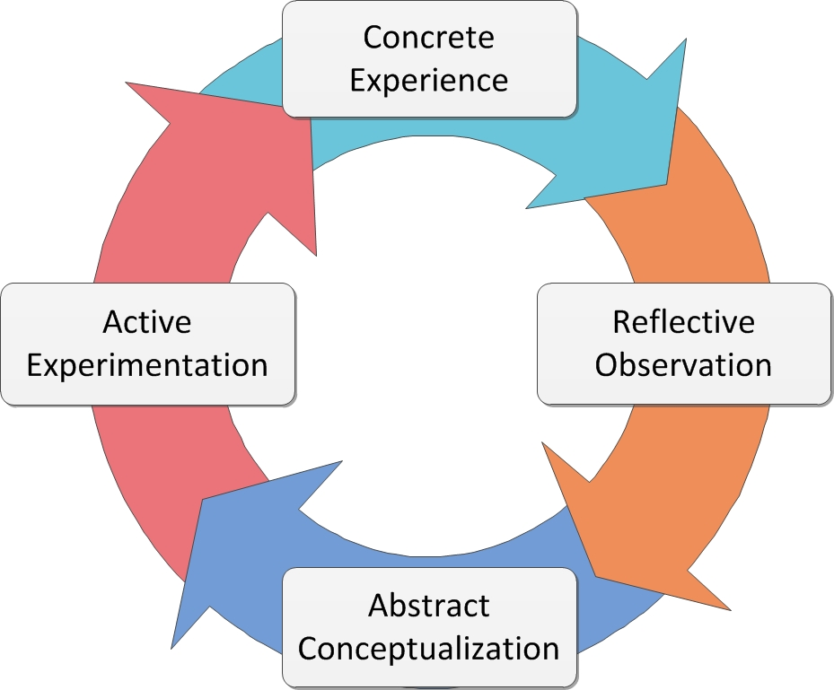
David Kolb’s Model of Experiential Learning

Slide 11
Elements of a Civic Engagement Course
Course outcomes are designed to include in a significant or substantial way at least one of the four elements of the Board’s definition of Civic Learning: acquiring the:
  Knowledge,
  Intellectual skills, and
  Applied competencies or practical skills that citizens need for informed and effective participation in civic and democratic life, and
  Acquiring an understanding of the social and political values underlying democratic structures and practices.

Slide 12
Elements of a Civic Engagement Course
Either:
Every student is required to participate in the Civic Engagement activity (project or placement), or
The Civic Engagement activity is offered as an option alongside another Civic Learning activity of roughly equal weight.

Slide 13
And now . . .
Table Discussions!
Thank you!
John Reiff
(jreiff@bhe.mass.edu)

