Slide 1
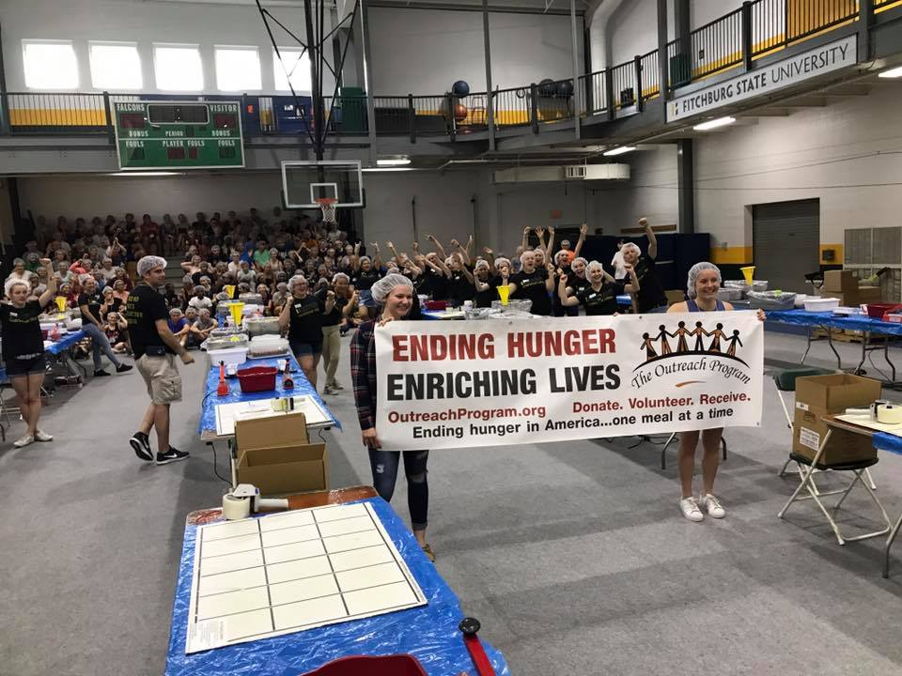
Civic Engagement in the Co-Curriculum

Slide 2
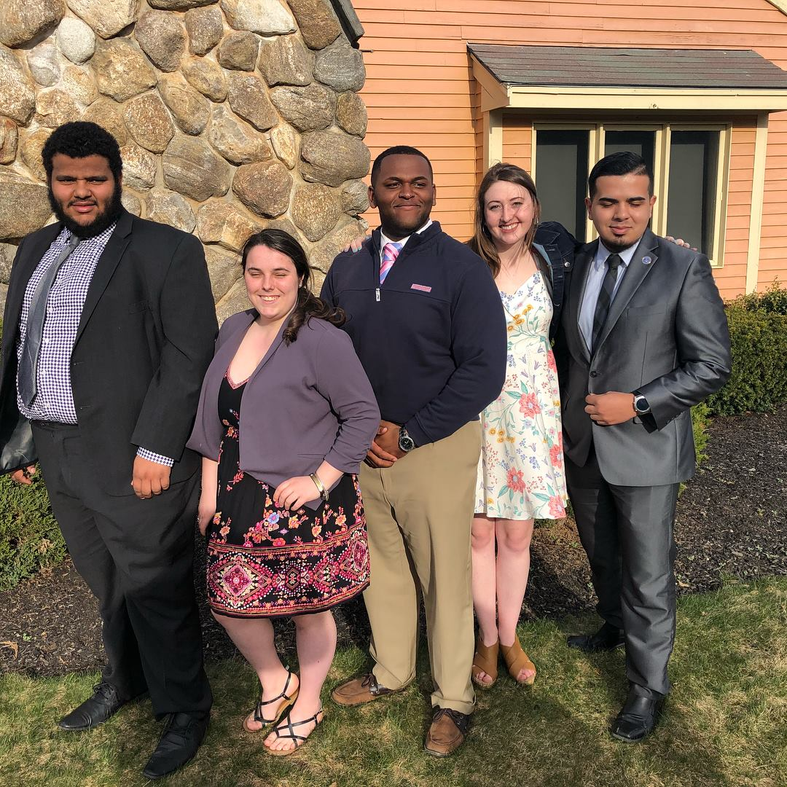
What Kinds of Civic Engagement Happen Outside the Classroom?
Student Governance
Political Activism – i.e. student political organizations,”Rock the Vote” drives, demonstrations
Advocacy – i.e. “It’s On Us,” Black Lives Matter, Feminist Conversations, Peer Educators
Workshops, panels, speakers
Free Tax Assistance

Slide 3
What Kinds of Civic Engagement Happen Outside the Classroom?
Philanthropic and Service Activities
Sometimes a requirement for any Student Organization to receive recognition and funding
Greeks
Alternative Spring Break
Boys & Girls Clubs
Blood Drives
Tutoring in Area Schools
Service Clubs – i.e. Alpha Phi Omega, Rotaract, Habitat for Humanity, Colleges Against Cancer, Relay for Life
Service Days/Events

Slide 4
Co-Curricular Challenges & Advantages for Assessment
Challenges
Lack of outcomes (in some cases)
Less structured collection of data (written student work, assignments, etc.)
Student resistance to formalized reflection or assessment
Varied duration and intensity of the experience
Advantages
Defined outcomes (in some cases)
Flexibility to try new things
Ability of students to be in leadership roles and shape the learning
Multi-year commitment from students at times

Slide 5
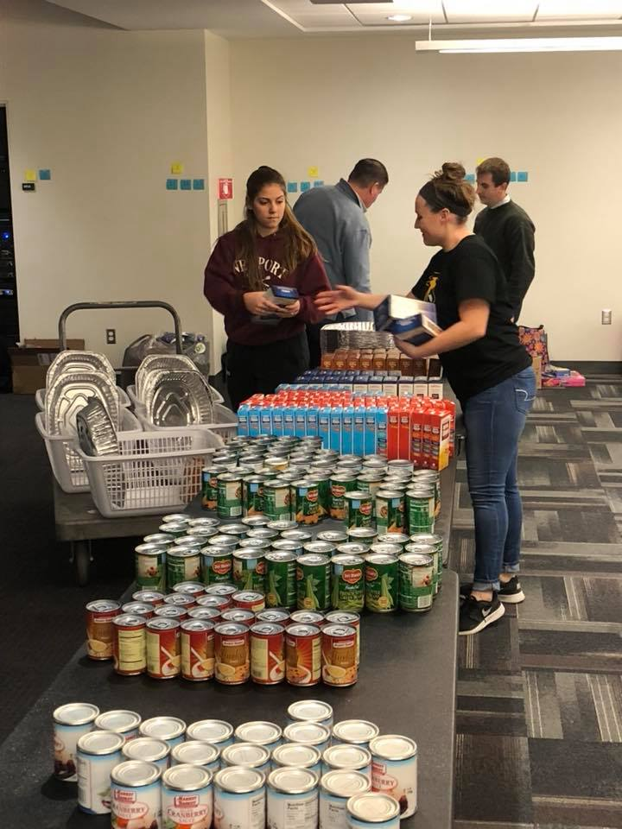
How do we Assess? Programmatic or Site Outcomes
Track numbers (i.e. hours devoted, number of voters registered, programs presented, money raised, number of times a topic is raised in official communications, number of families served)
Feedback from agency or non-profit about results (interview, focus group, survey)

Slide 6
How do we Assess? Student Learning Outcomes
From others:
Observations from agency or non-profit about student learning and student development (interview, focus group, survey)
Observations from the advisor or peer leader about student learning and student development (interview, focus group, survey)

Slide 7
How do we Assess? Student Learning Outcomes
Self-Reflection
Journaling
Reflective interviews or papers
Portfolio
Surveys of current participants/leaders
Surveys of alumni focusing on reflection on what was learned, continued civic engagement, continued philanthropic activity

Slide 8
How do we assess? Connecting to Larger Efforts
AAC&U VALUE Rubrics (one is Civic Engagement) – Valid Assessment of Learning in Undergraduate Education
National Survey on Student Engagement (NSSE)
Cooperative Institutional Research Program (CIRP)

Slide 9
How to Use Assessment Results
Demonstrate impact on achievement of institutional goals
Link to external measures of quality
Assist students in making meaning of their growth and experiences
Attract prospective students
Revise for effectiveness and best use of institutional resources

