Slide 1

Utilization Focused Approach to Self Study
A Program Evaluation of North Shore Community College’s Service-Learning Program
Presented by Cate Kaluzny, Ed.D.

Slide 2
Research questions
How do NSCC students perceive their service-learning experience?
What are the programs and services offered by the community partner organizations? What are their policies and regulations related to service-learning? What are their perceptions regarding students’ services? What are their expectations of service-learning students?
What factors motivate faculty members to become involved in the Service-Learning Program? What factors encourage them to persist?

Slide 3
Student
Many students indicated that the most-satisfying aspects of their service-learning experience were:
giving back to the community,
satisfaction with their service-learning projects,
interacting with new people,
learning new things, and
hands-on experience.
However, a few expressed concerns about commuting to the site, scheduling with agencies, paperwork associated with their service, coordinating with their team members, and communicating with the clients.

Slide 4
Community Partner
In-depth Semi-Structured Interviews
Twenty Community Partners
Risk and Safety, Orientations, Background Checks.
Community Partner Survey
Strengths: Willingness and Commitment of Students to Serve
Challenges: Communication

Slide 5
Faculty Motivation and Persistence
In reference to the question of why they got involved with service-learning, faculty members responded that they valued active learning and experiential education. Also, they indicated that the relevance to course materials, their personal involvement in community service and enjoyment of working with students in co-curricular settings as the common influencing factors for being involved in the Service-Learning Program.

Slide 6
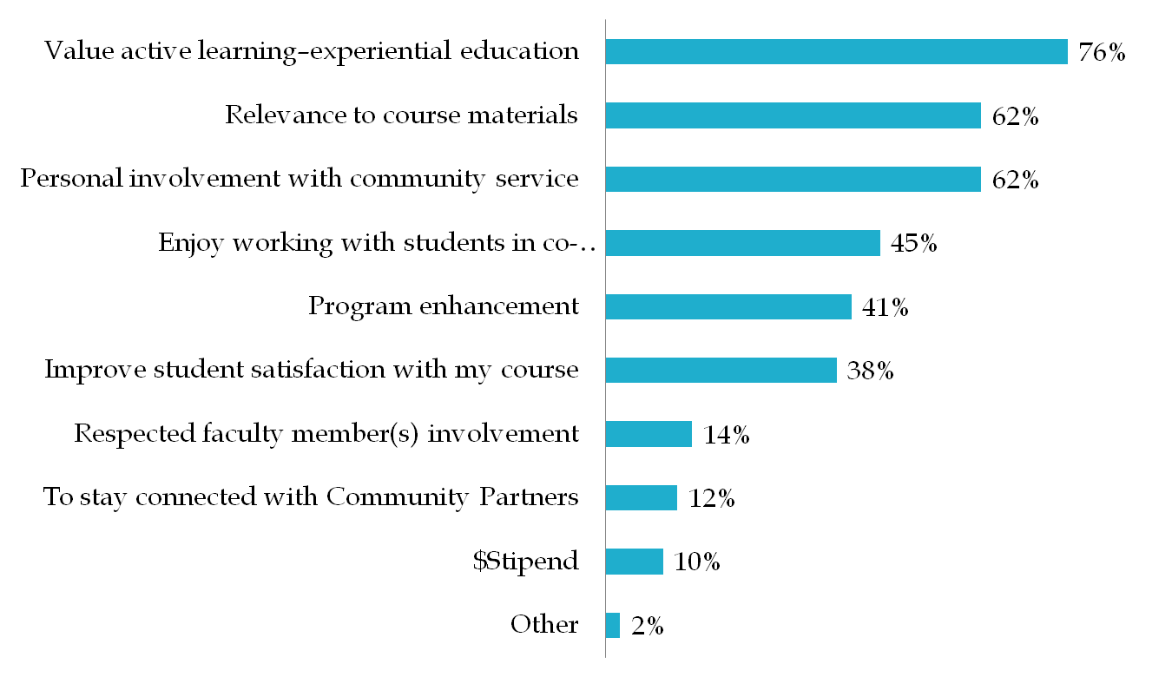
Why did you get involved in Service-Learning?

Slide 7
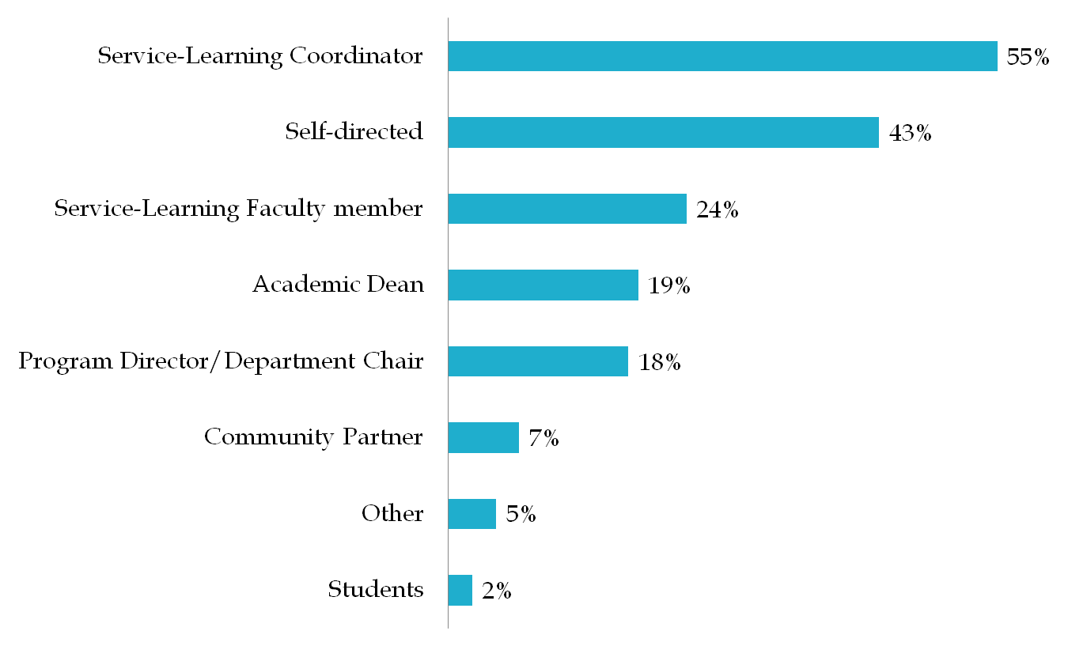
Who encouraged you to get involved in Service-Learning?

Slide 8
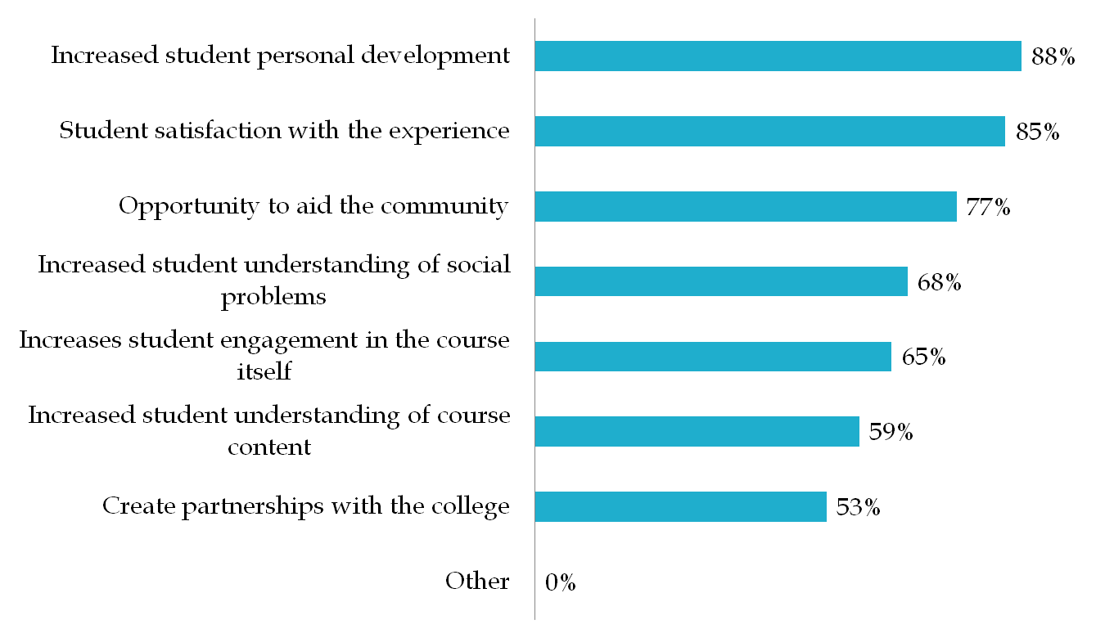
If YES, what ensures your continued participation in Service-Learning?

Slide 9
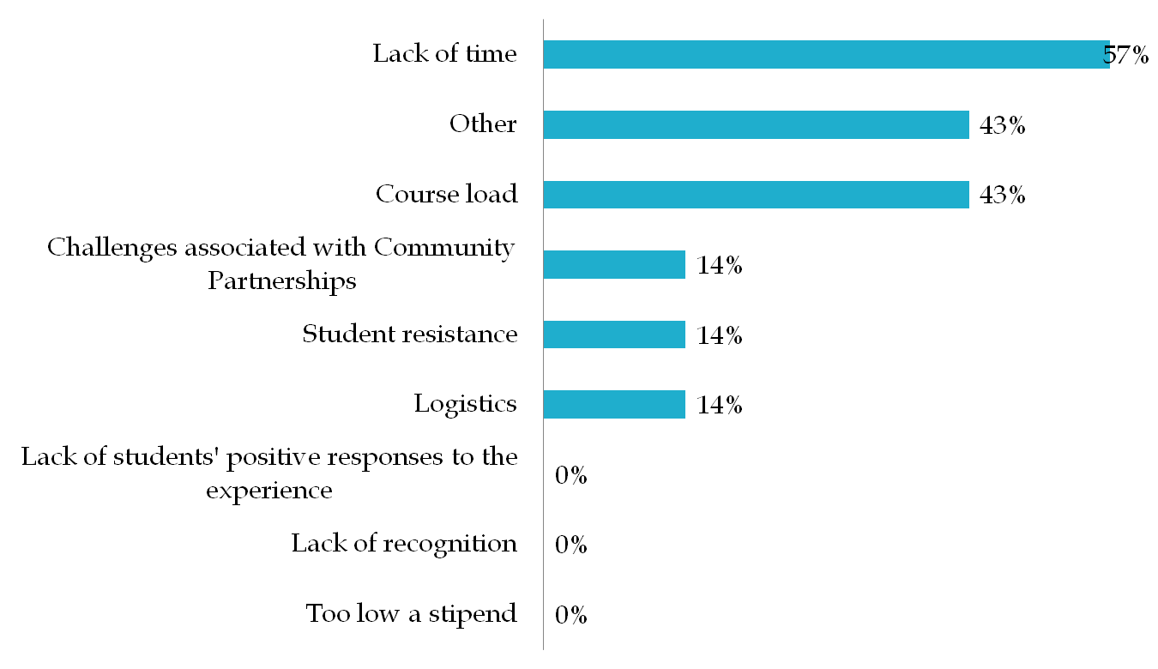
If NO, why not?

Slide 10
Closing the Loop
Maintain Strong Ties with Service-Learning Faculty (seek them out to assist in recruiting new service-learning faculty)
Create More Recognition for Service-Learning Faculty
Put Letters of Recognition in Faculty Files
Reward Years of Participation as Service-Learning Faculty
Expand Celebrations
Conduct Qualitative Study of Faculty Perceptions of Rewards and Recognition

Slide 11
Ongoing Assessment Activities
  Student Satisfaction Survey
  Participation in Regional Study of Community Partners
  Evaluation of Community Partner by Student
  Evaluation of Student by Community Partner
  Community Partner Satisfaction Survey
  Faculty Focus Groups and Surveys

Slide 12
Acknowledgement and Thanks
Saradha Ramesh, Ph.D., M.D.
Former NSCC ASSESSMENT COORDINATOR

