Slide 1
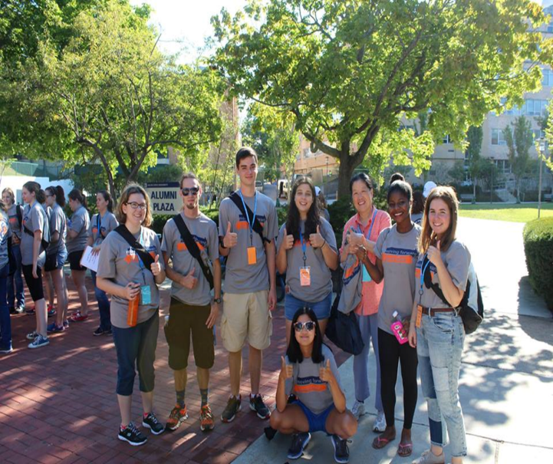
Identifying Opportunities for Civic Learning on Campuses and Across the System
Salem State University’s Pilot Civic Learning Study
Massachusetts Public Higher Education
Civic Learning and Engagement Conference
Civic Learning in Context
May 22, 2017
Cynthia Lynch
Director, Center for Civic Engagement

Slide 2
Pilot Civic Learning Study
Goals:
Develop a sustainable tool and process to be able to report data to the DHE via the HEIRS database.
Collect data on the prevalence of civic learning at Salem State for internal and external purposes.
Work with departments to develop civic learning and engagement professional development plans.

Slide 3
Timeline and Process
Winter 2016
Spring 2016
Spring 2016
1.Quality v. Quantity -new to SSU 2.Develop Data Collection Tool 3.Design Survey Monkey 4.Determine what is and is not CL and CLE
PILOT 1 1. Three Departments: Sports and Movement Science, Political Science, Communications 2. 141 Course Section Syllabi 3. Six- person audit team – training for inter-rater reliability.
1. Data analyzed and reports developed 2. Department meetings 3. Revision of data collection tool 4. Revision of survey process and training
1. Continued revisions of tool and committee approval 2. Expanded pilot 3. Expanded inter-rater reliability training sessions
PILOT 2
1. Three Pilot 1 departments plus Criminal Justice and Geography
2. 247 Course Section Syllabi
3. Eight- person audit team
Fall 2016
Spring 2017

Slide 4
Timeline and Process
Spring 2017
Spring 2017
1. Data analyzed and reports developed.
2. Data much more accurate
3. Data collection process more auditor friendly
4. Still some lingering issues
1. Department meetings 2. Discrepancies discussed and analyzed 3. Professional development opportunities discussed and planned
1. Scale up 2. Firm up reporting mechanisms 3. Develop professional development opportunities across disciplines and across campus
1. Learning Outcome Assessment of Civic Learning and Civic Learning with Engagement 2. Develop tools to measure the depth of CL and CLE that occurs because of its prevalence
Future
Future

Slide 5
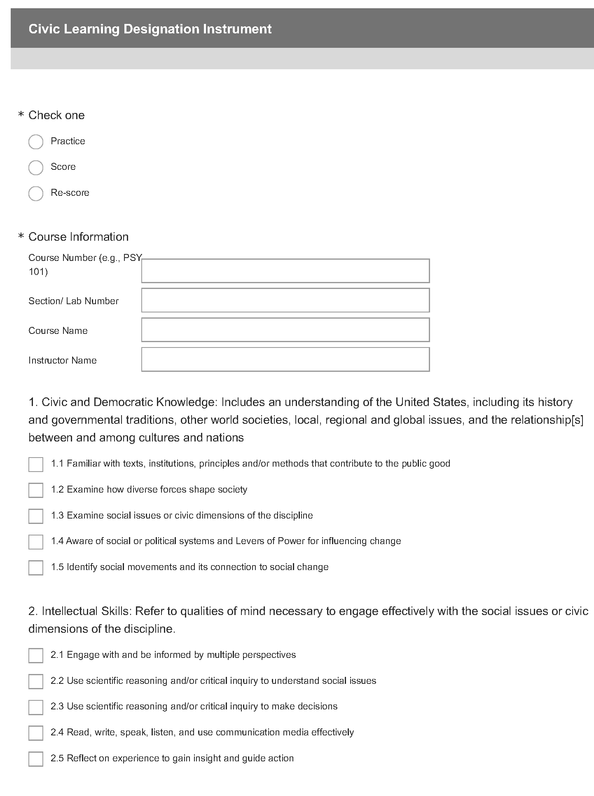

Slide 6
Overview of Data: Spring 2017
DEPT | Total Syllabi Audited
SMS | 123
COM | 40
CJ | 37
GPH | 26
POL | 20
TOTAL OVERALL | 246 Syllabi

Slide 10
Spring 2017 Trends
53%
Out of the 246 total syllabi audited,131 were found to include Civic Learning (CL).
42%
Of the131 civic learning syllabi, 55 were found to include a Civic Engagement Activity (CLE).

Slide 11
Spring 2017 Trends
Least Frequently Answered Questions:
10% (25 syllabi) answered 3.1 Challenge injustice and address its root causes
10% (24 syllabi) answered 3.2 Work Collectively in groups to address common problems
9% (22 syllabi) answered 1.5 Identify social movements and its connection to social change
Most Frequently Answered Questions:
43% (105 syllabi) answered 2.1 Engage with and be informed by multiple perspectives
43% (105 syllabi) answered 2.4 Read, write, speak, listen, use communication media effectively
39% (96 syllabi) answered 1.3 Examine social issues or civic dimensions of the discipline

Slide 13
Criminal Justice Department Trends
100%
Out of the 37 total CJ syllabi audited, 37 (ALL) were found to include Civic Learning (CL).
54%
Of the 37 CJ civic learning syllabi, 20 were found include a Civic Engagement Activity(CLE).

Slide 14
Strengths
Department Meetings
Deeper involvement in the CL/CLE work – Buy in!
Continuous improvement of data collection tool and process
New professional development ideas generated
Growing understanding of the breadth of CL/CLE at Salem State
CL/CLE data used in annual reports
Civic Learning is occurring in over 50% of the course sections (probably more when limitations are taken into account)
Tool dramatically improved – Roughly two minutes/syllabus
Reliability definitely improved!
Initial HEIRS database reporting protocols developed and piloted

Slide 15
Limitations
Use of only the syllabi and not the assignments for the audit process
Some syllabi not turned in on time
Not having a disciplinary expert who knows the terminology and is familiar with the program and faculty who teach the sections
Turnover in audit team and the need for additional training
Turnover in graduate students who perform the data analysis and develop the department reports
Challenges in scaling up – personnel and budget

Slide 16
Next Steps
Continue to refine process and revise tool – currently only doing it with spring courses need to develop a fall process
Discuss process for scaling up
Additional graduate students
Department liaisons
On agenda for summer department head meetings
Work with the registrar and strategic planning and decision support on HEIRS reporting processes
Develop professional Development opportunities to meet identified departmental needs as well as a focus on CLE
Create learning outcome assessment tools for CL and CLE

