Slide 1
The “Architecture” of the UMass Amherst Assessment Program
Learning from our Peers
AMCOA Team Meeting
September 28, 2018
Martha L. A. Stassen
Associate Provost, Assessment & Educational Effectiveness
Director, Office of Academic Planning and Assessment

Slide 2
Office of Academic Planning & Assessment (OAPA)
The Office of Academic Planning and Assessment (OAPA) supports the University’s assessment and evaluation priorities by marshaling evidence and promoting a culture of evidence in line with the University’s Strategic Plan.
In addition to providing direction and consultation on campus-wide and department-based student learning assessment, OAPA supports intentional improvement by contributing evidence for the strategic planning process, directing the Educational Effectiveness Program (EEP) in Academic Affairs, and designing and directing survey and evaluation research projects across campus.
OAPA Website: www.umass.edu/oapa

Slide 3
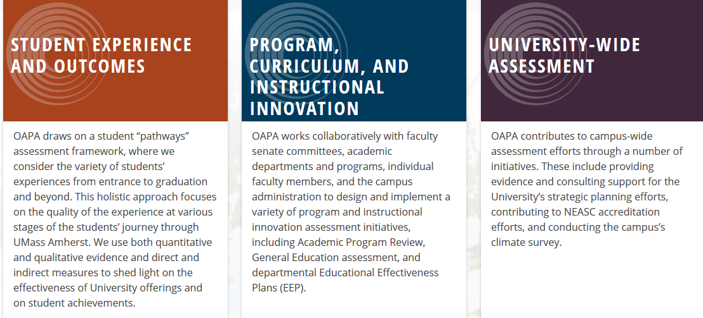
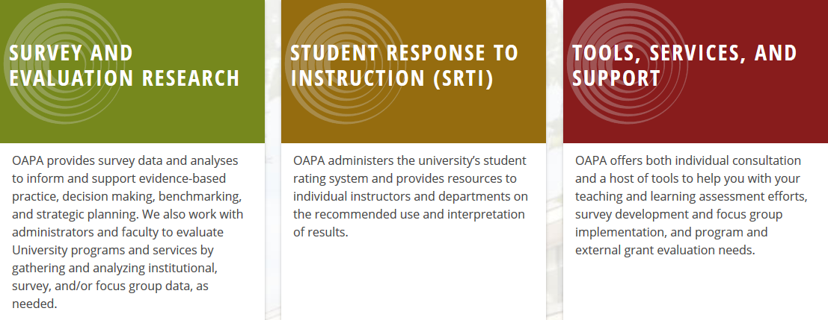

Slide 4

OAPA: How we began …. and continued for years

Slide 5

OAPA Activity now. Guided by Strategic Plan.
Campus -wide
SLO
Assessment
Department
Assessment
(EEP)
Indirect &
Survey Evidence
practice
Strategic &
Unit
Planning
to inform
evidence
Instruction, Course,
Teaching Innovation
Assessment
Using

Slide 6

Educational Effectiveness Plan (EEP)
The EEP provides departments with an ongoing structure for conducting systematic inquiry in the effectiveness of their efforts to support student success. EEP results provide departments with current information they can use for Unit Planning, Annual Budget Planning, AQAD reports, Accreditation, and other reporting on an ongoing basis.
1
Review Student Learning and Experiential Goals
2
Identify the Focus of your Line of Inquiry
3
Identify and Collect Evidence
4
Analyze and Interpret Results, as a Department
5
Take Action Based on Results, as a Department

Slide 7
Educational Effectiveness Plan (EEP)
Identify the Focus of your Line of Inquiry
Your Inquiry should focus on aspects of Student Learning and Experiences…
  Where current evidence suggests improvement is needed;
  Of high priority/concern to the department, with particular attention to student learning/achievement.
Unclear where to focus your attention? Consider the following:
  In departmental discussions, what are some of the recurring concerns, questions, or frustrations around undergraduate student performance?
  Are there some theories or hypotheses that faculty have about why students behave in certain ways or why students respond as they do? Are these worth pursuing as a line of Inquiry?
  Is there an institutional or school/college-level undergraduate experience priority your department feels it can contribute to – but you need more information to gauge student interest or determine current levels of success?
  Is there a particular learning objective the department is invested in reviewing – either because there is concern students aren’t meeting departmental expectations OR because you believe it’s a particular strength and you want to systematically demonstrate students’ capacities?
Note: Don’t dismiss an important question because you don’t yet see what evidence you could bring to bear to answer the question. The Office of Academic Planning and Assessment (OAPA) will provide individual consultation to help you explore possible sources of evidence.

Slide 8
Reflection….
Assessing Impact | Further Improvement
Ripples have become tributaries | Expand, systematize, and deepen connections to teaching
Evidence informs Strategic Planning Progress | Ensure department attention to EEP doesn’t fade.
“The EEP can be helpful to us….” | Be vigilant, insist on connections across SLO assessment, EEP, T&L initiatives and planning

Slide 9
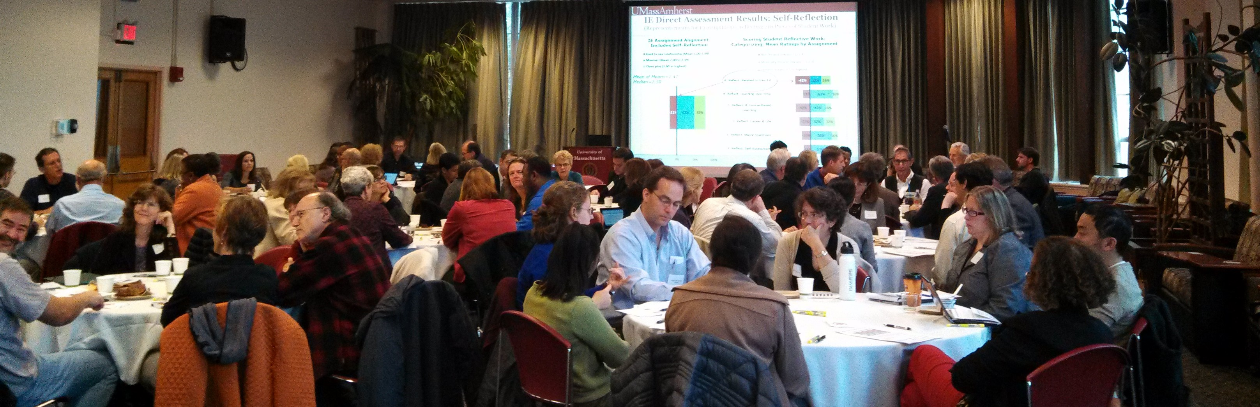
Architectural Foundation
Discussion, Conversation, Consultation….

